Slide 1
Incident Management using SARTopo
Patty Lindsay, Mountaineer Area Rescue Group

Slide 2
History: 2015
New laptops
SOG#3 Map Setup and Printing rewritten
SARTopo instead of Terrain Navigator Pro
Small group classes on how to print a map with SARTopo

Slide 3
History: 2016
SARTopo Operating Guide created
SOGs
#12, #12B – Collection of GPS data
#13 – Use of GPS in the field
First 8-hour SARTopo class in October
SARTopo used at searches / Sims
Rivesville, Cheat Lake Sim, Renick, White Park Sim

Slide 4
History: 2017
Second 8-hour SARTopo class (without the network headaches!)
More fully deployed at Canaan Valley
Developing and refining best practices
First 4-hour class:
Everything but drawing areas and writing tasks
More in depth on GPS prep and collection

Slide 5
Now
TaskPrep Utility:
Our TAF form for SARTopo assignments
FTL notes on back
Set for all TAFs:
Safety message
Radio freqs
Base phone number
Generate GPS assignments faster

Slide 6
Now
SOG#3 : Managing an Incident using SARTopo
Soon to be released, submitted to BOD
Integrates:
SOG#3 Map Setup and Printing
SOG#12, and #12B Collection of GPS Tracks
Workflow portion of SARTopo Operating Guide
Updated:
Incident checklist
Lessons learned -> Evolving best practices
One source
Notes:
Pull up manual and take a quick look at Chapter 1

Slide 7
Example: Old SOG#3 Content

Slide 8
SARTopo – Large Incident
Notes:
Comms – not tried yet. Would like to improve tracking of clues.
Plans – no printer
Plans writes, OPS Back Table prepares TAFS and GPSes
At Canaan Valley, we had 2 at Ops back table, and 2 at plans

Slide 9
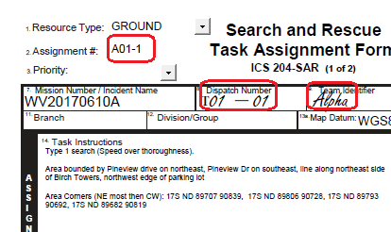
TAF Forms

Slide 10
Task Log

Slide 11
Task Numbers
Assignment Number
Every task has one
Does not imply order
Tasks written by Operations
OPS001, OPS002, etc
Tasks written by Plans
A01-1, A01-2 <- tasks that search segment A01
PLN001 <- any others written by Plans
Dispatch Number
Every executed task has one
Assigned in order dispatched
To1-03 <- Third task dispatched in first Op Period

Slide 12
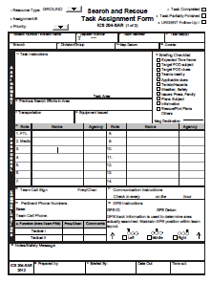
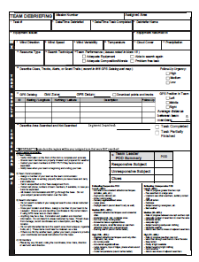
TAF Paper Copies
Ops Back Table prints 1 copy, 2 sided
Front Back : FTL Info / Notes

Slide 13
TAF Paper Copies
FTL is briefed and gathers team names
Front is copied, placed in “In Progress” folder
Team gets the 2-sided copy
At debrief, form pulled from a stack of blank forms
Debrief form stapled to base copy of TAF front
Debrief map printed after GPS tracks and clues are loaded to SARTopo, stapled to TAF and debrief

Slide 14
TaskPrep Utility
Inputs:
Export file from SARTopo
Fillable-PDF TAF file
Configure file:
Map SARTopo fields to PDF Fillable Fields
Text for safety message, radio freqs, etc
Output
Filled, but editable TAF PDFs
GPX files, one for each assignment

Slide 15
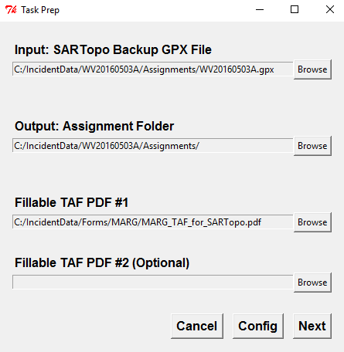
TaskPrep Utility

Slide 16
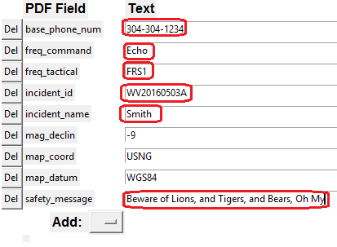
TaskPrep Utility

Slide 17
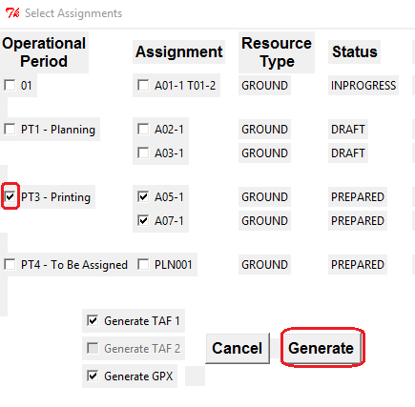
TaskPrep Utility

Slide 18
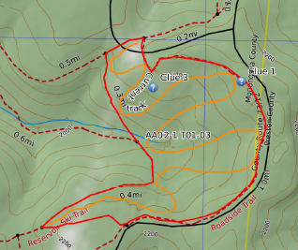
Debrief Map

Slide 19
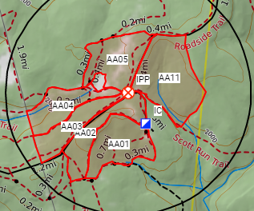
Segment Map

Slide 20
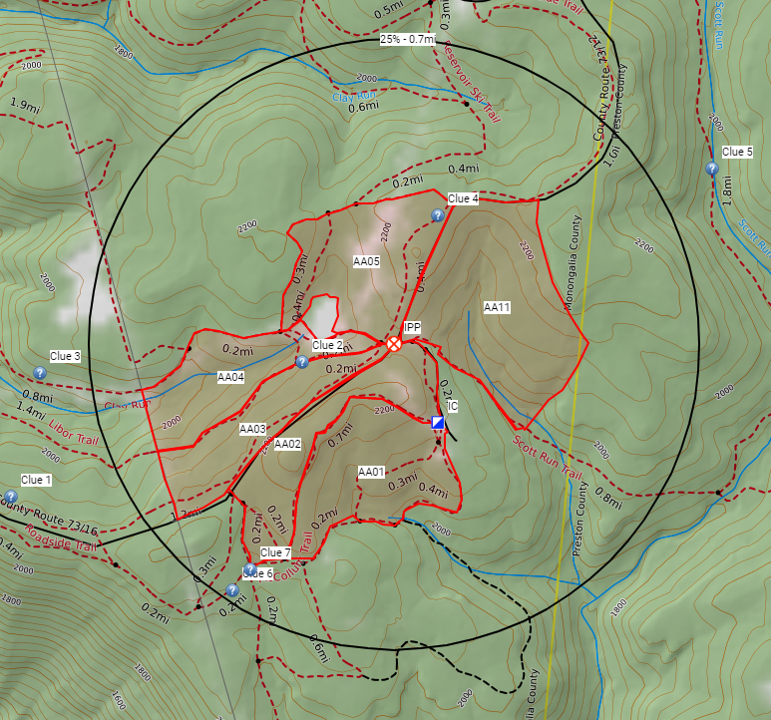
Clue Map

Slide 21
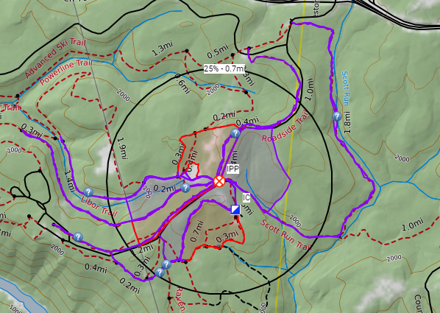
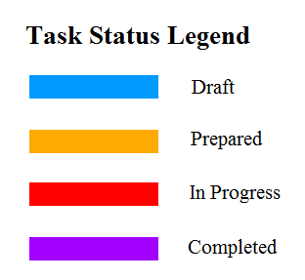
Task Progress Map Projector?

Slide 22
SARTopo Classes
8 Hour Class
‘SARTopo Operations’
For all base staff
Class limit is 15
Work in teams of 5
Experience SARTopo as a collaborative platform
Covers full cycle of Incident
Draw lines and polygons
Write assignments
Not hands on with GPS
Online version coming

Slide 23
SARTopo Classes
4 Hour Class
‘SARTopo Ops Specialist’
For Ops Back Table, and Comms
Class limit is 5
Work individually
Does not cover planning function
No drawing or writing of assignments
Hands on with GPS

