Slide 1
Communications 101-104: Field IV, III, II, I
Keith Conover, M.D., FACEP, FASRC

Slide 2
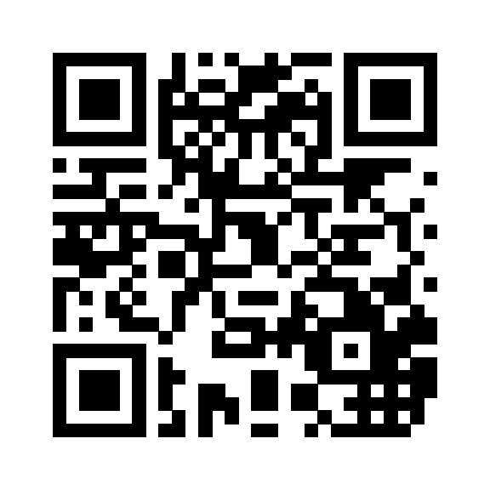
Download PDF of Slides
http://www.conovers.org/ftp/ASRC-Commo.pdf
Notes:
You can find these slides, with speakers’ notes, at this URL/QR code. I will display this again at the end of each of the four sections of the talk and leave it up during the break.

Slide 3
What Will We Cover?
The communications standards for ASRC Field training levels:
Field IV: ASRC Commo 101
Field III: ASRC Commo 102
Field II: ASRC Commo 103
Field I: ASRC Commo 104
Notes:
The numbering conventions for college courses and our Field Levels don’t line up well as they go in opposite directions. So be it.
We will discuss what you need to know to meet the current Training Standards for each of the Field levels. No more (maybe a tiny bit more) and no less.
Looking for help improving this educational curriculum, please take notes on where we can improve it and let me know either during the presentation or later. Especially interested in opinions on chunks that should be moved from one level to another.
The idea is to create, in addition to the videos of this series of presentations, four sets of slides that anyone can use to teach classes on ASRC communications. Changes we make in these presentations can feed back to updates of the Training Guide and Training Standards.

Slide 4
Comms? Commo?
Side issue: Do we abbreviate Communications as:
Commo?
Comms?
We will postpone this discussion/argument/fight to some other time

Slide 5
Communications 101: Field IV Level
Keith Conover, M.D., FACEP, FASRC

Slide 6
Field IV Training Standards
Be able to effectively communicate, in English, a USNG position:
Using a handheld radio
Following ASRC communications standard operating procedures as outlined in the Appalachian Search and Rescue Conference Radio SOP Crib Sheet (“Commo Crib Sheet”) except for, at the Field IV level, memorizing the phonetic alphabet
Notes:
This is all that the ASRC Training Standards have as far as communications. However, that “effectively communicate, in English” part is worthy of a very careful look, as it underpins all of the communications skills at the higher levels, and for other disciplines such as rope rescue and search tactics. At the Field IV level, we’re leaving out most of the “knobology” – how to operate a handheld radio – and just leaving it as “push this button and talk into the radio.”

Slide 7
Using a Radio

Slide 8
How to talk to your radio
Hold face of handheld or speaker-mike 90° away from your mouth: talk across the face of your microphone or handheld, not into it.
Speak slowly and distinctly; ignore that adrenaline!
Notes:
Talking directly into the radio distorts your voice when the gusts of air from your mouth hit it.

Slide 9
How to talk to your radio
Press the push-to-talk
Wait for a half-second
Then talk
Keep finger firmly on push-to-talk button while talking
Notes:
If you start talking at the same time you press the patient, your first syllable may be cut off.
If you’re using a repeater, press the push-to-talk button and then wait for a full second before talking to let the repeater kick in.

Slide 10
“standard best practices…”
Prowords: Roger Wilco Over and Out?
Notes:
There is an almost-universal set of “prowords” used in radio communications; you can use them over a cellphone as well.
This particular combination of prowords is used in bad movies all the time. Why is it stupid?
Because it is redundantly repetitive, and it is downright rude.
Roger = Message received and understood
Wilco = Message received and understood and will comply
Over = Go ahead and talk, I’m now listening
Out = I’m turning off my radio now

Slide 11
Essential Prowords
This Is [insert team name here]
Over\Go Ahead: OK for other person to talk now
Roger: I received and understand your message
Affirmative: easier to understand than “yes”
Negative: easier to understand than “no”
Clear: I’m done talking now
Clear the Net: everyone shut up, I have something important to say
Secure the Net: turn down radios, keep them away from reporters and family
Mayday: I need help or I am going to die
Notes:
These are designed to make it easier to understand a message, and more importantly harder to misunderstand, when there’s lots of noise on the signal. These are the essential ones a Field IV should know.
Mayday = French m’aider (‘help me’); it’s not included on the ASRC Commo Crib Sheet, perhaps because almost everyone knows it from popular culture.

Slide 12
Status Codes
Status One: alive and well
Status Two: needs evac and/or medical care
Status Three: dead
Notes:
These are also on the commo crib sheet. You need to know them as well. Why do we use them, even if they seem a bit against the ICS prohibition of aural brevity codes? Just because. Seriously, these three different statuses immediately drive a search mission in three different directions. Communicating this right away, with a single simple utterance, may save a life, either of the patient or of a searcher who can stop searching a dangerous area.

Slide 13
“standard best practices…”
“Base, this is Field Team Alfa”
“Base from Team Alfa”
“Base, Alfa”
“You, this is me”
Why not “Team Alfa to Base”?
Notes:
Because nobody listens closely to the radio until AFTER they hear their name or callsign.

Slide 14
Field IV Training Standards
Be able to effectively communicate, in English, a USNG position:
Using a handheld radio
Following ASRC communications standard operating procedures as outlined in the Appalachian Search and Rescue Conference Radio SOP Crib Sheet (“Commo Crib Sheet”) except for, at the Field IV level, memorizing the phonetic alphabet
Notes:
This is all that the ASRC Training Standards have as far as communications. At the Field IV level, we’re leaving out most of the “knobology” – how to operate a handheld radio – and just leaving it as “push this button and talk into the radio.”

Slide 15
“a USNG position”
“Base, this is John Smith. I’m separated from my team and I am lost and I have the radio. Over.”
“John, this is Base, we copy, what is your USNG location?”
“My USNG app shows 17 S PE 3277 2036, over.”
“John, use your compass to walk slightly north of due east, about a half-mile, to a two-lane road. Turn left on the two-lane road. Base is about a mile down the road on your left. Over.”
“Base, I understand and will start walking. Thank you. John Smith clear.”
Notes:
This is a good example of what a Field IV should be able to do. If this happens to you, for the benefit of your future SAR reputation, it would be best to not ask for Base to send a vehicle to come pick you up along the road.

Slide 16
Any questions? Over.

Slide 17
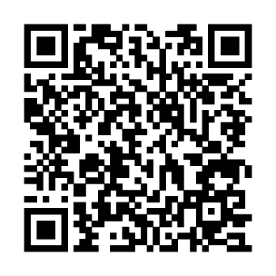
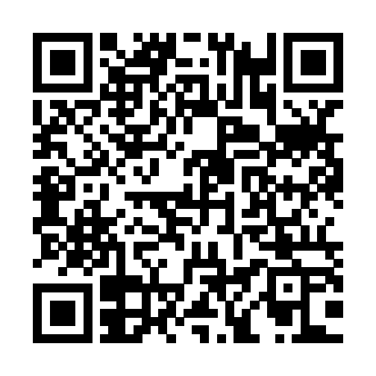
http://www.conovers.org/ftp/ASRC-Commo.pdf
http://archive.asrc.net/ASRC-Communications/2007-03-12-ASRC-Radio-Crib-Sheet.pdf
http://www.conovers.org/ftp/AppSAR/AppSAR-8-Nontechnical-and-Semi-Tech-Evacs.pdf

Slide 18
Communications 102: Field III Level
Keith Conover, M.D., FACEP, FASRC

Slide 19
Field III Training Standards
Be able to use a handheld radio using ASRC communications standard operating procedures as outlined in the Appalachian Search And Rescue Conference Radio SOP Crib Sheet (“Commo Crib Sheet”) to communicate effectively and efficiently in English during field tasks:
Using the phonetic alphabet and numerals
Using standard best practices for talking over a handheld radio
Without reference to written communications references…
Notes:
This is the first chunk of the Field III commo Training Standards.

Slide 20
How to talk to your radio
Hold face of handheld or speaker-mike 90° away from your mouth: talk across the face of your microphone or handheld, not into it.
Speak slowly and distinctly; ignore that adrenaline!
Notes:
Review from Field IV: Talking directly into the radio distorts your voice when the gusts of air from your mouth hit it.

Slide 21
How to talk to your radio
Press the push-to-talk
Wait for a half-second
Then talk
Keep finger firmly on push-to-talk button while talking
Notes:
Review from Field IV: If you start talking at the same time you press the patient, your first syllable may be cut off.
If you’re using a repeater, press the push-to-talk button and then wait for a full second before talking to let the repeater kick in.

Slide 22
How to talk to your radio
If need to hear part of message again, say “Say again.”
Do not say “repeat”:
“Repeat” sounds like “Received”
“Repeat” used by NATO to mean “shell the enemy again”
Notes:
Now some new stuff to expand on Field IV.

Slide 23
How to talk to your radio
Long transmission:
Say “break,” wait for a few seconds, then say “continuing…”
Or, say “how copy so far?” and then resume after first part acknowledged
Notes:
This allows anyone with priority traffic to interrupt. It also gives the transmitter amplifier a rest which makes it less likely to fail. If you’re talking through a repeater, they have a Time-Out-Timer (TOT) that will simply cut you after after a certain amount of time, at which point you are simply talking to yourself. Most newer radios have a TOT of their own, the length of which can be set in the menu.

Slide 24
“effectively communicate…”: Closed Loop Communication

Slide 25
“effectively communicate…”
What is closed-loop communication?
Notes:
Communications where you are sure the message was received and understood. That’s two-way closed communications, but some argue that it’s even better if it’s three-way: the person receiving the message knows that the receiver knows that the sender knows that it was received and understood.

Slide 26
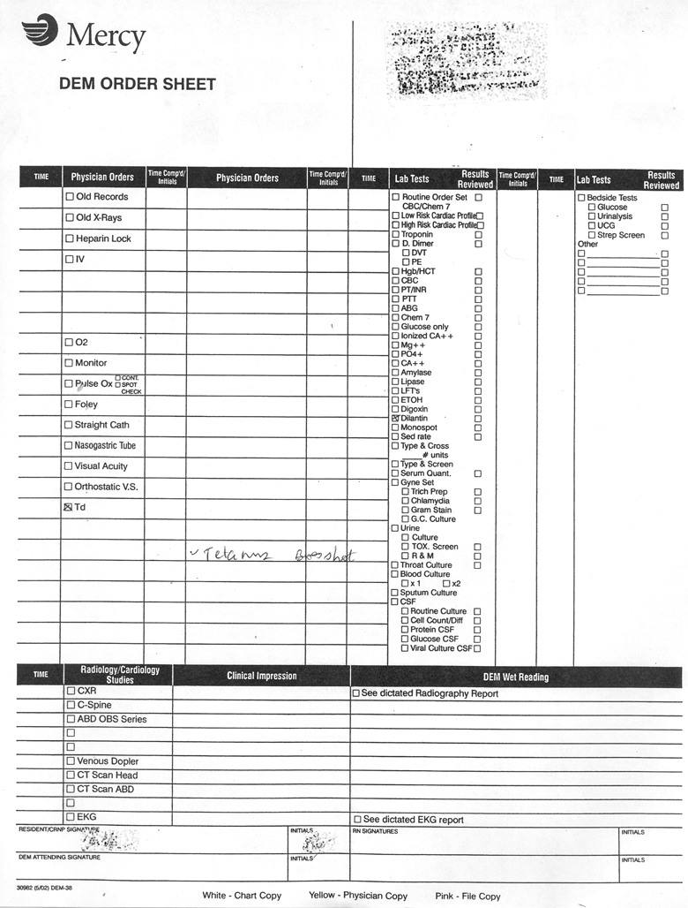
Notes:
Here is an example of a system failure due to open loop communications in my day job as an emergency physician.
One of my interns filled out this order sheet and gave it to the unit clerk. The patient got his tetanus booster shot. But…
Courtesy Keith Conover, used with permission.

Slide 27
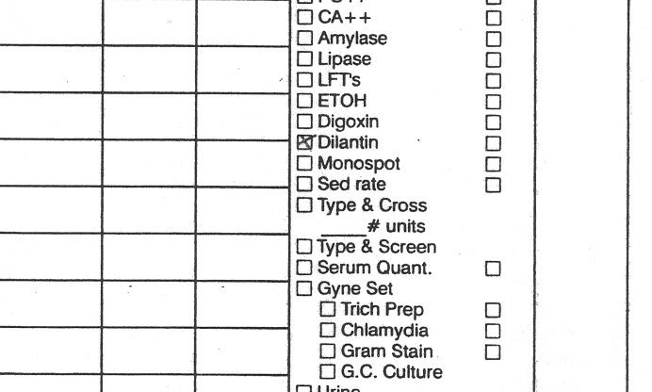
Notes:
Because the designer of this form made the checkboxes so small, and because the intern thought he was supposed to keep the “X” within the checkbox, the unit clerk didn’t see it. The delay in drawing and sending and getting back the patient’s Dilantin level delayed his care by several hours and resulted in a formal complaint. This was an example of a message that was open-loop and resulted in a system failure.
Courtesy Keith Conover, used with permission.

Slide 28
“effectively communicate…”
Ensure closed loop by echoing commands:
“Down Slow!” “Down Slow!”
“Down Fast!” “Down Fast!”
Notes:
If we’re using a rope to lower the litter during a semi-tech evac, we use closed-loop communications. We echo the commands.

Slide 29
“effectively communicate…”
ASRC tradition and best practice is that calls are statements and not questions.

Slide 30
“effectively communicate…”
The call “On Belay!” does not mean, “Belayer, are you ready?” It means “Belayer, I’m on the end of the rope and ready to be belayed.”

Slide 31
“effectively communicate…”
On a line search, when we pass the call down to the right end, “Ready Right!” we are not asking “Is the right ready?” Instead, we are saying, “Get ready, right!”

Slide 32
“effectively communicate…”
On a line search
The field team leader always says “Ready…” first
The right end always says “Right…” first, left always “Left…” first
Notes:
This is not a simple echo, but a reversal of the word order.

Slide 33
“effectively communicate…”
The Belayer always says “Belay…” first
The Litter Captain always says “On…” or “Off…” first
Notes:
Another example of reversal. Note that with the reversal, you can pass these commands down a chain of people and back just like on a search line.

Slide 34
“effectively communicate…”: Standard Terms
Notes:
When considering closed-loop communications, we saw how standard terms can make communications easier, more efficient, and less likely to be misunderstood. The same thing applies any time you speak over the radio or cellphone.

Slide 35
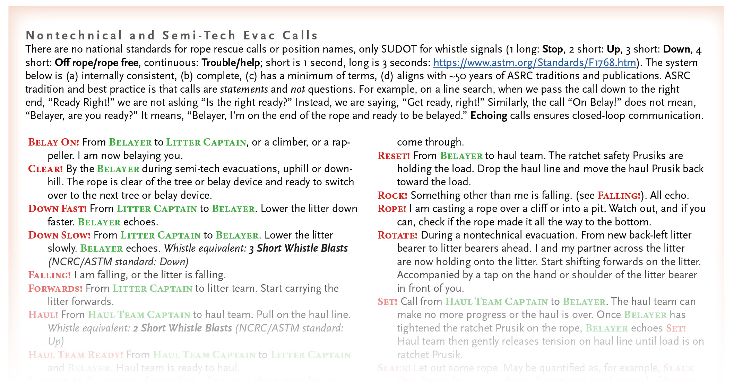
“effectively communicate…”
Notes:
Communication is not just via radio or cellphone. For radio, we call standard terms “prowords.” When running a line search or litter evacuation, we call them “calls.” Regardless, standard terms make better communications. This is from my textbook chapter on Nontechnical and Semi-Tech Evacs. It’s in essence what the ASRC has done for 50 years, an oral tradition now written down.
From Appalachian Search and Rescue by Keith Conover, used with permission.

Slide 36
“effectively communicate…”
“The system below is (a) internally consistent, (b) complete, (c) has a minimum of terms, (d) aligns with ~50 years of ASRC traditions and publications.”

Slide 37
Download AppSAR Evacs
http://www.conovers.org/ftp/AppSAR/AppSAR-8-Nontechnical-and-Semi-Tech-Evacs.pdf
Notes:
Again, I will leave this on the screen when we take a break at the end of the ASRC Communications 101 Field IV section.

Slide 38
“standard best practices…”
Prowords: Roger Wilco Over and Out?
Notes:
Review from Field IV: There is an almost-universal set of “prowords” used in radio communications; you can use them over a cellphone as well.
This combination of prowords is used in bad movies all the time. Why is it stupid?
Roger = Message received and understood
Wilco = Message received and understood and will comply
Over = Go ahead and talk, I’m now listening
Out = I’m turning off my radio now

Slide 39
Essential Prowords
This Is [insert team name here]
Over\Go Ahead: OK for other person to talk now
Roger: I received and understand your message
Affirmative: easier to understand than “yes”
Negative: easier to understand than “no”
Clear: I’m done talking now
Clear the Net: everyone shut up, I have something important to say
Secure the Net: turn down radios, keep them away from reporters and family
Mayday: I need help or I am going to die
Notes:
Review from Field IV: These are designed to make it easier to understand a message, and more importantly harder to misunderstand, when there’s lots of noise on the signal. At the Field III level, you need ot have these down cold.
Mayday = French m’aider (‘help me’)

Slide 40
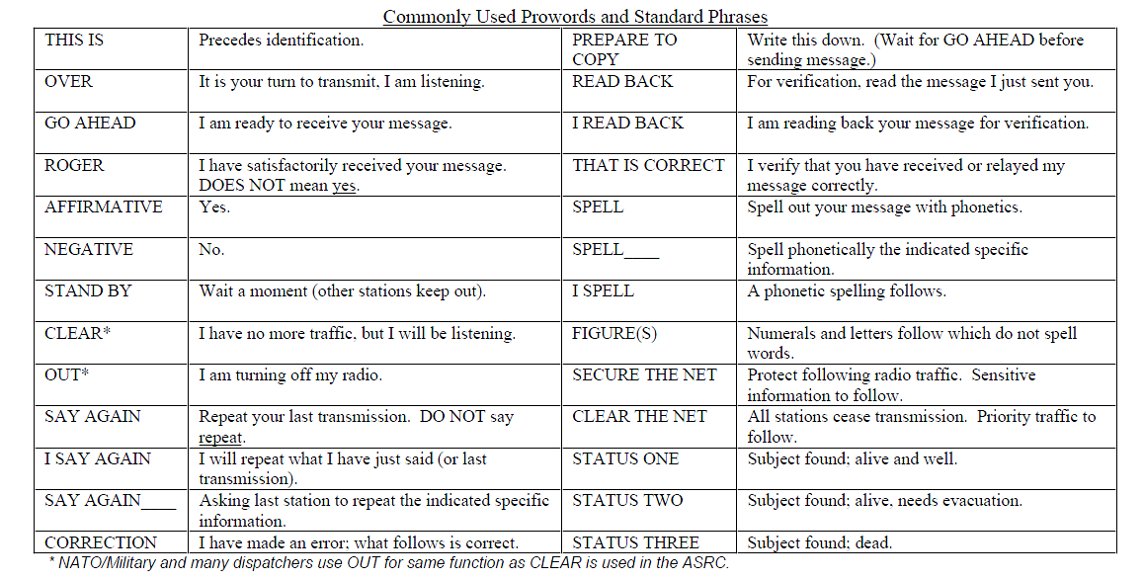
Notes:
These are the prowords on the commo crib sheet. They are similar to but not exactly the same as NATO military prowords. You should know all of them cold. There are others as well, which you will learn by listening to experienced people on the radio.

Slide 41
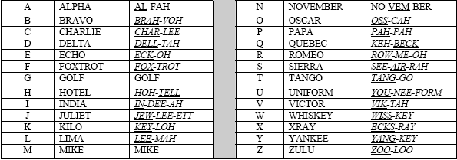
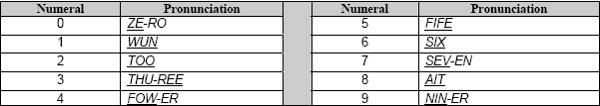
Notes:
This is the ITU (International Telecommunications Union) and ICAO (International Civil Aviation Organization) phonetic alphabet. There are others, including NATAO standards which are similar but slightly different, but this is the biggest international standard and what the ASRC mandates. Learn it by heart. It’s on the commo crib sheet, which you can use as a crutch at the Field IV level, but to qualify for Field III, you have to have this down cold. Including the numbers.

Slide 42
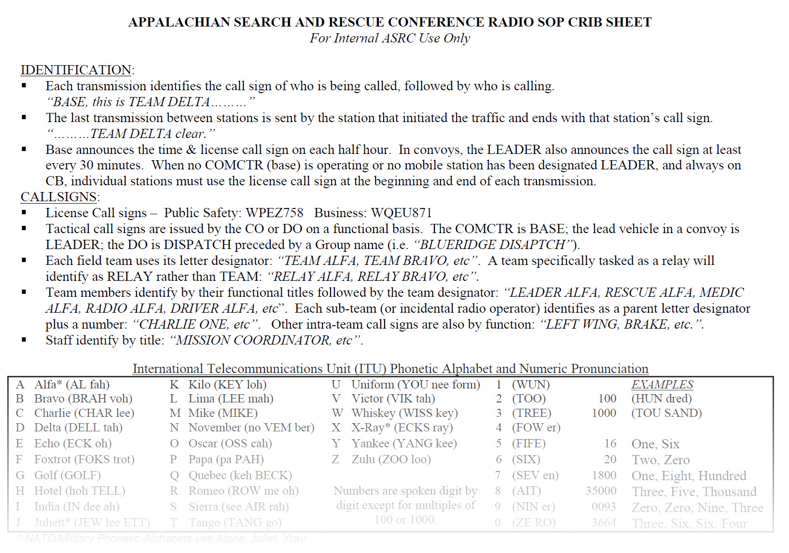
ASRC Commo Crib Sheet
Notes:
From Appalachian Search and Rescue by Keith Conover, used with permission.

Slide 43
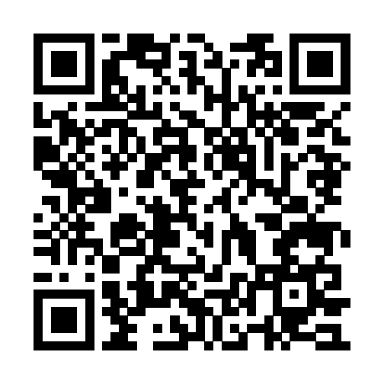
Download PDF of ASRC Commo Crib Sheet
http://archive.asrc.net/ASRC-Communications/2007-03-12-ASRC-Radio-Crib-Sheet.pdf
Notes:
I will also show this and leave it up after the break after we finish Field IV.

Slide 44
Status Codes
Status One: alive and well
Status Two: needs evac and/or medical care
Status Three: dead
Notes:
These are also on the commo crib sheet. You need to know them as well. Why do we use them, even if they seem a bit against the ICS prohibition of aural brevity codes? Just because. Seriously, these three different statuses immediately drive a search mission in three different directions. Communicating this right away, with a single simple utterance, may save a life, either of the patient or of a searcher who can stop searching a dangerous area.

Slide 45
“standard best practices…”
“Base, this is Field Team Alfa”
“Base from Team Alfa”
“Base, Alfa”
“You, this is me”
Why not “Team Alfa to Base”?
Notes:
Review from Field IV: Because nobody listens closely to the radio until AFTER they hear their name or callsign.

Slide 46
“standard best practices…”
“Base, this is Field Team Alfa.”
“Alfa, this is Base, go ahead.”
“Alfa starting task at 1915 hours. Over.”
“Base copies Alfa starting task at 1915, thank you. Base clear with Alfa.”
Notes:
Here is what you will hear from experienced ASRC members on the radio. This list is repeated verbatim in Field IV and Field III. At the Field IV level, we expect students simply to know these procedures and prowords. At the Field III level, we expect students to have practiced enough that they can use these procedures and prowords fluently, rolling trippingly off of the tongue, as opposed to being tongue-tied and tripping over their own tongues.

Slide 47
“standard best practices”
If need to hear part of message again, say “Say again.”
Do not say “repeat”:
“Repeat” sounds like “Received”
“Repeat” used by NATO to mean “shell the enemy again”
Notes:
Review from Field IV:

Slide 48
“standard best practices”
Long transmission:
Say “break,” wait for a few seconds, then say “continuing…”
Or, say “how copy so far?” and then resume after first part acknowledged
Notes:
Review from Field IV: This allows anyone with priority traffic to interrupt. It also gives the transmitter amplifier a rest which makes it less likely to fail. If you’re talking through a repeater, they have a Time-Out-Timer (TOT) that will simply cut you after after a certain amount of time, at which point you are simply talking to yourself. Most newer radios have a TOT of their own, the length of which can be set in the menu.

Slide 49
“standard best practices…”
ICS (Incident Command System):
Plain English
No 10-codes or similar
Use functional titles (“Ops” “Plans” “Team Bravo”) or last names
Notes:
New stuff now

Slide 50
“effectively communicate…”
Notes:
Communication is not just via radio or cellphone. For radio, we call standard terms “prowords.” When running a line search or litter evacuation, we call them “calls.” Regardless, standard terms make better communications. This is from my textbook chapter on Nontechnical and Semi-Tech Evacs. It’s in essence what the ASRC has done for 50 years, an oral tradition now written down.
From Appalachian Search and Rescue by Keith Conover, used with permission.

Slide 51
“effectively communicate…”
“The system below is (a) internally consistent, (b) complete, (c) has a minimum of terms, (d) aligns with ~50 years of ASRC traditions and publications.”

Slide 52
Download AppSAR Evacs
http://www.conovers.org/ftp/AppSAR/AppSAR-8-Nontechnical-and-Semi-Tech-Evacs.pdf
Notes:
Again, I will leave this on the screen when we take a break at the end of the ASRC Communications 101 Field IV section.

Slide 53
“effectively communicate…”: Tognazinni’s Paradox
Notes:
Bruce Togazinni was the original Apple “user interface evangelist” and very interested in usability.

Slide 54

Notes:
This is the book wherein he shows that the choice of just one or two words can have a major effect on operations. One of his tasks was to design a tutorial for the original Apple computer. He found the hardest part of designing this – he tested drafts on naive users – was a single screen. He needed to have the user tell the program whether the computer was attached to a monochrome monitor, either black and white or black and green, or a color monitor. We will see and hear the story of his repeated failure and then relate this to effective ASRC communications.
Fair use per Wikimedia Commons guidelines.

Slide 55

Tognazzini’s Paradox
Tognazzini, B (“Tog”). TOG on Interface.1992; Reading, MA: Addison-Wesley.
Problem: find out if user has a black and white/black and green or color monitor
1. Are you using a color monitor?
2. Is the picture above in color? Failure - 25%
Green
3.
Are the words above in color? Failure - Color: 0%. B+W: 0%. Green: 100%.
Blue
Orange
Magenta
Notes:
1. Decided that users might not know whether the monitor was color or not, decided not even to test.
2. Those using a mono monitor wouldn’t know whether the monitor was B+W or the color was turned down. Users asked the testers if color monitor or not. Decided not to package a tester with the program.
3. Green IS a color, right?

Slide 56
Tognazzini’s Paradox
Green
5. Are the words above in several different colors? Failure - Color: 0%. B+W: 20%. Green: 25%.
6. Do the words above appear in several different colors? 0% failure!
4.
Are the words above in more than one color? Failure - Color: 0%. B+W: 20%. Green: 50%.
Blue
Orange
Magenta
Notes:
4. B+W users who answered incorrectly did so on purpose, I guess they were getting tired of the game. The green screen users said green and black were two different colors.
5. Actually responding to “are the words above several different colors”

Slide 57
“effectively communicate…”: NEXUS Criteria

Slide 58
Changing One Word
the absence of tenderness at the posterior midline of the cervical spine,
the absence of a focal neurologic deficit,
a normal level of alertness,
no evidence of intoxication, and
absence of clinically apparent pain that might distract the patient from the pain of a cervical-spine injury
Notes:
The NEXUS criteria are the validated criteria to “clear” the cervical spine, based on research done at multiple hospitals in Pittsburgh and Los Angeles including my UPMC Mercy. The criteria are these words, which are listed like this in the article.

Slide 59
Changing One Word
Focal neurologic deficit present
Midline spinal tenderness present
Altered level of consciousness
Intoxicated
Distracting injury present
Notes:
An EMS study supposedly showed that EMTs and paramedics cannot apply the NEXUS criteria properly. But they changed the words, and via Tognazinni’s paradox, we know that changing one innocuous word can make a difference. The study failed, not because the medics were no good at applying the criteria, but that the criteria had been changed. The terms were way different in that study. These current ones are called the “Domier criteria” in EMS and are closer to the original but still are significantly different.

Slide 60
in English…

Slide 61

Notes:
Fair use per Wikimedia Commons guidelines.

Slide 62
“in English…”
“Omit needless words”
Strunk and White: The Elements of Style
“Craft message before engaging mouth”
“Listen twice, think three times, speak once”
Notes:
If you read that small, short (43 pages) book and internalize its rules for writing, such as Omit Needless Words, you will communicate over the radio more effectively. The two other aphorisms capture the gist of this for talking on radio or cellphone.
You can also communicate more effectively by rehearsing what you’re going to say, in your mind or under your breath.

Slide 63
Knobology
Notes:
We call this “knobology.” Unfortunately, it is specific to each and every brand and model of handheld radio, though we will cover some fairly-common features. Ask for a printed or digital copy of at least the essential programming information for your Group’s radios. I keep a full copy of the manual for my handheld radios in Dropbox synced to my cellphone and made available offline. I also have the most important programming points in text in my Outlook Notes that sync to my phone and are quicker to access that way.

Slide 64
Field III Training Standards
Be able to confidently and reliably operate standard handheld radio controls and perform the following tasks on a Group-owned radio:
Operate off/on switch
Operate volume adjustment
Operate push to talk
Operate channel selector
Attach and detach antenna
Replace battery, and if available, install AA cells in an empty AA-cell battery pack
Toggle keyboard/channel select lock if available
Know other buttons might accidentally hit and how to recover from them
Notes:
Here is more from the Field III Training Standards.

Slide 65
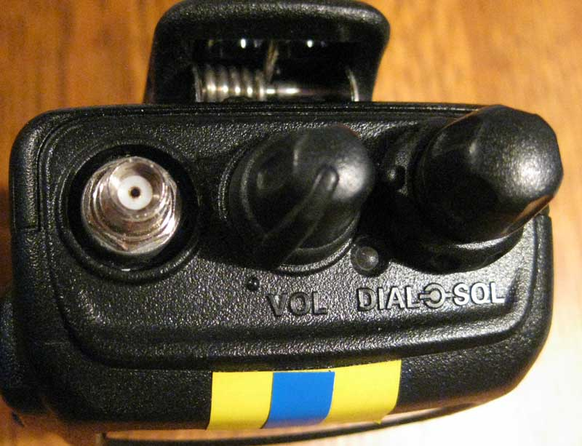
Notes:
This is my wife’s old Yaesu ham handheld that might have had a diode removed from the motherboard to allow it to transmit outside the ham band, for instance on the ASRC frequencies.
What is the thing on the left? Extra credit for the radio nerds who can identify the specific type. (Antenna connector, extra credit for “SMA female”)
Why should you put on an antenna before turning on the radio? (Accidentally transmitting without an antenna may kill the radio.)
What is the dial in the middle? (Twist a bit to turn on, twist more to increase volume)
Why does the righthand dial say “Dial” AND “SQL”? (Dial is the center knob and is channel select. SQL is the surrounding knob and is carrier squelch)
What does carrier squelch mean and how does it work? (Only turns on the speaker when the signal is stronger than the point you set; avoids having to listen to static roaring all the time.)
Why do newer radios not have a carrier squelch dial? (Because they set it via menu and you don’t often need to adjust it.)
By Keith Conover, used with permission.

Slide 66
FCC Rules
Only “type-accepted” radios
Ham radios not acceptable unless also Part 90 type-accepted
Part 93 exception: only for life, limb or property, and only until alternate communications are available
Notes:
“Type accepted” means that the FCC has accepted this “type,” that is, brand and model, for compliance with the FCC requirements for things like quality of transmissions, to make sure that they don’t create interference on adjacent channels.
It is possible that, in the old days before cheap Part 90 Type-accepted radios, SAR hams who were looking for a new handheld radio would first ask: “Which diode do I unsolder and take out to open up the radio to work on the Special Emergency frequencies?” Not that I know anything personally about people doing such things. [clear throat]

Slide 67
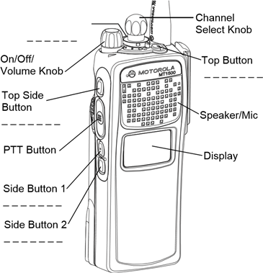
Notes:
Some radios, for example commercial Motorola radios that cost thousands of dollars each rather than the hundred-or-so we pay for most of our SAR radios, have extra buttons, programmed for specific functions. Note that these radios don’t have a knob for adjusting squelch. Many of the newer cheaper radios we tend to use also don’t have a knob for squelch, but you can set the squelch level via an internal

Slide 68
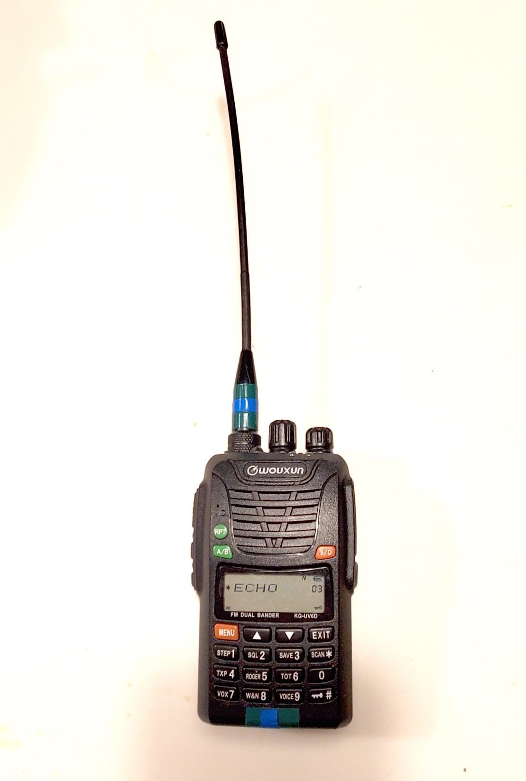
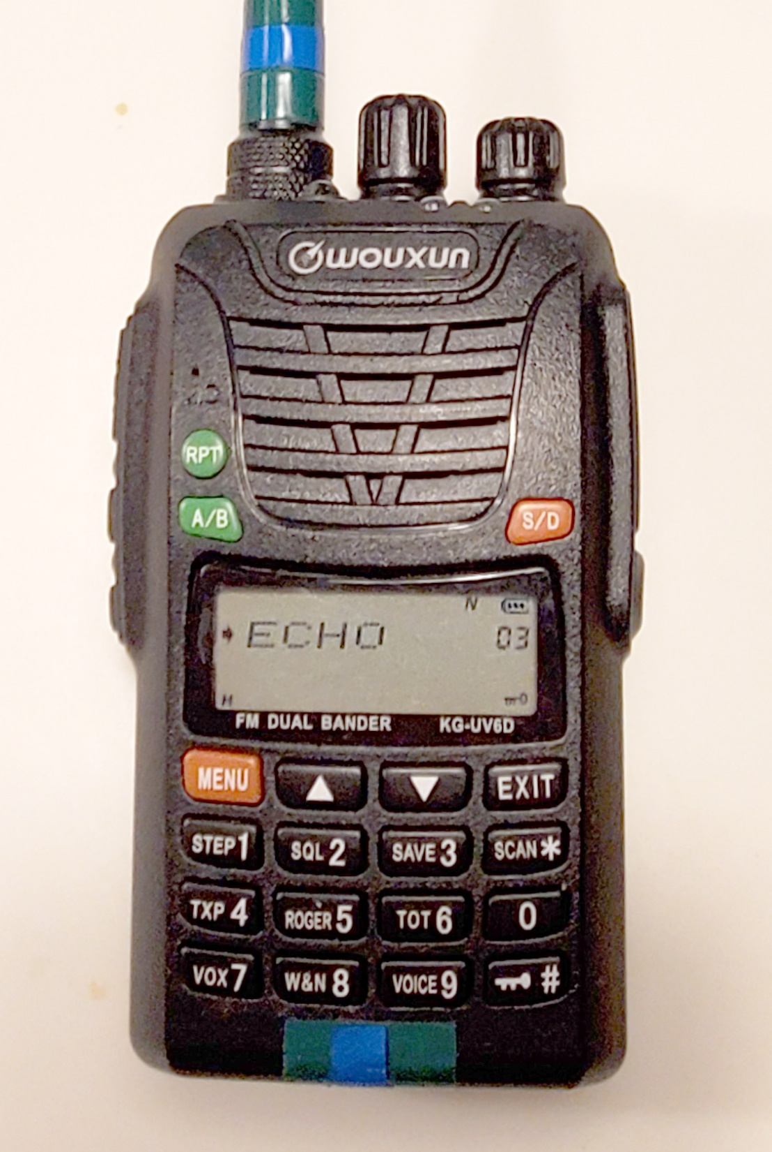
Notes:
These Wouxun (pronounced “ocean”) Chinese radios are commonly used in the ASRC; most AMRG radios are of this type. They are cheap compared with the commercial Motorola radios: between $150 and $200 each, so a factor of 10 less than the Motorola radios. They not as sturdy as the Motorolas but pretty sturdy. And if one breaks you can replace it cheaper than you could repair a Motorola radio. Though they work on the ham 2 meter and UHF bands, and are popular ham radios, they are also type-accepted (FCC = Federal Communications Commission term for being legal to use on ASRC frequencies).
Note the keyboard and LCD display. This allows great flexibility, but also many more opportunities to reprogram the radio so that it’s totally useless. Best to keep the keyboard locked! the button at the bottom right locks the keyboard, and on later versions of this radio, lock the channel dial as well. Note the little key icon at the bottom right of the LCD screen indicating the keyboard is locked. Similar radios from Baofeng and Anytone are becoming popular as well.
By Keith Conover, used with permission.

Slide 69
Best Practices

Slide 70
Field Radio Best Practices
Always get a spare battery, and maybe a better antenna to use when and if needed
Before leaving base camp call Base for a radio check
When starting your task call Base with time and location
If you find a clue, call Base with location and await further instructions
Call Base regularly if so directed (often every hour)

Slide 71
Field Radio Best Practices
GPS Coordinates:
Always use phonetic numbers
Always pause between the first four and the second four
Say twice: “We are at, figures, 3405, 7046. I say again, figures, 3405, 7046. How copy, over?”
Have Base read back coordinates: close the loop.
Notes:
The question of whether to use 4 digits by 4 digits or FIVE by FIVE. There are arguments either way; 4x4 is accurate enough for our needs, and it’s what’s provided by the free USNG and myUSNG apps. But if you’re looking at a dedicated GPS or smartphone GPS app, it’s hard to figure out which four digits to report, which argues for using the last five.

Slide 72
Field Radio Best Practices
If you make a find, call Base and:
“Clear the net”
“Secure the net”
Once task is done, call Base before returning
Once back at base, call Base and let them know
Turn off radio.
Turn in radio, spare battery, extra antenna, and note any comms problems.

Slide 73
Field Radio Worst Practices
“You know, I haven’t heard anything from the radio for a long time.”
Radio off or in scan mode
Volume all the way down
Dead battery
Wrong channel (bumped the knob); you do know which channel to use, right?
PL decode turned on (need manual to fix this in field, or a handheld with a good menu system)
No line-of-sight signal
Notes:
It’s worth calling out scan mode. Just like receive-online “police radio scanners,” most modern handheld radios have a “scan mode.” One scan mode scans all of the channels in the radio, and with a radio with 200 or more channels, a radio in scan mode can spend a LOT of time scanning channels other than the one you’re supposed to be listening to, so you may miss messages. Some radios also have the capability to scan, not the programmed channels, but every frequency in a band. If your radio starts scanning the entire band, you’ll likely never hear any message on the frequency you’re supposed to be listening to.

Slide 74
Field Radio Worst Practices
“Field Team Bravo, I missed a big chunk of your message, please say again entire message.”
Talking too soon after pressing push-to-talk
Not keeping enough pressure on PTT button
Forgetting to say other person's name first to get their attention (“Base, this is Bravo, how copy, over?”)
Not having other person read back easy-to-flub messages such as coordinates.
Didn’t say twice: “… I say again, figures, 3405, 7046. How copy, over?”
Notes:
If you think that it’s easy to keep pressure on the push-to-talk button, try it when it’s near zero and you have mittens on.

Slide 75
Show Radio!
Notes:
Show my personal handheld radio, same as AMRG Group radios, with some basic knobology, including monitor button, flashlight button which mainly exists to turn on and drain your battery, and again keyboard lock.

Slide 76
Cellphones

Slide 77
Field III Training Standards
Know best practices for using cellphones for wilderness search and rescue communications, including:
Methods to improve communications
Advantages of texting over voice communications
Notes:
A ferromagnetic ground plane: acts like a mirror to make the signal bigger. You can do this by holding your cellphone on top of a vehicle hood, vehicle roof, or your head. Your body is basically a bag of salt water that makes a pretty good ground plane. Applies to radios too.
Cellphone UHF reflector: hold out in front of you about a foot and turn until facing Base.
Reflector for radio at VHF (about 2 meter wavelength) at arms’ length.
Why is texting better than voice when you have a marginal signal? Less bandwidth, asynchronous, more likely to get through.

Slide 78
Field III Training Standards
Know the uses, advantages and disadvantages of
Signal mirrors and improvised mirrors (knifeblade, mirror on compass)

Slide 79
Signal Mirrors

Slide 80
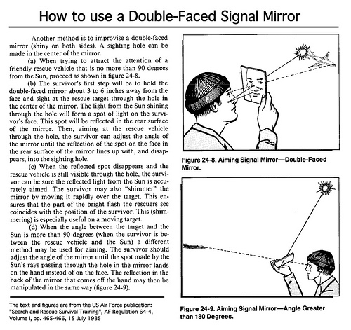
Notes:
Air force guidance on using signal mirrors with a small unsilvered circle in the center
Public domain, US Air Force.

Slide 81
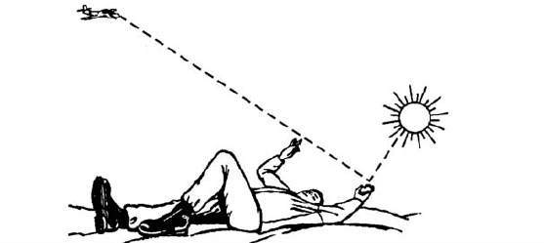
Notes:
Air force guidance on using signal mirrors WITHOUT a small unsilvered circle in the center
Public domain, US Air Force.

Slide 82
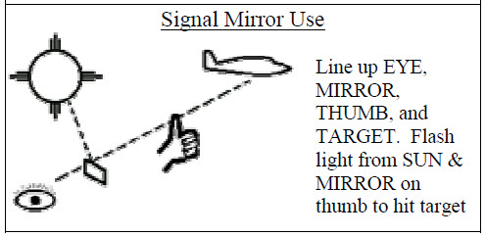
Notes:
ASRC Crib Sheet guidance on using signal mirrors with a small unsilvered circle in the center

Slide 83
Whistles

Slide 84
Field III Training Standards
Know the uses, advantages and disadvantages of
Whistles
Know that whistle and hand signals can be used for rescue system management and are on the ASRC Radio SOP Crib Sheet

Slide 85
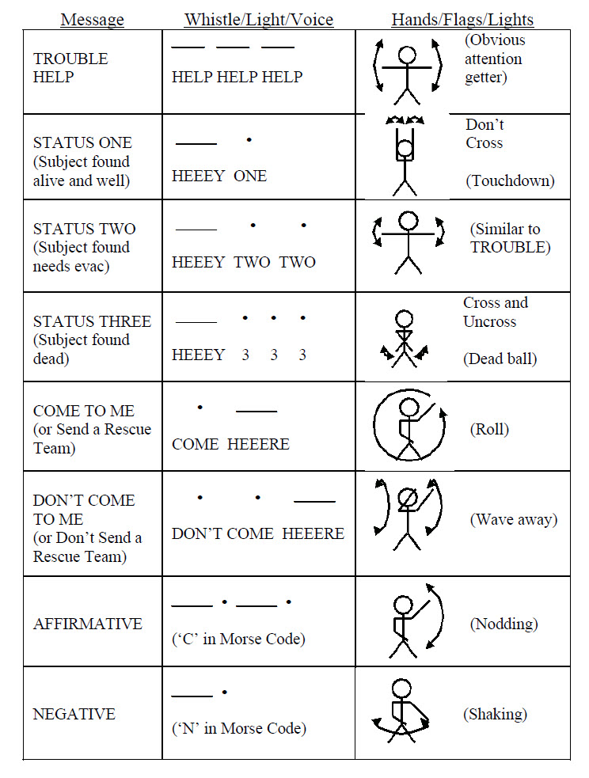
Notes:
Here they are, on your handy ASRC Commo Crib Sheet. Nobody expects you to memorize them.

Slide 86
Download PDF of ASRC Commo Crib Sheet
http://archive.asrc.net/ASRC-Communications/2007-03-12-ASRC-Radio-Crib-Sheet.pdf
Notes:
Again, this will be on the screen during the break at the end of Field III before we move on to Field II.

Slide 87
Ropework Whistle Signals
SUDOT
1 long: Stop
2 short: Up
3 short: Down
4 short: Off rope/rope free
Continuous: Trouble/help
Short is 1 second
Long is 3 seconds
astm.org/Standards/F1768.htm
Notes:
The international standards-setting organization ASTM has a Committee F-32 on search and rescue. Many ASRC members have contributed to their work. They have established a standard set of whistle signals for ropework.

Slide 88
“effectively communicate, in whistle…”
Notes:
Those whistle signals are also in that table in my Nontechnical and Semi-Tech Evacs chapter.
From Appalachian Search and Rescue by Keith Conover, used with permission.

Slide 89
Download AppSAR Evacs
http://www.conovers.org/ftp/AppSAR/AppSAR-8-Nontechnical-and-Semi-Tech-Evacs.pdf
Notes:
Which will also be on the screen at the end of this session.

Slide 90
Smoke and Flares

Slide 91
Field III Training Standards
Know the uses, advantages and disadvantages of
Smoke
Flares
Notes:
Smoke and flares are easy to see from the air. But pilots don’t like them as the smoke can whip around and interfere with their vision at just the wrong second. And the reason that they are deprecated in the ASRC is…

Slide 92
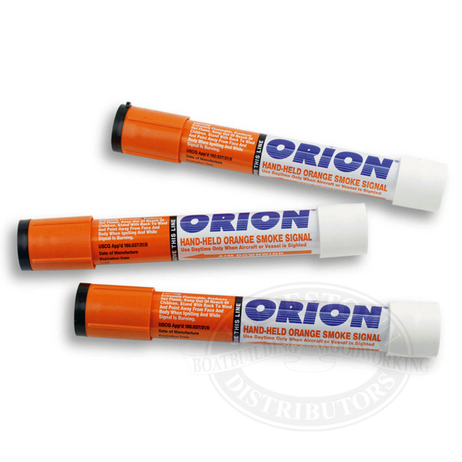
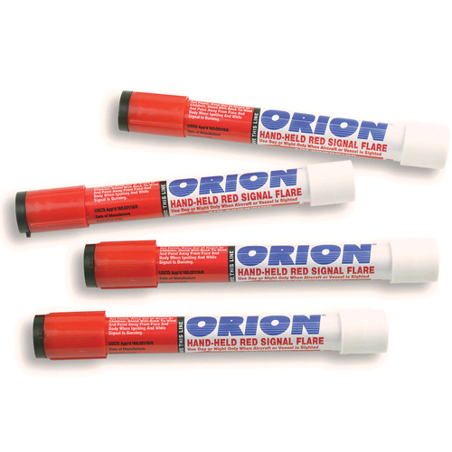
Notes:
By Keith Conover, used with permission.

Slide 93
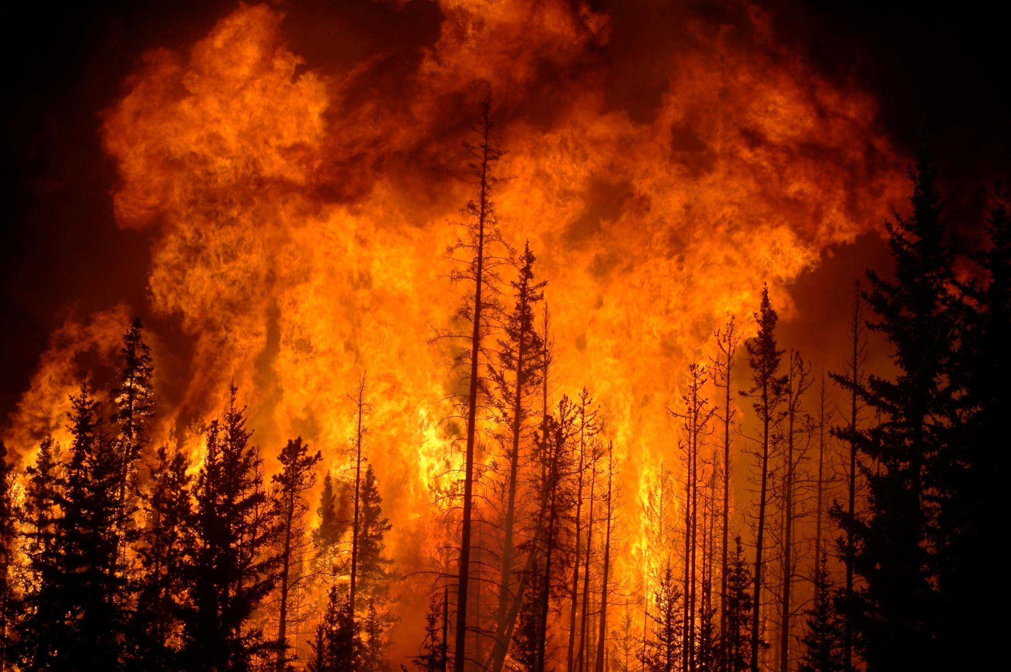
Notes:
that we have twice started forest fires trying to use flares and smoke to vector in helicopters. Really. They were smaller than this slide, but still… don’t use smoke or flares unless you are aware of the risks and have your Fire Department tanker handy.
From Wikimedia Commons.
This file is licensed under the Creative Commons Attribution 2.0 Generic license.
courtesy Cameron Strandberg from Rocky Mountain House, Alberta, Canada

Slide 94
Cyalume Sticks

Slide 95
Field III Training Standards
Know the uses, advantages and disadvantages of
Chemical luminescent light sticks

Slide 96
Cyalume Sticks
Telling you where your airscenting dog is at night
Showing the corners of a LZ for night helicopter landing with night vision
As a substitute, for a night task, for a headlamp or candle lanterns? (Military $15 Combat Light Shield Device available on amazon.com)
Notes:
Since I don’t have a search dog and I have a headlight with a low setting I have never used a Cyalume stick for SAR. Or much of anything else except Halloween. Anyone use Cyalumes regularly?

Slide 97
Show Cyalume stick and case!

Slide 98
Any questions? Over.

Slide 99
http://www.conovers.org/ftp/ASRC-Commo.pdf
http://archive.asrc.net/ASRC-Communications/2007-03-12-ASRC-Radio-Crib-Sheet.pdf
http://www.conovers.org/ftp/AppSAR/AppSAR-8-Nontechnical-and-Semi-Tech-Evacs.pdf

Slide 100
Communications 103: Field II Level
Keith Conover, M.D., FACEP, FASRC

Slide 101
Field II Training Standards
Know basic radio principles relevant to the ASRC, including
Electromagnetic waves, wavelength and frequency, and effect of frequency on radio signal propagation

Slide 102
Electromagnetic waves, Frequency, Wavelength, Bands and Propagation

Slide 103
Show Slinky!
Notes:
If you push electrons up and down in an antenna, like in this slinky, they emit electromagnetic waves through space: The faster you jiggle the Slinky, the higher the frequency of the electromagnetic radio waves. Show slinky jiggling, faster and faster.

Slide 104
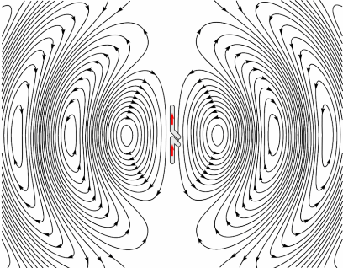
Notes:
Like this. Please don’t have a seizure.
This file is made available under the Creative Commons CC0 1.0 Universal Public Domain Dedication.
Via Wikimedia Commons courtesy user Chetvorno.

Slide 105
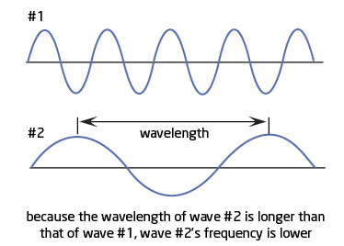
Notes:
Frequency and wavelength are inversely related. The lower the frequency, the longer the wavelength. And the lower the frequency, the longer an antenna needs to be. The frequencies we use, around 155 MHz, are very close to the ham 144-147 MHz band, which is called the “two-meter” band, because the wavelength is about two meters. The constant that governs the relation between wavelength and frequency is the speed of light, which is also the speed of radio waves.
From Keith Conover, used with permission.

Slide 106
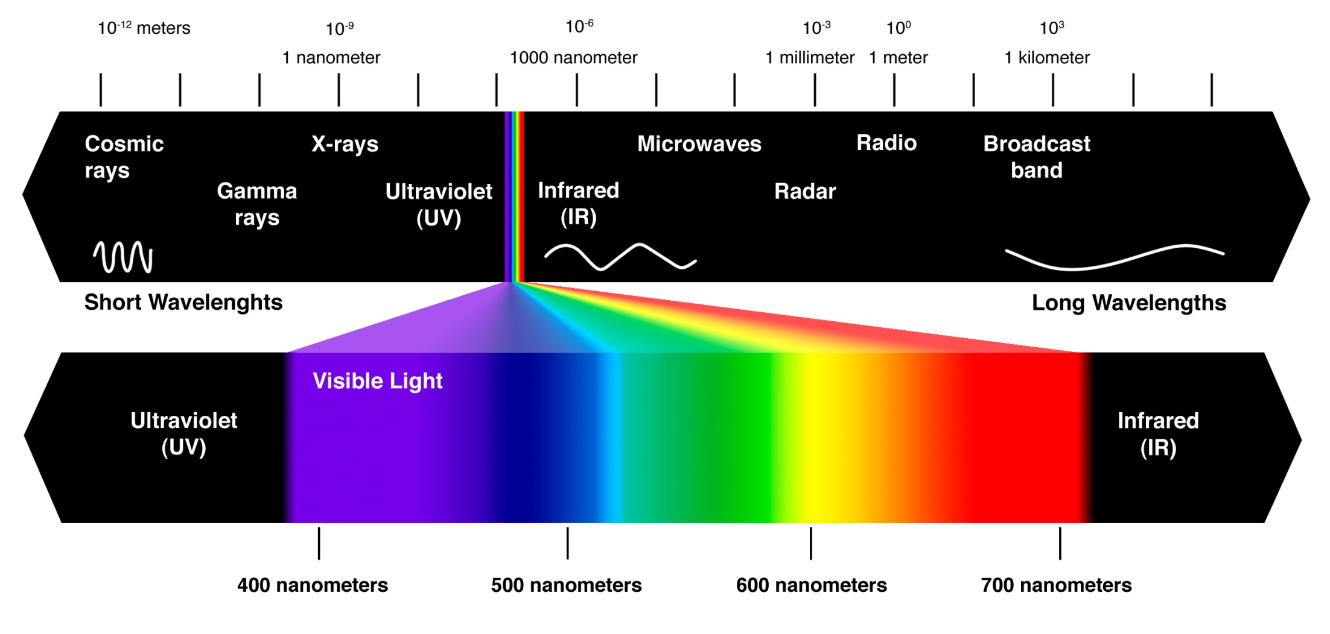
Notes:
Infrared warming you from a hot stove or the sun, visible light, radio waves, X-rays and gamma rays… all are electromagnetic waves.
This file is licensed under the Creative Commons Attribution-Share Alike 4.0 International license.
Courtesy user Ander032.
Espektro_elektromagnetiko_osoa.jpg

Slide 107
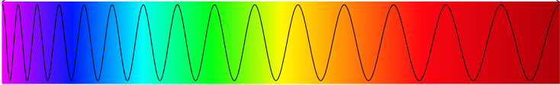
Notes:
Here is another way to visualize frequency versus color, and the variation continues to the right and eventually gets to radio frequencies.
Via Wikimedia Commons: Spectre_detail.png
This file is licensed under the Creative Commons Attribution-Share Alike 3.0 Unported license.
Courtesy user Timichal.

Slide 108
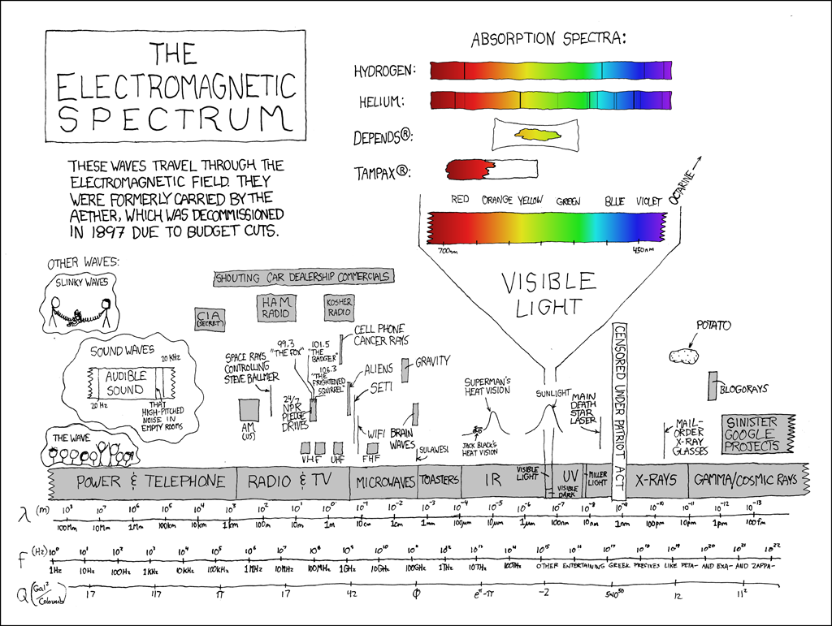
Notes:
Randall Munro’s XKCD.com, of course, provides the most entertaining map of the electromagnetic spectrum.
Courtesy xkcd.com, used with permission.

Slide 109
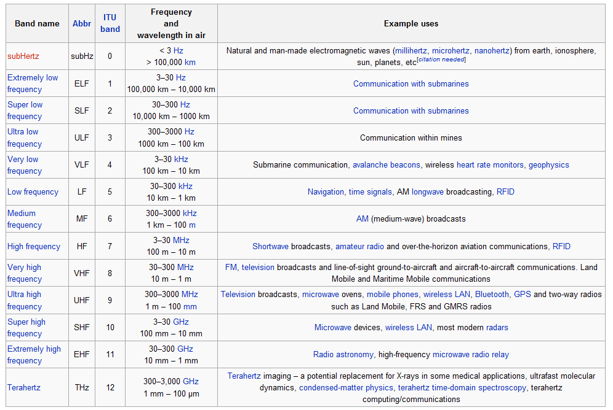
Notes:
We almost always use VHF (very high frequency) for the ASRC “Special Emergency” radio frequencies, but we use UHF (ultra high frequency) for our cellphones on on personal FRS radios.
While we have high-powered (5 watt) handhelds for formal training and missions, people often use UHF Family Radio Service (FRS) radios which are cheap and require no licensing. FRS radios are limited to 2 Watts on channel 1-7 and channels 15–22. Previously, FRS radios were limited to 500 milliwatts so older FRS radios may be limited to this power output. That’s a tenth of the Part 93 type-accepted radios we routinely use on our Special Emergency frequencies, so they are not very powerful. All 22 FRS UHF channels around 462 and 467 MHz are also shared with the General Mobile Radio Service (GMRS). GMRS requires a personal license. GMRS radios may operate up to 50 watts, and may use repeaters.
Programmable dual-band VHF/UHF radios that the ASRC tends to use, both mobile and handheld, tend to be able to operate on FRS/GMRS radio frequencies.

Slide 110
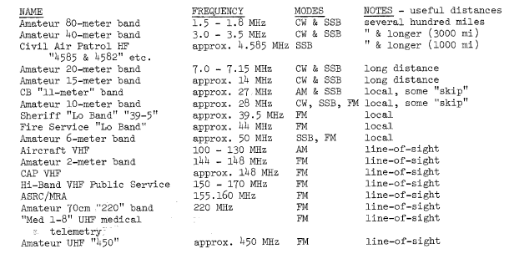
Notes:
Many frequencies and frequency bands are known by names. This table is from my 1977 SAR textbook and you can access the communications chapter, or for that matter the whole thing, online…
This hasn’t changed all that much from 1977, except for the addition of 800 MHz trunked systems. Trunked systems are sort of halfway between our “regular” radios and a cellphone system. The system assigns frequencies to a transmitting radio “on the fly” and so they channels don’t correspond with specific frequencies. The channels are usually called “talkgroups.” The ASRC doesn’t use trunked systems, but someone from an organization that uses a trunked system sometimes works with us. Our radios will never work with 800 MHz trunked systems.
One other change: there are now Federal interoperability channels that we are allowed to use to communicate with other public safety agencies when needed. There are some of these channels on both VHF and UHF that many of our radios can access. They tend to have channel names like VTAC. Many but not all other public safety agencies have these channels programmed in their radios.
From Ground Search and Rescue by Keith Conover, used with permission.

Slide 111
National Interoperability VHF Channels
155.7525 MHz: VCALL 10
151.1375 MHz: VTAC 11
154.4525 MHz: VTAC 12
158.7375 MHz: VTAC 13
Notes:
These are the VHF Federal interoperability channels we can use for missions or training without specifically being licensed for them.

Slide 112
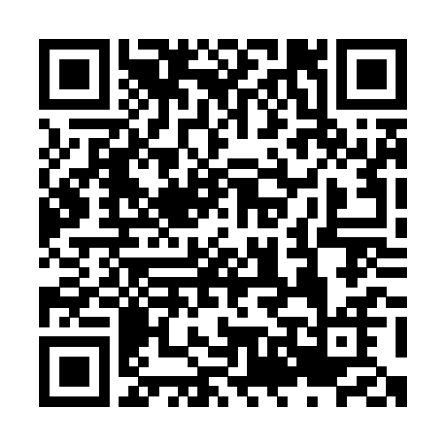
Download Radio-Communications Chapter
http://archive.asrc.net/ASRC-Training/1977-01-00-Radio-Communications.pdf
Notes:
here. Again this will be up on the screen at the break.

Slide 113
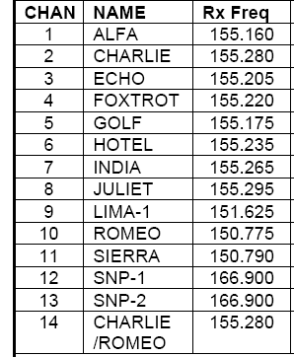
Notes:
For the ASRC frequencies, we give them phonetic alphabet names. Because of interference with other users, we use one frequency in one place and another in another place.

Slide 114
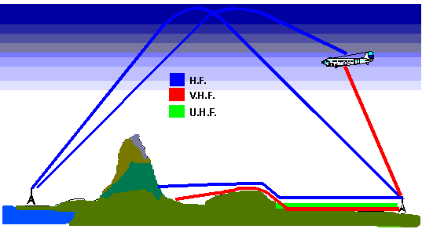
Notes:
We call this concept illustrated in this diagram “radio signal propagation.” It means how radio waves can get from point A to point B, either in a straight line, by bending around obstacles, or by bouncing off of something. Propagation varies with things like the weather – rain in the air or on tree leaves absorbs radio frequency energy, particularly at high-band VHF frequencies we use.
HF (high frequency) radio transmissions, like some non-handheld ham radios, can bounce off the ionosphere, a layer of electrically charged particles high in the atmosphere.
VHF can bend around obstacles a bit but only a bit.
UHF won’t bend around obstacles, but it’s better than VHF for getting between steel studs in buildings, so more popular in urban areas.
UHF-VHF-HF-Radio-Wave-Propagation: public domain, NASA

Slide 115
AM, FM and Overmodulation

Slide 116
Field II Training Standards
Know basic radio principles relevant to the ASRC, including
The difference between AM and FM and how speaking loudly on FM decreases signal strength

Slide 117
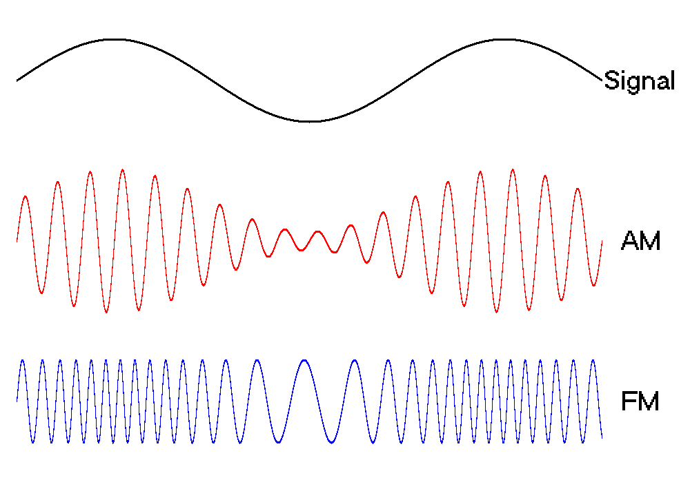
Notes:
Unless you’re using Morse code, you want to encode your voice onto your radio signal. The vibrations of your voice are a lot slower than the radio waves your radio or cellphone uses. You can increase and decrease the strength of the radio signal based on your voice – we call that amplitude modulation, or AM; or, you can vary the frequency slightly based on your voice – and we call that frequency modulation or FM. We only use AM to talk with aircraft, mostly we use FM.
Found in multiple places on the Internet with no copyright notice, presumed public domain.

Slide 118
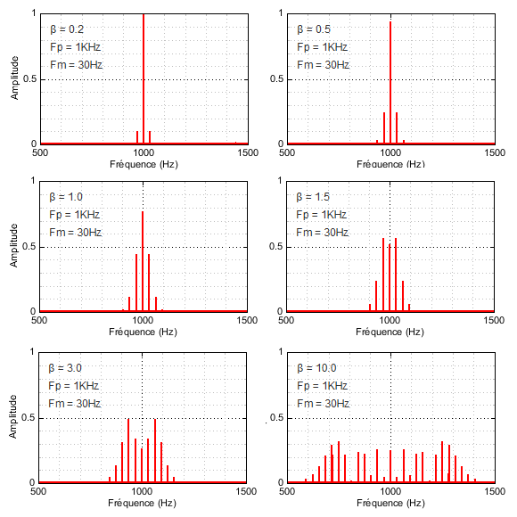
Notes:
These graphs show the signal strength on the vertical axis and the frequency on the horizontal axis.. Starting at the top left and proceeding to the bottom right, it shows the effect of speaking louder and louder at the central “official” channel frequency. Particularly on FM, if you talk very loudly, it decreases the signal strength in the middle of the frequency and can make it harder for your listeners to hear. We call that “overmodulating.” So, don’t shout at your radio, it makes you harder for the person on the other end to hear you.
Via Wikimedia Commons: Modulation fm.png
This file is licensed under the Creative Commons Attribution-Share Alike 4.0 International license.
Courtesy user Jlpons.

Slide 119
FM Paradox: “speak softly and carry a big antenna”
Talking more loudly decreases FM signal strength
And, even on AM, speaking too loudly (overmodulating) distorts your voice so it is hard to understand

Slide 120
Simplex vs Duplex and Repeaters vs Remote Bases

Slide 121
Field II Training Standards
Know basic radio principles relevant to the ASRC, including
…
Simplex vs duplex

Slide 122
Simplex and Duplex
Phones and cellphones are full duplex
Push-to-talk Radios are simplex
Notes:
Got it?

Slide 123
Field II Training Standards
Know basic radio principles relevant to the ASRC, including
…
Retransmitters (remote bases) and repeaters…

Slide 124
MULTIPOINT NETWORK (SIMPLEX)
F1
F1
F1
F1
F1
F1
Rev 3.1 12 Jan 2019 © G.Harrison
Notes:
The simplest way to use a base radio and a bunch of handhelds is for everyone to be on the same frequency. But, if you let everyone talk with everyone, as you add more teams, it quickly gets confusing.
Diagram by Gene Harrison, FASRC, used with permission.

Slide 125
STAR NETWORK (SIMPLEX)
F1
F1
F1
F1
F1
F1
Rev 3.1 12 Jan 2019 © G.Harrison
Notes:
You can require that people in the field only talk with Base but not talk directly with each other unless they get permission from Base. This is the standard way we work on a medium-sized search. We might say “Base, Field Team Alfa requests permission to go direct with Field Team Bravo.” Base might say yes, or say “Alfa, Bravo, permission granted to go direct with Bravo; change channel from Echo to Foxtrot for direct conversation but then come back to channel Echo once done.”
Diagram by Gene Harrison, FASRC, used with permission.

Slide 126
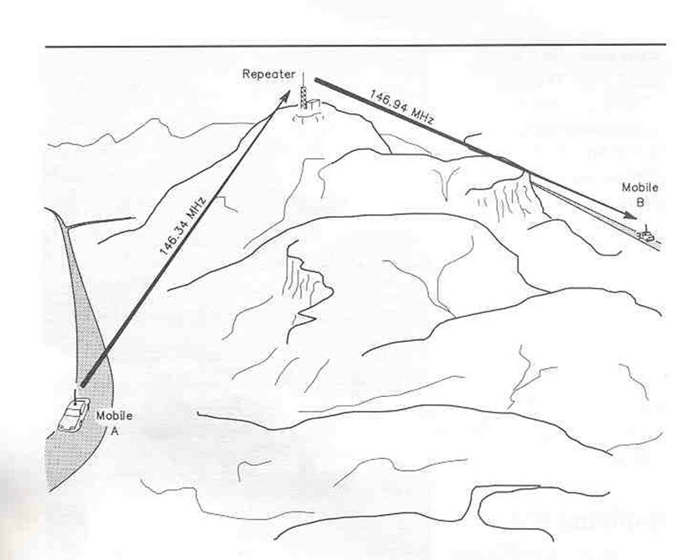
Notes:
Since VHF doesn’t go over hills much, we sometimes use a repeater. As with this diagram of a ham repeater, the hams talk on 146.34 MHz (“34”) and listen on 146.94 MHz (“94”). Hams call this a 34/94 repeater; the difference between the two frequencies, 0.6 MHz which is 600 kHz, helps prevent interference between the two at the repeater, which are being received and transmitted at the same time. The repeater is set up the exact opposite as far as frequencies: it listens on 34 (we call that the repeater input) and repeats whatever it hears on 94 (the repeater output). Though you can’t both talk at the same time, you can use the repeater to talk from one side of the mountain to the other. Without the repeater, could couldn’t talk with each other due to the mountain between you.

Slide 127
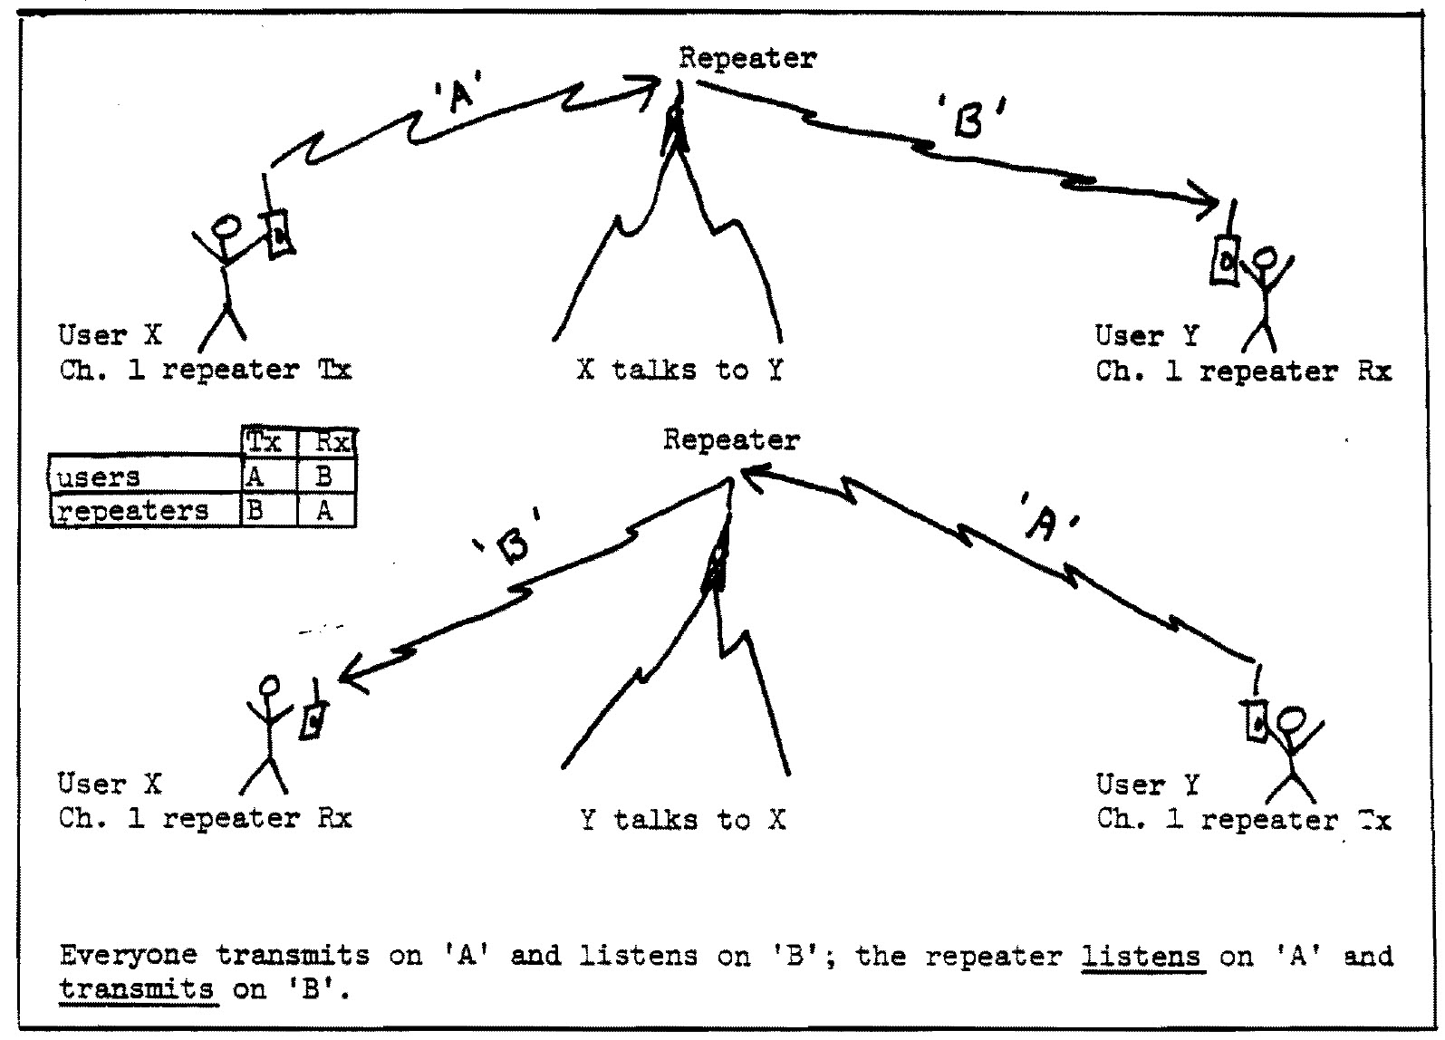
Notes:
Again for a repeater, people with handhelds transmit on A and listen on B; the repeater listens on B and transmits everything it hears on A. Again, the repeater input and output are the precise opposite of how the handhelds are programmed.

Slide 128
Download Radio-Communications Chapter
http://archive.asrc.net/ASRC-Training/1977-01-00-Radio-Communications.pdf
Notes:
That last diagram is from the radio communications chapter of my 1977 search and rescue textbook, download if you wish. This will be up on the screen during the break at the end of this section.

Slide 129
AUTOMATIC REPEATER (1-WAY DUPLEX RELAY)
BOTH Repeater & ReTrans
F2
F1
T
R
F2
F1
F2
F1
Rev 3.1 12 Jan 2019 © G.Harrison
Notes:
There is a difference between a repeater and a retransmitter. A repeater sends out whatever it hears, as it hears it. A retransmitter saves up what it hears and then trasnsmits it as soon as you’re done speaking. Rather than calling this 1-way duplex relay, some call this half duplex: the signal goes in two directions but only one person can talk at a time.
Diagram by Gene Harrison, FASRC, used with permission.

Slide 130
RETRANSMITTER (2-WAY DUPLEX RELAY)
ONLY ReTransmitter!
F2
F1
T
T
R
R
F2
F1
F1
F1
Rev 3.1 12 Jan 2019 © G.Harrison
Notes:
A remote base is sometimes called a retransmitter. Base talks to the mountaintop remote base/retransmitter on the control frequency, usually a UHF frequency, and the other radios in the field all talk with the mountaintop remote base/retransmitter on the tactical or field frequency.
Rather than call this 2-way duplex, others Rather than calling this 1-way duplex relay, some call this half duplex remote base.
Diagram by Gene Harrison, FASRC, used with permission.

Slide 131
Antennas, ERP, Ground Planes and Reflectors

Slide 132
Field II Training Standards
Antenna principles, including:
Antenna radiation patterns and effective radiated power (ERP)
The effect of ground planes and reflectors and how to improvise them in the field
How to use other teams to relay to Base
The effect of altitude on radio communications

Slide 133
Wave Arms, Show Antennas
Notes:
If I am standing here and I’m an antenna, very little of the radio-frequency energy radiates up from the top of my head. But off to either side [hold arms straight out to either side] – where my arms are pointing – there is a lot of RF energy. Which means if I lay down and my head is pointing to Base they aren’t likely to hear me. A rubber ducky antenna, like the ones we tend to use in the field, radiate a lot energy, not vertically up but, when my antenna is straight up, up and down a lot [wave arms up and down]. That RF energy is not heading towards Base, so it’s wasted. If I replace the rubber duckie on my handheld radio with a quarter-wave [hold it up] or 5/8 wave extendable whip antenna [hold it up and extend and collapse it] then a lot more of the RF energy goes out directly perpendicular to my body [hold arms perfectly 90° out from body]. One of these antennas will improve not only your Effective Radiated Power and make it easier for your signal to get back to Base, but it will also make you receive Base better. I’ll show you some diagrams of antenna radiation patterns that show this better than my arms.

Slide 134
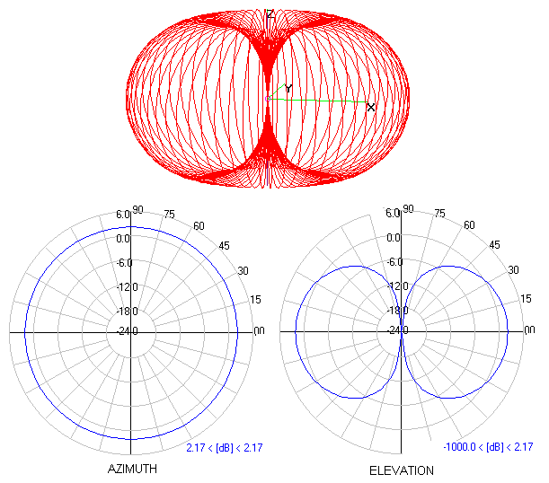
Notes:
This is a standard antenna radiation pattern diagram. For the diagrams on the bottom, the further out from the center the blue line, the higher the effective radiated power. The bottom left is a top view of an antenna, and the bottom right diagram is a side view, with no RF energy radiated from the top of the bottom of the antenna.
Source unknown, presumed public domain.

Slide 135
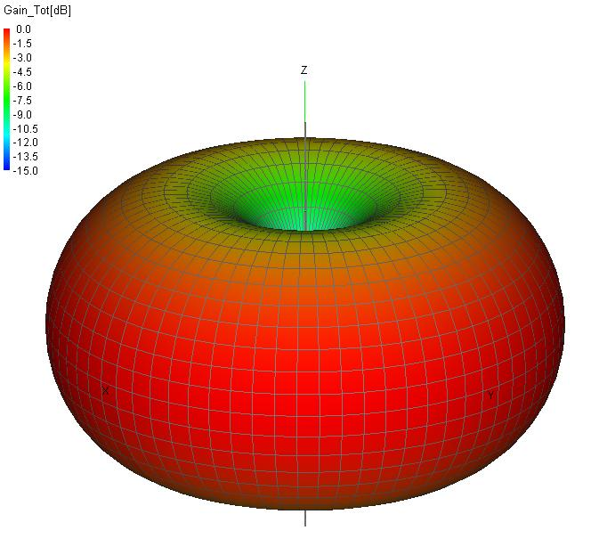
Notes:
This is a 3-D visualization of the radiation pattern of a rubber duckie antenna.
Source unknown, presumed public domain.

Slide 136
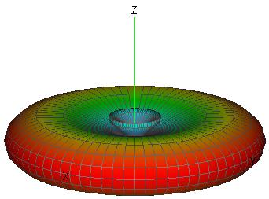
Notes:
This is a 3D of the ERP of a 5/8 wave antenna on your handheld. So as long as you hold that antenna straight up and down, it’s like having a radio that’s twice as powerful and a receiver that’s twice as sensitive.
Source unknown, presumed public domain.

Slide 137
Terms
ERP = Effective Radiated Power
Duckie antenna
¼ wave antenna
⁵/₈ wave antenna
Notes:
From duckie to quarter-wave to five-eighths wave antennas, the doughnut gets squashed flatter and flatter. As long as you hold the antenna straight up, you get better effective power to talk with Base, and equivalent better reception as well!

Slide 138
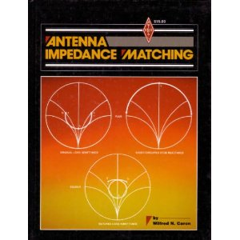
Notes:
And we just went through the Reader’s Digest condensed version of Antennas for Dummies. We haven’t even talked about impedance matching, SWR ratios and SWR meters… there are big textbooks on this stuff. Even if your brain is starting to hurt, I want you to appreciate how much we’ve left out.
Fair use per Wikimedia Commons.

Slide 139
Antenna Tricks?
Two antennas met on a roof, fell in love and got married. The wedding wasn't great, but the reception was excellent.
Notes:
Can squash the doughnut, even with a duckie, by placing a radio-frequency mirror, a ground plane, under the radio.
This can be your body (hold the radio on your head). This can be a vehicle hood or roof.
You can use your body (or a bit of aluminum foil) as a reflector; holding the radio out at arms’ length is about right for VHF frequencies that the ASRC commonly uses.
BTW, if your radio is on your waist and the rubber ducky antenna is right up against your stomach, this is a good way to shield your antenna from any nearby radio signals. Having the radio on a chest harness or pack strap with the antenna sticking up from your body works much better.
When all else fails, climb a tree or climb a hill to get some altitude to get a better line of sight. Or, you can try calling a nearby team direct and ask them to see if they can relay to Base.

Slide 140
Squelch, Tone Squelch and the Monitor Button

Slide 141
Field II Training Standards
Carrier squelch, monitor buttons, and PL tone squelch

Slide 142
Carrier Squelch
What is carrier squelch and why should we care?
Notes:
Also known as “noise squelch.” It turns off the speaker unless it detects a strong enough signal on the frequency. “Enough” is set by setting the squelch level.
It is worth noting that if you’re trying to listen to someone with a very weak signal, you can turn off the squelch.
On older radios, you do this by turning down the squelch knob.
On newer radios, you do this by pressing a “monitor” button.
On my Wouxun handhelds, it’s a long press on the bottom button. But I always forget and do a short press and that turn on the useless little LED flashlight on the top instead. Sigh. On Baofengs, it’s the button right below the push-to-talk.

Slide 143
CTCSS
Continuous Tone-Coded Squelch System
= “PL” (Private Line; Motorola trademark)
= “CG” (Channel Guard; Bendix-King trademark)
= “tone” “subaudible tone” “PL tone” = FRS “subchannel”
DCS (digital) squelch available, we don’t use
Notes:
”PL Decode” turns off the speaker unless it detects a strong enough signal on the frequency also with the proper subaudible PL tone. There are two purposes:
so you don’t have to listen to static all the time, and
so you don’t have to hear other users on the same frequency
Note that FRS “subchannel” is nothing of the sort. It doesn’t prevent interference with others on the same channel but a different subchannel, it just keeps you from hearing them.

Slide 144
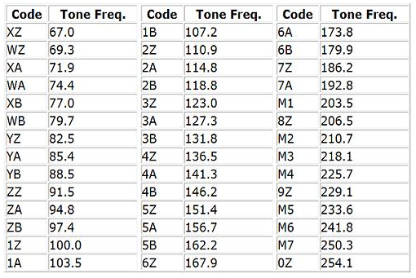
Notes:
ASRC standard procedure is to have all radios programmed to transmit the 3A (127.3) PL tone. But to not use PL squelch. Why?
First, we need to listen to those on a different or no PL to find out if there is a lot of interference on the channel.
Second, what if some people have radios and are trying to talk on one of the ASRC frequencies, but don’t know to have PL 3A encode on their signals? We’ll never hear them.
So why transmit 3A? Just in case we really need to use that transmit PL, for instance to allow us and only us to access a portable repeater. We don’t want to have local EMS agency transmissions going through our repeater.

Slide 145
Network Discipline

Slide 146
Field II Training Standards
Basic principles of network discipline
FCC or ASRC says “thou shalt”

Slide 147
Network Discipline: FCC
Thou shalt use Special Emergency frequencies for SAR mission communications only
Notes:
The ASRC says this because the FCC (Federal Communications Commission) says this.
There is an exception for our business band license but that requires that we use frequency Lima-1, 151.625, which we rarely use.
Can we use one of our Special Emergency frequencies to order a pizza? The answer is not simply no or yes. If the pizza is feeding people engaged in the mission, the answer is probably yes. If not, the answer is probably no. The only way to find out for sure is to get taken to court see how the FCC administrative law judge rules.

Slide 148
Network Discipline: FCC
Thou shalt not use profanity on the radio
Notes:
FCC says so.

Slide 149
Network Discipline: ASRC
Thou shalt not make wisecracks or jokes on the radio
Notes:
ASRC, not FCC, says this.

Slide 150
Network Discipline: ASRC
Thou shalt use the format “You, this is me.”
Notes:
ASRC, not FCC, says this.

Slide 151
Network Discipline: ASRC
Thou shalt use standard prowords and Status Codes (1, 2 or 3)
Notes:
ASRC, not FCC, says this.

Slide 152
Network Discipline: ASRC
Thou shalt make short, concise communications
Notes:
ASRC, not FCC.

Slide 153
Network Discipline: ASRC
If thou must maketh a long transmission…
Notes:
ASRC, not FCC, says this

Slide 154
Network Discipline: ASRC
Use your tactical callsign (“Field Team Alfa”) or your position or last name
Notes:
ASRC, not FCC

Slide 155
Network Discipline: ASRC
Remember there are people listening to their radio scanners
Notes:
There is a rule “Don’t put anything in an email that you wouldn’t want to see on the front page of the newspaper.”
Everything you say on a radio can be heard by people with radio scanners. And if it’s big search, the press will be listening to those scanners as well.

Slide 156
Improving Field Communications

Slide 157
Field II Training Standards
Techniques for improving cellphone communications in the backcountry, including use of texting instead of voice, and ways to improve antenna effective radiated power (ERP)

Slide 158
Cellphones
Texting
Antenna Ground Plane
Antenna Reflector
Notes:
Why does texting work even when you don’t have a good enough signal to maintain a voice connection? (Lower bandwidth requirements = less data to transmit; also fault-tolerant transmission.)
How do you make an antenna reflector for a cellphone? (Hold in front of your body about a few inches and slowly turn around until you get more bars.)
How do you make an antenna ground plane for a cellphone? (Hold on top of your head, or on top of a vehicle roof.)

Slide 159
Any questions? Over.

Slide 160
http://www.conovers.org/ftp/ASRC-Commo.pdf
http://archive.asrc.net/ASRC-Training/1977-01-00-Radio-Communications.pdf
http://www.conovers.org/ftp/AppSAR/AppSAR-8-Nontechnical-and-Semi-Tech-Evacs.pdf

Slide 161
Communications 104: Field I Level
Keith Conover, M.D., FACEP, FASRC

Slide 162
Base Antenna/Mast

Slide 163
Field I Training Standards
Know and be able to set up and properly operate a radio station at Base, including:
Considerations for placing Base antennas with reference to communications efficacy, high points and ground planes, and dangers including wind and lightning

Slide 164
Base Antennas/Masts
Hazards
Mast fall radius
Electric wires?
Crushable things?
Guy wires/stakes:
tripping/clotheslining
Notes:
As you’re putting up the mast: Look up for electrical wires within the fall radius.
Mentally use the height of the mast to look for crushable things. Like radio operators.
Flag the stake at the bottom and the middle of guy wires!

Slide 165
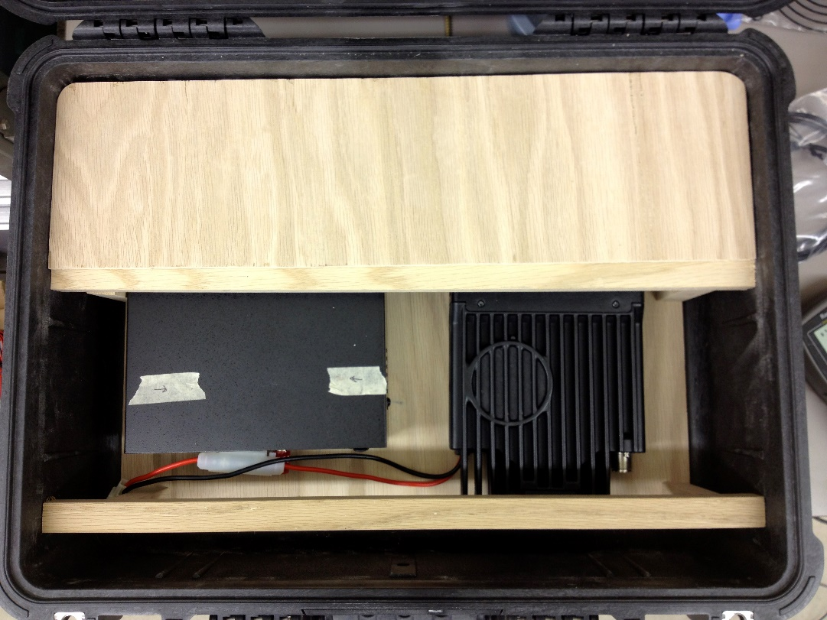
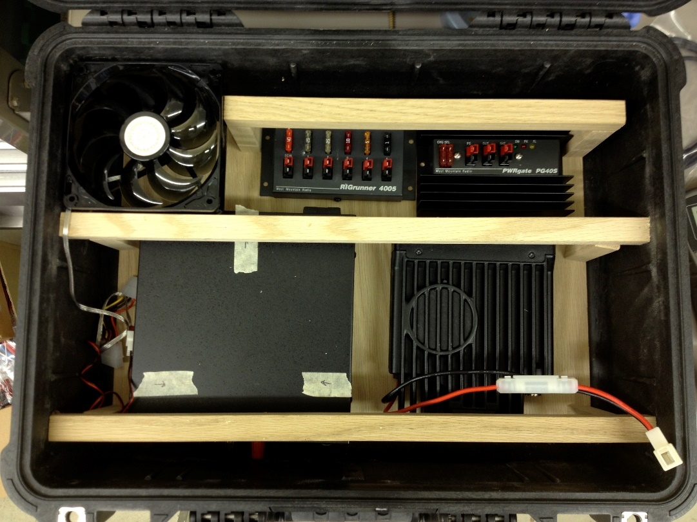
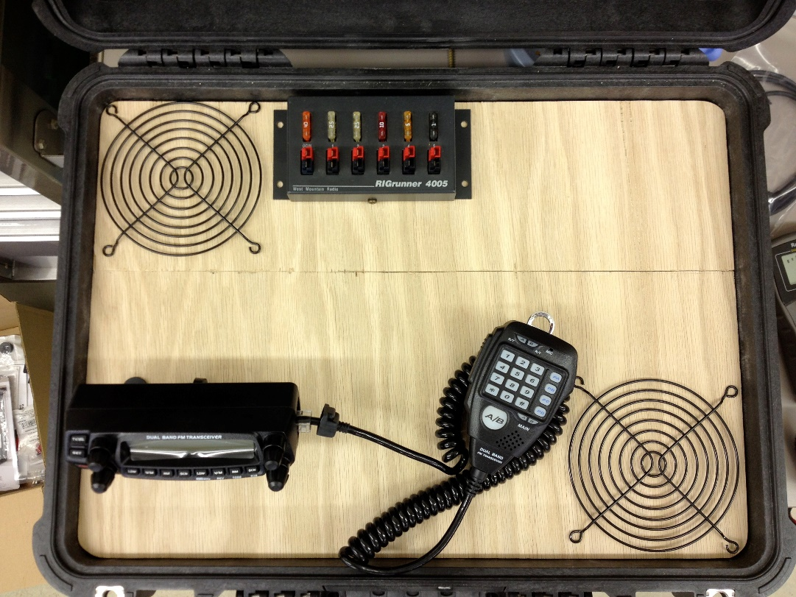
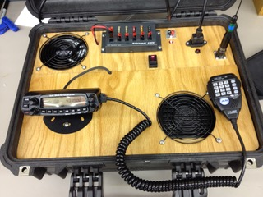
Notes:
ASRC Groups have tended to build a home-brew Base Radio setup in a box, containing a mobile ham/commercial FM transceiver, a power supply that will run the radio either on a car battery or AC power, either from a building or from a generator. This is AMRG’s old Base Radio setup being built into a Pelican case.

Slide 166
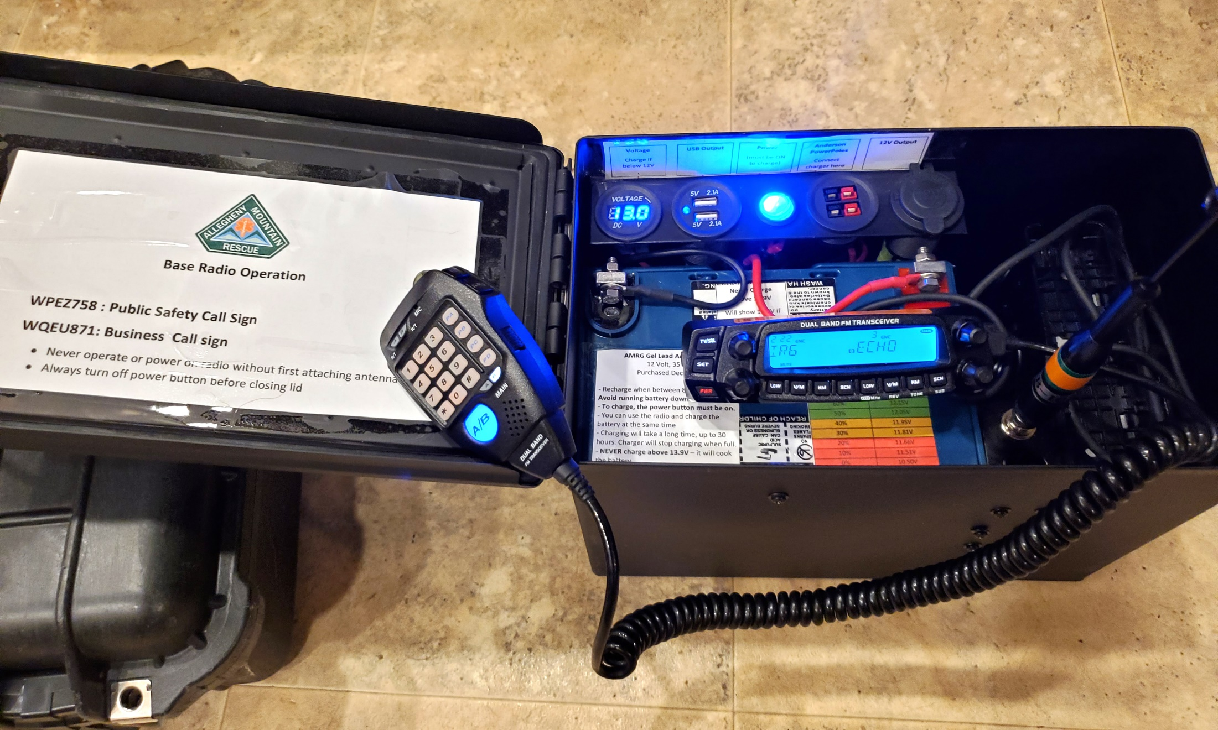
Notes:
More recently – and these pictures are from January 2021 for a revision of the AMRG Base radio setup after a coiuple of the components failed – ASRC Groups are following the example of amateur radio hams who prepare for emergencies by building everything into a “hammo box.” Better yet, as with this AMRG radio box, an enterprising ham is building and selling “hammo box kits” with everything you need to have a compact Base radio with minimal configuration.

Slide 167
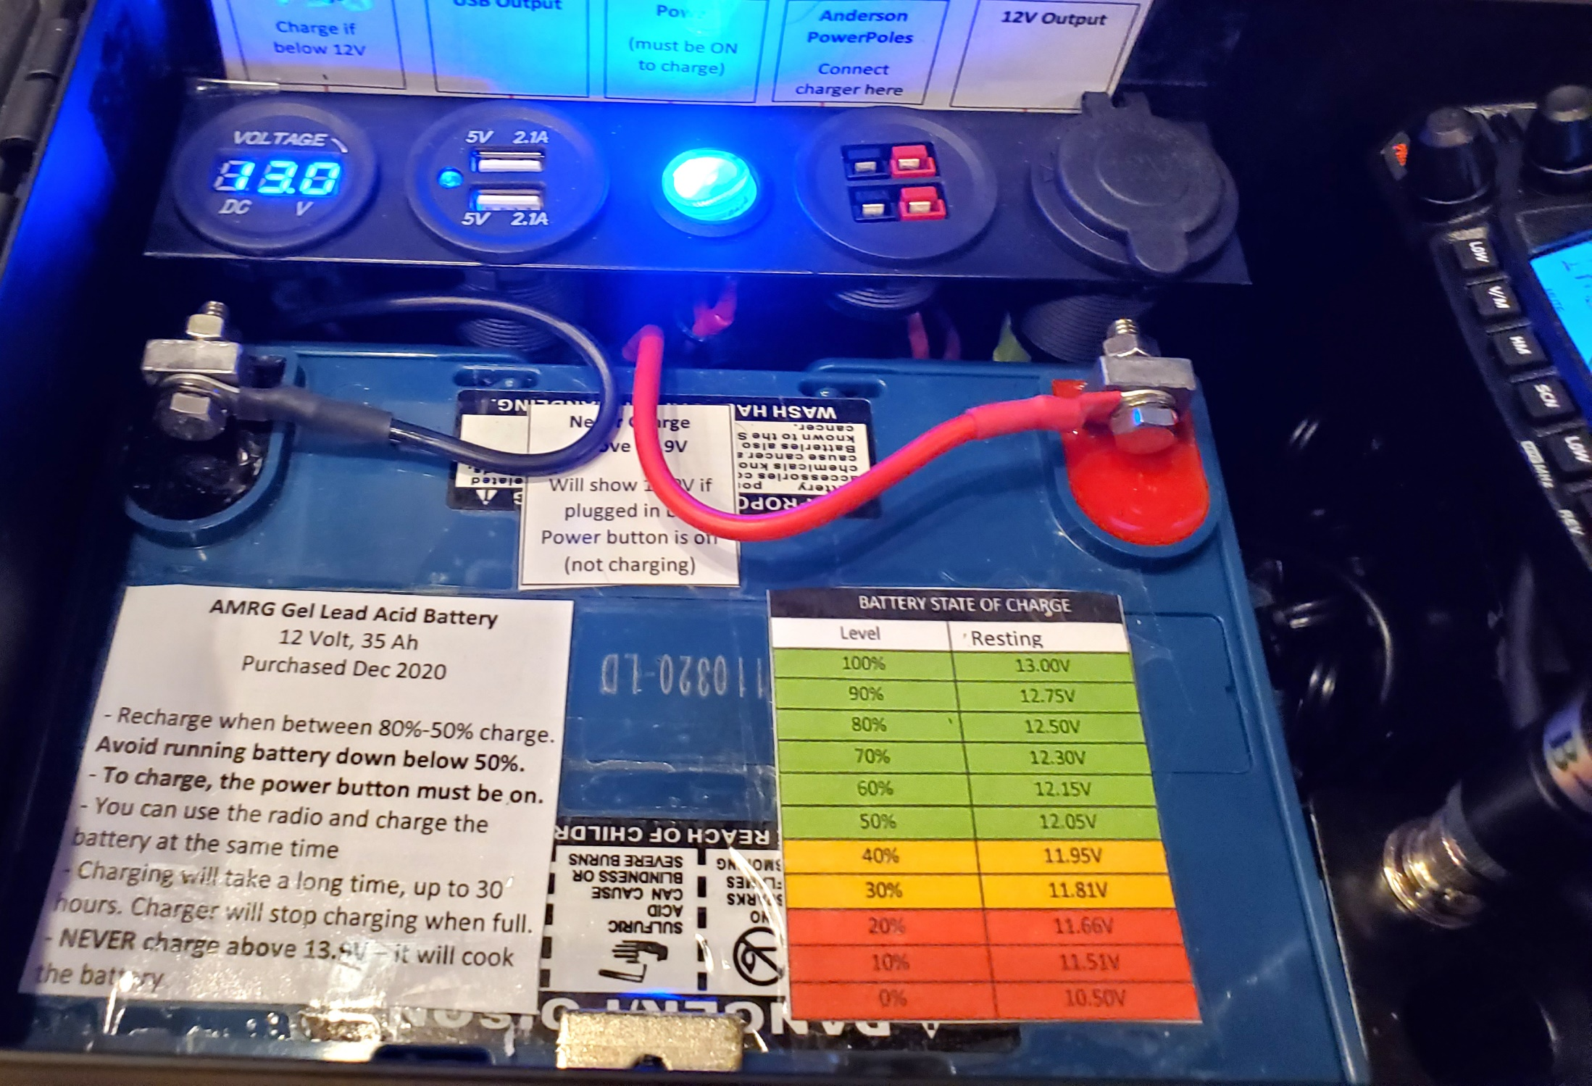
Notes:
These “hammo box” kits include a gel-cell 12 volt battery that will run the radio for hours, so that you can have the Base radio set up and operating in minutes, even without any external power. One note about these “hammo box” kits: you shouldn’t buy the model that comes with an FM ham transceiver built-in. Such radios (a) might not transmit outside ham frequencies without modifying the motherboard, and (b) are not FCC Part 93 type-accepted for use on Special Emergency frequencies and are unlawful to use on ASRC frequencies. Thus, this is the old AMRG radio just in a new box.

Slide 168
Base Antennas/Masts
Hazards
Lightning (Ground Stake)
Notes:
As you’re putting up the mast, you should consider what happens if lightning strikes it. A thick wire, from the antenna or the antenna’s coaxial cable (“coax”) should go to a copper stake put deep into the ground.

Slide 169
Notes:
Reserved for a nice closeup picture the bottom of the mast with ground stake and cable for a basic Base radio and mast setup.

Slide 170
Base Antennas/Masts
Efficacy
Mast height
Mast/antenna vertical
High-gain antenna, good ERP
Away from big metal
Notes:
Higher is better, and given the mast is usually pretty vertical, the best antenna you can get, with the highest horizontal ERP (remember what that is?) will help.

Slide 171
Dealing with Handheld Radios at Base

Slide 172
Field I Training Standards
Know and be able to set up and properly operate a radio station at Base, including:
How to assemble handheld radios, and properly handle sign-in/sign-out of such radios
How to change handheld radio batteries
How to set up and use battery chargers
How to identify and prioritize batteries for charging or sign-out
How to determine when battery charging is complete

Slide 173
Managing Handhelds at Base
How to assemble handheld radios…
How to change handheld radio batteries
How to set up and use battery chargers…
How to determine when battery charging is complete…
It all depends on your brand and model of radios, batteries and chargers. You may need a two-minute just-in-time training if they are radios and chargers you haven’t used before.

Slide 174
Field I Training Standards
[…] properly handle sign-in/sign-out of such radios
Notes:
Why should we do this? Because it decreases our loss of equipment.

Slide 175
Notes:
One best practice: radio equipment doesn’t get signed out to a team, it gets signed out to an individual person. Note the “Responsible Person” column on this form The creates a greater sense of responsibility for the radio and makes it more likely it will get turned back in. At the end of the mission, and not three months later when someone finds it under the seat of their car.

Slide 176
FCC Rules for the Base Radio Operator

Slide 177
Field I Training Standards
Know and be able to set up and properly operate a radio station at Base, including:
Observing the FCC rules under which ASRC operates:
Use and number of units allowed for each FCC licensed frequency used by ASRC

Slide 178
FCC Rules
Allowable number of units

Slide 179
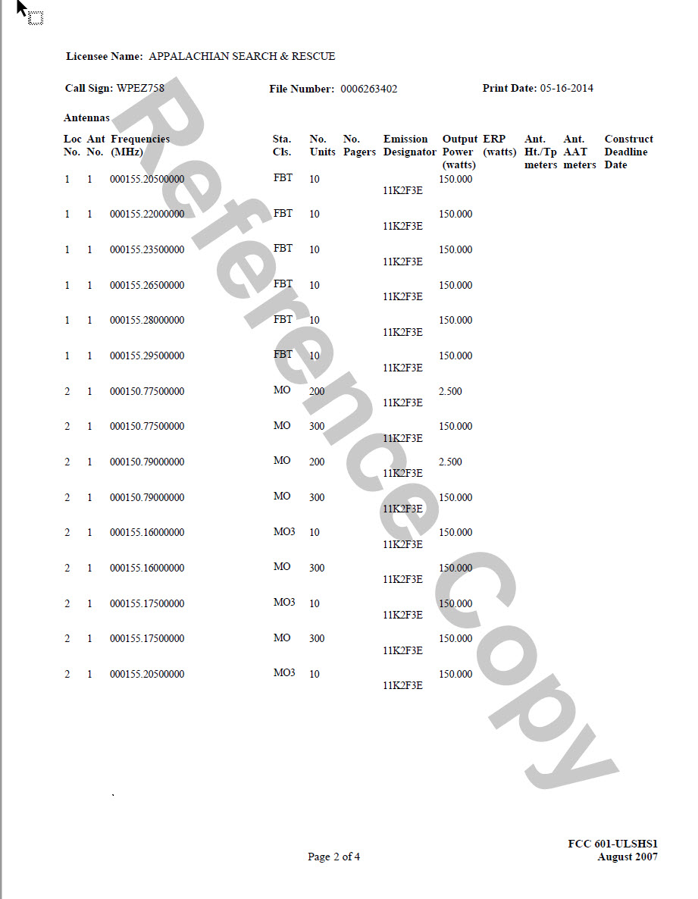
Notes:
This is page 2 (of 4) of our special emergency license that expires 2024. The entire thing is in the ASRC Archive if you really want to see it: just go to archive.asrc.net. The columns are: [read off]

Slide 180
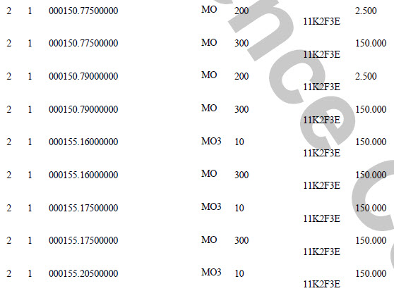
Notes:
If we zoom in and ignore the FBT fixed bases, which we don’t use, we can see that, we can use Alfa (155.160) through Juliet (which is 155.295 and which is on the next page), we can have 300 150 watt or less mobile radios on each frequency, and another 200 2.5 watt handhelds on each of the frequencies Romeo (150.775) and Sierra (150.790) which are designed to work through a vehicle-based repeater. We can also have 10 “MO3” mobile repeaters. And our “Base” radio is, by FCC standards, a mobile radio that has just been parked for a bit. Again, you can see the entire license at archive.asrc.net. And notice the “2” in the “location” column on the left? That refers to where we are allowed to operate under our license.

Slide 181
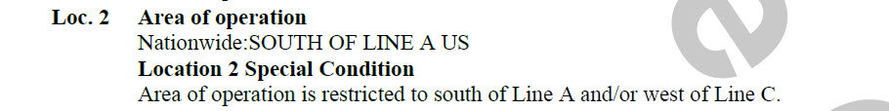

Notes:
This is Location 2: south of Line A and west of Line C. Anywhere in the US, including Alaska, Hawaii, Puerto Rico and the Virgin Islands except right next to the Canadian border.

Slide 182
Field I Training Standards
Know and be able to set up and properly operate a radio station at Base, including:
Observing the FCC rules under which ASRC operates:
…
Announcing the ASRC callsign

Slide 183
FCC Rules
Base shall issue our FCC callsign every 30 minutes
47 CFR § 90.425 - Station identification
each… system shall be identified by the transmission of the assigned call sign during each transmission or exchange of transmissions, or once each… 30 minutes in the Public Safety Pool… during periods of continuous operation.
Notes:
CFR is Code of Federal Regulations; these are the FCC rules on saying our callsign

Slide 184
FCC Rules
ASRC FCC Callsigns:
Special Emergency ASRC Channels: Alfa, Charlie, Echo, Foxtrot, Golf, Hotel, India, Juliet, Romeo, Sierra: WPEZ758
Business Band (Channel Lima-1): WQEU871
Notes:
Notice there is no Bravo. We had to give up that frequency and we didn’t re-letter our frequencies. Alfa through Juliet start with 155.160 and go up from there. Romeo and Sierra are 150.775 and 150.779, 5 MHz lower which makes them handy to use for input to a mobile repeater. We can use them in full-power mobile and handheld radios as well. You do not need to memorize these callsigns. We put callsign labels right on the Base radios.

Slide 185
Field I Training Standards
Know and be able to set up and properly operate a radio station at Base, including:
Observing the FCC rules under which ASRC operates:
…
Concerns with interference with other channel users

Slide 186

Notes:
Most of the information about radio-frequency interference don’t apply to us. However, we have to do our best not to interfere with other licensed users of our channels. We are usually interlopers in an area where other public safety agencies are already using some of the frequencies for which we are licensed. A best practice is to listen to a channel, and if it’s busy, try to find a channel that’s not being used in the area. If a channel seems quiet and then gets busy, it’s possible to simply move all of our communications to another channel. Honestly, the usual problem is their high-powered base stations interfere with us. And we have to change channels to something without such interference.

Slide 187
Field I Training Standards
Know and be able to set up and properly operate a radio station at Base, including:
…
Carrying out the duties and responsibilities of Net Control

Slide 188
Being Net Control

Slide 189

https://www.idahoares.info/_downloads/procedures/NET_CONTROL_STATION_TRAINING_MANUAL_3-05rev.pdf
Notes:
If you want to get good at net control, get your ham license and participate in amateur emergency services nets. Or even just listen to them. Simply browsing online resources like this will give you a leg up. It’s from Idaho Amateur Radio Emergency Services (ARES). It’s designed for long-distance HF radio nets during disasters and the like, and these nets can get very busy during a disaster.

Slide 190
Net Control Best Practices
For efficiency note on your net worksheet as many calls as you can before you acknowledge any.
Acknowledge all stations heard by call and than yield the frequency to any station reporting in with emergency traffic.
Clear emergency traffic then priority messages and finally those with routine messages.
Notes:
Here is some advice from this handbook appropriate to being Net Control on a search where things are getting out of control.

Slide 191
Net Control Best Practices
Pair stations to pass traffic to another frequency whenever possible.
Be friendly, yet in control. Speak slowly and clearly with an even tone. Speak with confidence even if you are inwardly nervous.
Ask specific questions – give specific instructions. This reduces the need for repeats and prevents confusion.
Notes:
More advice from the ham net control manual. Pair stations would be “Teams Delta and Foxtrot, please switch to channel Echo, the once done with your two-team traffic, switch back to Alfa.”

Slide 192
Net Control Best Practices
When there is a double (i.e., when two or more stations transmit on the same frequency at the same time), listen to see if you can identify either station by call sign or text, then ask all stations to stand by while you solicit clarification or repeats from each station involved as needed.
Notes:
More advice from the ham net control manual

Slide 193
Net Control Best Practices
Don't think on the air. If you need a moment to consider what is needed next, say something like "stand by" and un-key your microphone. This adds a professional touch.
Notes:
More advice from the ham net control manual

Slide 194
Net Control Worst Practices
Thinking aloud on the air: "Ahhh, let me see. Hmmm. Well, you know, if…“
On air arguments or criticism
Rambling commentaries
Shouting into your microphone
"Cute" phonetics
Notes:
More advice from the ham net control manual

Slide 195
Net Control Worst Practices
Identifying every time you key or unkey the mic
Using "10" codes, Q signals or anything other than "plain language"
Speaking without planning your message in advance
Notes:
More advice from the ham net control manual

Slide 196
Net Control Best Practices
If field teams frequently have to wait to talk to you/Base, take time out to ask someone to work on getting a second Base radio on a second frequency and a second radio operator.
“Don’t just do something, stand there.” Don’t get sucked into continuing to answer the radio instead of asking for help.
Notes:
Some advice from SAR net control people.

Slide 197
Net Control Best Practices
As search gets larger, designate channel that seems to be clear as tactical
Note frequency in communications plan
Add frequency to TAFs for teams’ reference
Require teams to request to talk directly: “Base from team Charlie, permission to go direct with Team Delta on tactical channel Alfa? Over.” “Team Charlie from Base, go direct with team Delta on tactical frequency Alfa; both teams check in with Base on main channel Echo once done with direct traffic. Over.”
Notes:
More from experienced SAR comms people

Slide 198
Field I Training Standards
Know and be able to set up and properly operate a radio station at Base, including:
Using the Equipment Log to track radio equipment and the Communications Log to track radio traffic

Slide 199
Notes:
This is a radio equipment log that Bru Randall of SMRG and then AMRG and now MARG sent to me.

Slide 200

Notes:
Not much to say here. This is a Pennsylvania Search and Rescue Council communications log.

Slide 201
Any questions? Over.

Slide 202

http://www.conovers.org/ftp/ASRC-Commo.pdf
http://archive.asrc.net/ASRC-Training/1977-01-00-Radio-Communications.pdf
http://archive.asrc.net/ASRC-Communications/2007-03-12-ASRC-Radio-Crib-Sheet.pdf
http://www.conovers.org/ftp/AppSAR/AppSAR-8-Nontechnical-and-Semi-Tech-Evacs.pdf

