Slide 1
Allergy and Anaphylaxis
Keith Conover, M.D., FACEP, Allegheny Mountain Rescue Group
References in Survival and Wilderness Travel Chapter in http://www.conovers.org/ftp/AppSAR-Drafts

Slide 2
Why?
Allergies are common and debilitating
Beesting and food allergies are common and can be life threatening
Need to destroy some myths about how to manage different allergies

Slide 3
Delayed vs Immediate Hypersensitivity
Delayed Hypersensitivity
Slow onset (hours/days)
Slow resolution (6 wks)
Examples:
Nasal allergy (hay fever/allergic rhinitis)
Eye allergy (allergic conjunctivitis)
Poison ivy rash
Antihistamines for quick relief
Steroids to shorten course or prevent
Notes:
There are two types of allergy with which we are concerned: Delayed and Immediate Hypersensitivity. (We don’t care about the other three types.) Delayed hypersensitivity is the most common.
Conjunctiva are the clear coverings of the inside of your eyelids and the white parts of your eye.

Slide 4
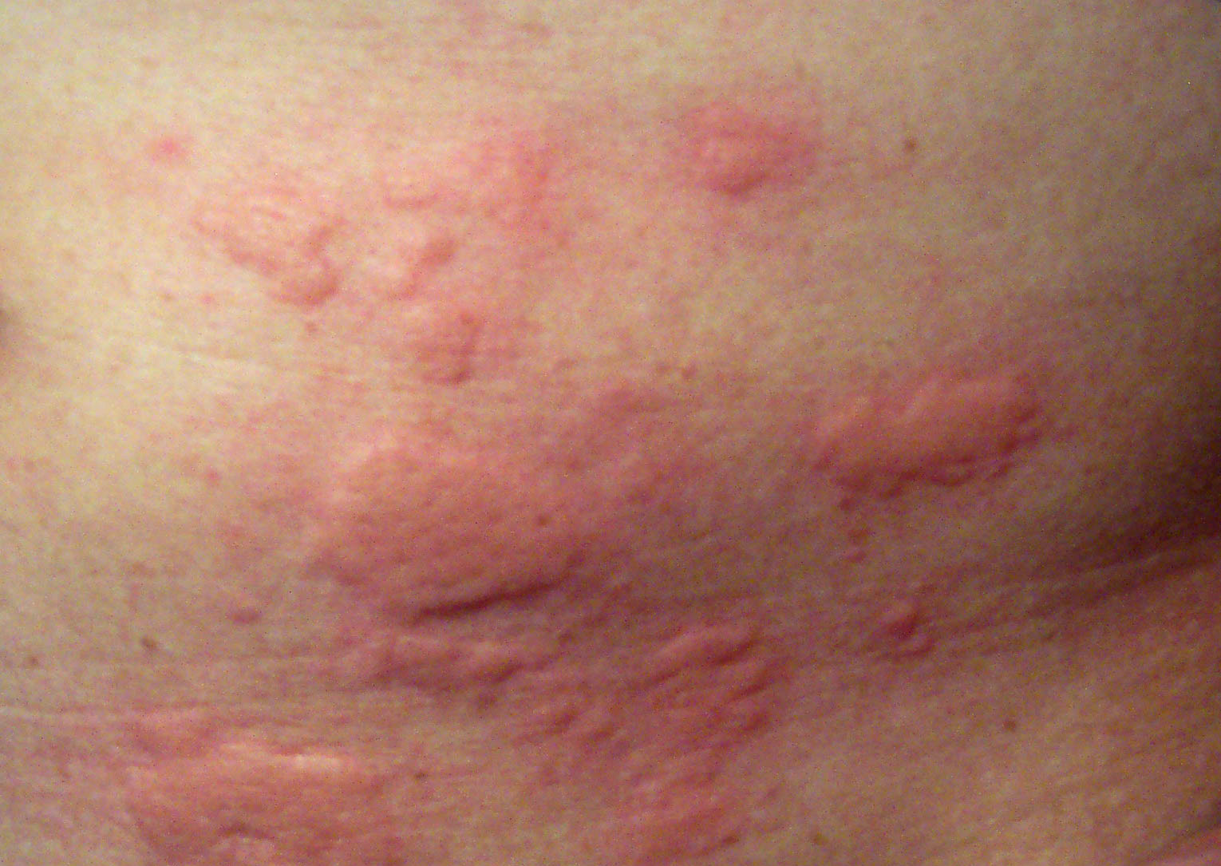
Notes:
What is this? Hives, AKA urticaria, remember, doctors get paid by the syllable, with extra credit for Latin or Greek roots.
Licensed under the Creative Commons Attribution-Share Alike 3.0 Unported license via Wikimedia Commons, courtesy Enochlau.

Slide 5
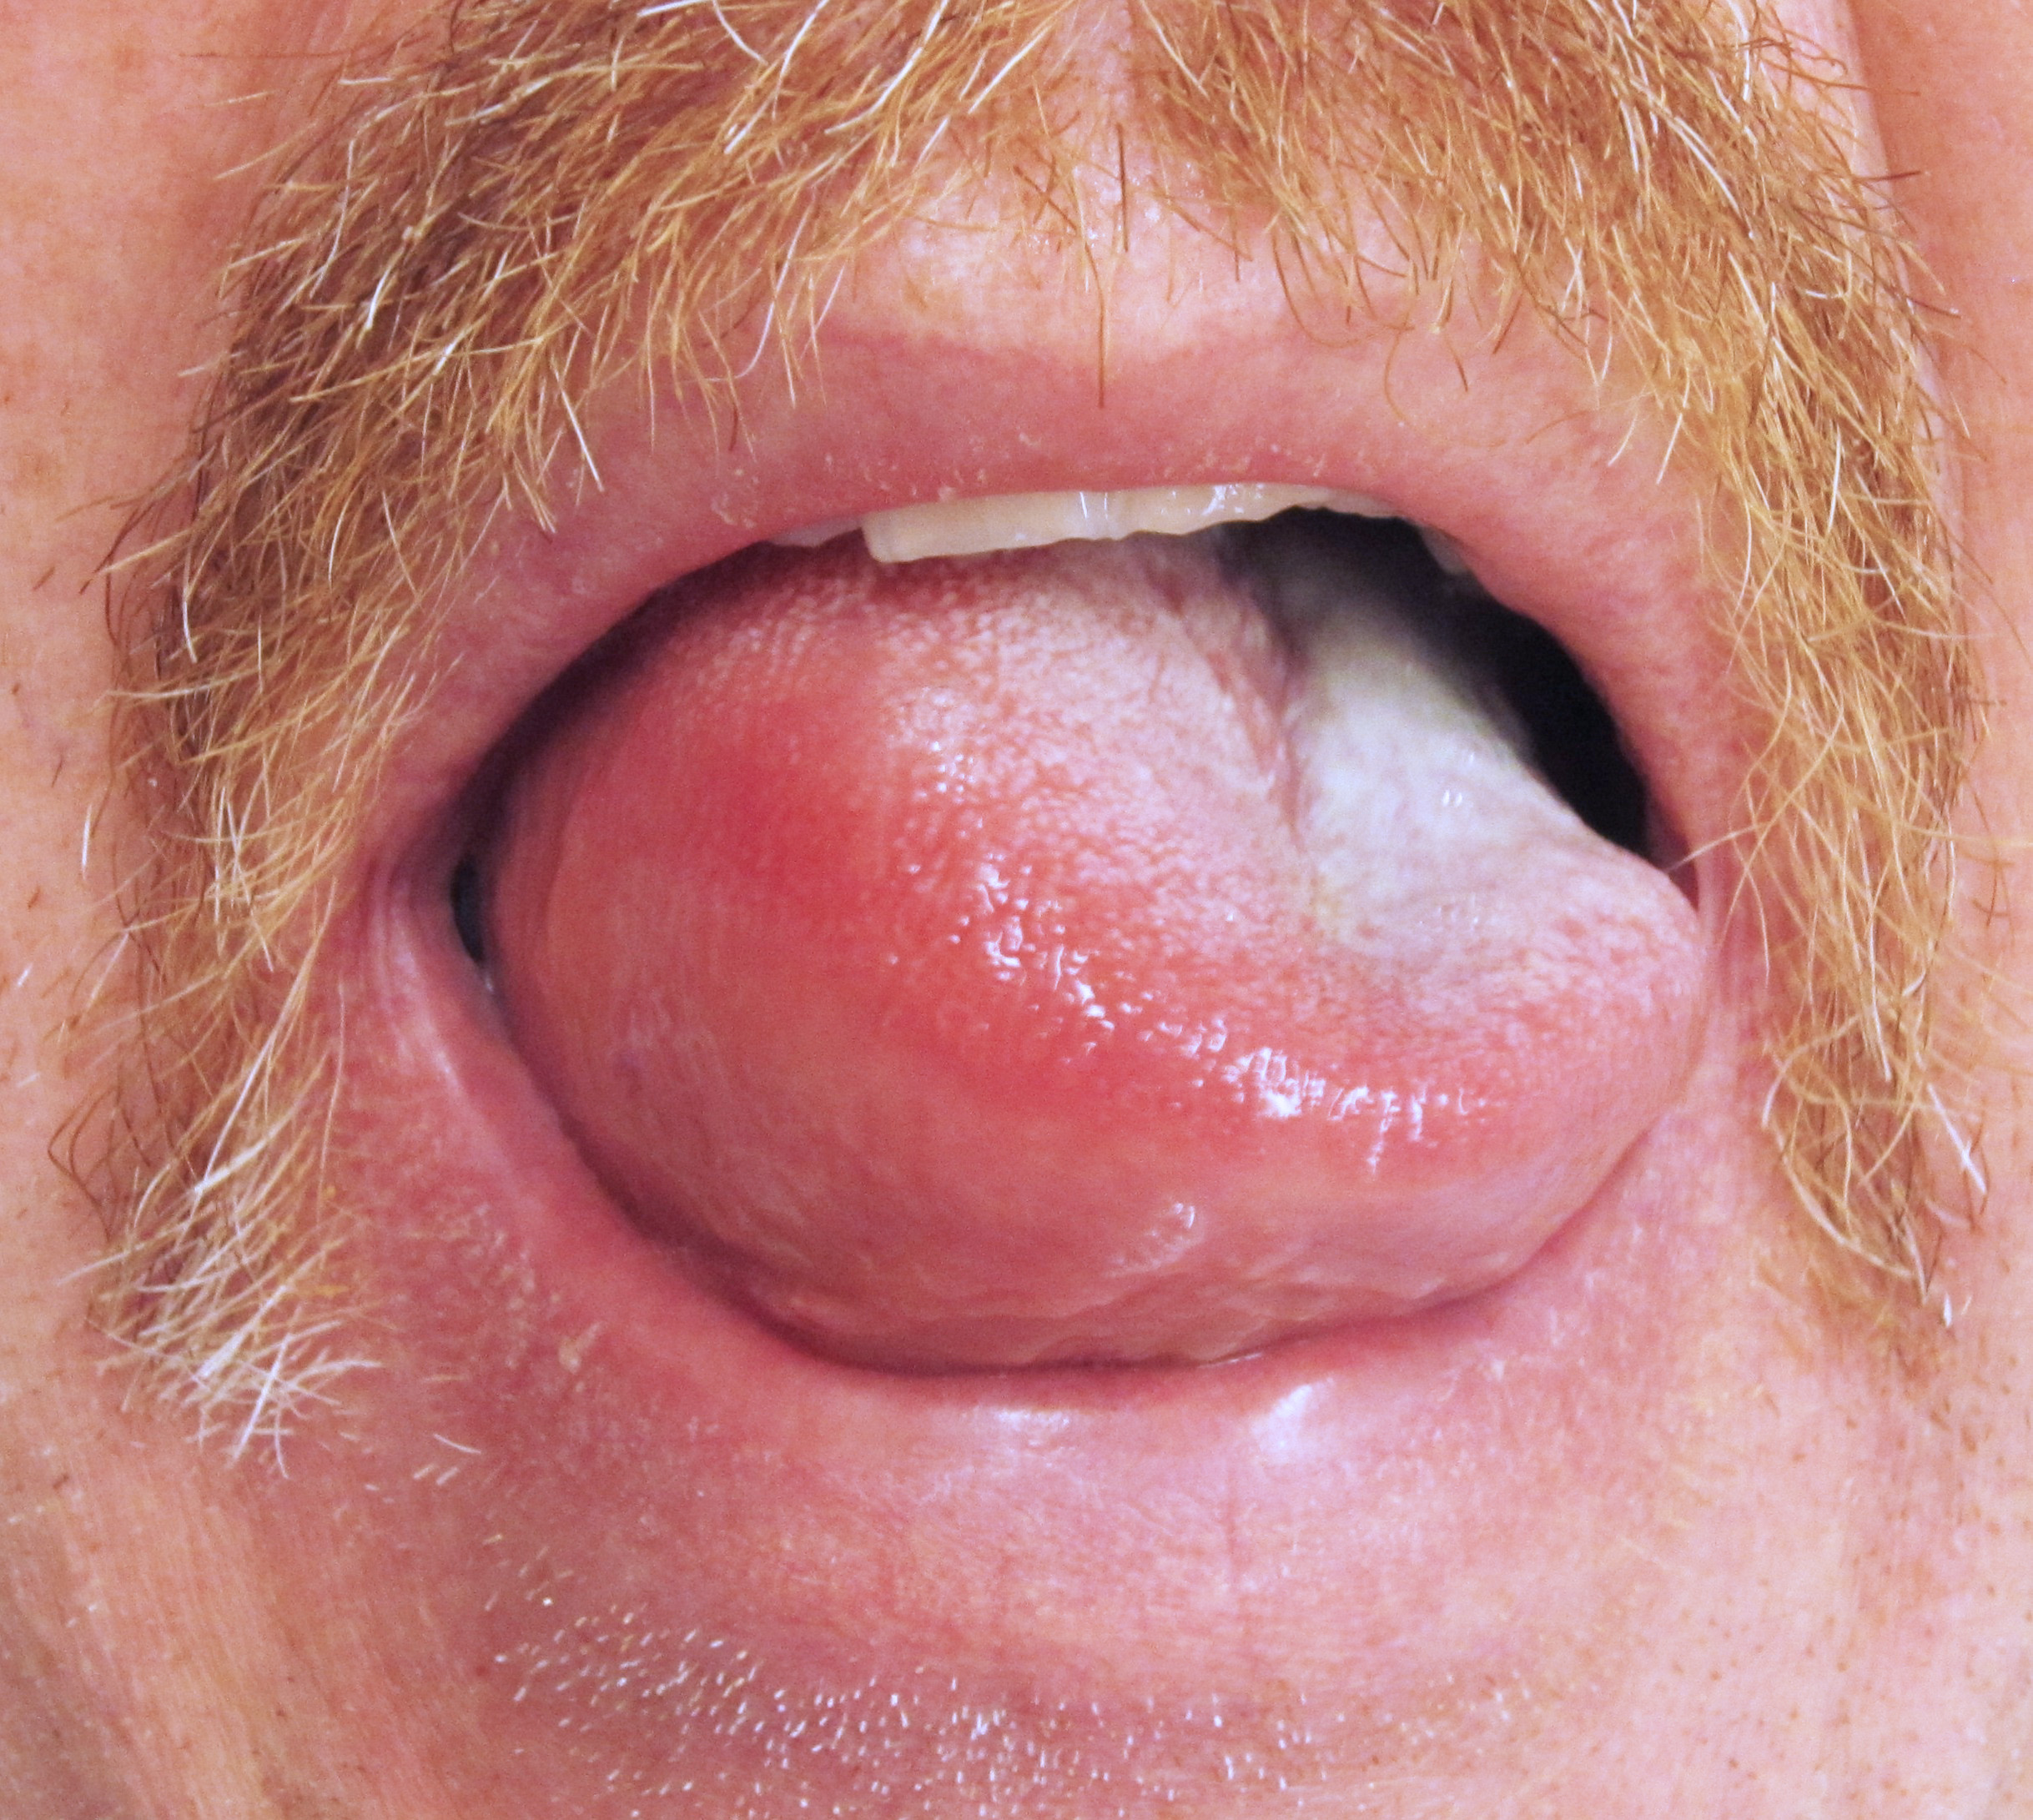
Notes:
What is this? Angioedema of the tongue.
Licensed under the Creative Commons Attribution-Share Alike 3.0 Unported license via Wikimedia Commons, courtesy James Heilman, MD

Slide 6
Delayed vs Immediate Hypersensitivity
Immediate Hypersensitivity
Fast onset (minutes) and resolution (hours)
Examples:
Hives
Angioedema/Anaphylaxis
Epinephrine for quick relief
Antihistamines for ongoing relief
Steroids basically useless
Notes:
My wife Betty is allergic to cold. She has a condition such that her skin mast cells degranulate when they get cold. She gets hives.
Usually, she takes some Pepcid – famotidine – before she goes out in the cold for a walk or a hike, or to shovel snow. This prevents her from getting hives.
Once, she forget to take it and all of her skin was swollen and bright red. She was miserable. She said, “I just took a Pepcid Complete but I know it takes about half an hour to work. I am totally miserable. Is there anything that will work faster?” “Yes, an intramuscular injection of adrenaline – epinephrine.” “GIVE IT TO ME!” I did and it worked in just a few minutes.

Slide 7
Immediate Hypersensitivity
Worst outdoor danger by far
Caused by:
Bee and wasp stings
Peanut, tree nut or other allergy
Antibiotic and other medication allergy
Notes:
Don’t worry about lions, tigers and bears, or even rattlesnakes, worry about beestings, they’re more likely to kill you and your teammates.

Slide 8
Histamine and Antihistamine
Histamine
Chemical messenger
Found in mast cells, mostly in skin and mucous membranes of airways and gut
In feedback/feed-forward mechanism, triggers other mast cells to release histamine

Slide 9
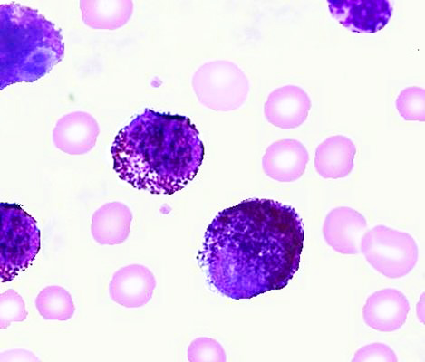
Notes:
Mast cells. The dark purple granules are full of histamine, bradykinin, and various cytokines: chemical messengers that trigger inflammation. Although these are free in the blood due to a mast cell leukemia, most are in the skin and mucous membranes that line the airways, lungs and gastrointestinal tract. You can’t see them as they are so small, but these mast cells are covered with antibodies. Public domain via Wikimedia Commons, courtesy Ayman Qasrawi.

Slide 10
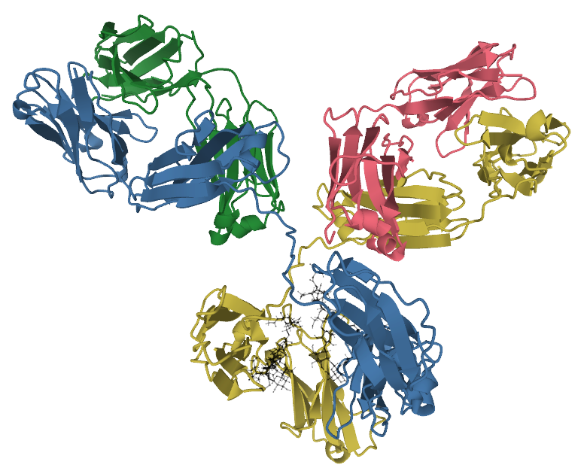
Notes:
This is part of your immune system: an antibody, in a diagram showing the details of how the proteins in it are folded up. You need to memorize what this looks like. Just kidding.
Licensed under the Creative Commons Attribution-Share Alike 4.0 International license via Wikimedia Commons, courtesy Tokenzero.

Slide 11
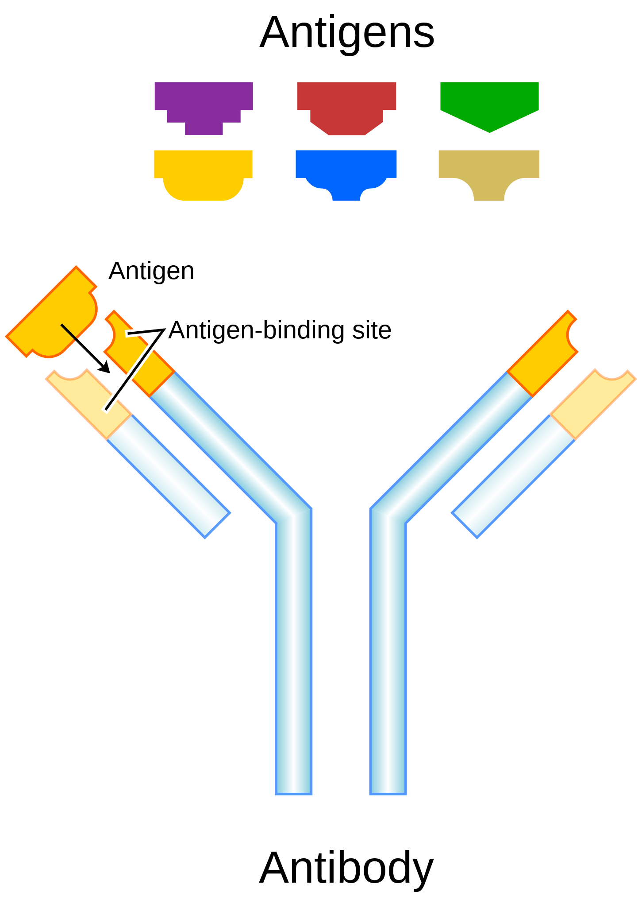
Notes:
This is a more useful abstraction. This you DO need to understand. In this diagram, the light-blue rods are the constant region, and the yellow bits at the end are the variable regions That variable region is crafted by your immune system to bind and recognize specific antigens: parts of enemy bacteria, viruses – and in the case of allergies and anaphylaxis, parts of pollen, mold spores and beesting venom. Note that only the yellow antigen will bind and activate this antibody. These antibodies can be free-floating in your blood and extracellular fluid, for example in your skin, or attached to cells of your immune system. When the correct antigen binds to the variable region, the bottom of the constant region will activate the immune system cell to which it attaches. That’s how your immune system recognizes antigens from bad things like certain bacteria or viruses. It’s also how your immune system gets confused and reacts to relatively benign things like pollen, mold spores or beesting venom, and causes an allergic reaction. We call those relatively benign things like pollen, mold spores and beesting venom allergens: antigens that cause allergy.
Public domain via Wikimedia Commons, courtesy user Fvasconcellos.

Slide 12

Notes:
Here is a mast cell with two antibodies attached to it. The antibodies are attached to the cells via the bottom of the Y, the constant region.
Public domain via Wikimedia Commons, courtesy US National Institutes of Health.

Slide 13
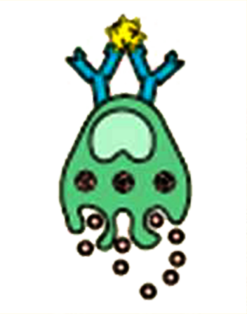
Notes:
When a ragweed pollen bit attaches to the antibodies, they send a message to the cell to degranulate: to dump its load of histamine, bradykinin and cytokines into the extracellular fluid. We are not going to talk further about bradykinin or cytokines as (a) it’s too complicated, (b)) for our purposes they aren’t as important as histamine and (c) we really don’t know squat about them. Double negative used intentionally to emphasize how little we know about them, following Shakespeare’s use of double negatives. This signals other mast cells to degranulate as well sin a feedback situation like when the speaker with the microphone gets too close to the speaker. These chemicals also directly cause itching and swelling.
Public domain via Wikimedia Commons, courtesy US National Institutes of Health.

Slide 14
Histamine and Antihistamine
Histamine Receptors
Cells sense histamine via receptors on the cell surface.
Receptor has a socket imilar to socket on antibody
Antihistamines fit into the socket and block it from histamine
Multiple slightly different histamine socket shapes

Slide 15
Histamine and Antihistamine
H1 Histamine Receptor
Found on mast cells in skin and mucous membranes
Original “antihistamines” blocked this receptor, thus, “H1 receptor”
H2 Histamine Receptors
Found in lining of stomach
Activation > acid secretion
“H2 blockers” decrease stomach acid
Notes:
Mucous membranes are the “skin” of the airways. And so now the term “antihistamines” now refers to H1 antihistamines, and “H2 blockers” refers to those to decrease stomach acid.

Slide 16
H1 Antihistamines
First-generation H1 antihistamines
diphenhydramine: original Benadryl
chlorpheniramine: Chlor-Trimeton
First-generation antihistamines in:
NyQuil
Dimetapp
Tylenol PM
Advil PM
Motrin PM
Percogesic
Aleve PM
Triaminic Night Time
Theraflu
Mucinex Night Time
Sudafed PE Sinus Congestion Night
Vick’s Night
Delsym Night Time
and a bunch of others.
Notes:
Now there are zillions of products using the “Benadryl” label, but when medical people say “Benadryl” they mean diphenhydramine.

Slide 17
First-Generation H1 Anthistamines
Penetrate blood-brain barrier and affect brain histamine receptors
Make you sleepy, decrease your mental abilities and reflexes
50 mg Benadryl impairs > alcohol 0.8
Anti-itch/sedating effects last 4-6 hours but mental effects 12 hours
International organizations say “ban all first-generation antihistamines”

Slide 18
First-Generation H1 Anthistamines
Why ban first-generation antihistamines?
Unwanted side effects
Kill people by vehicular homicide
Better alternatives available
Better alternatives also cheap generics
Don’t put them in your kits.

Slide 19
Second-Generation H1 Anthistamines
Don’t cross blood-brain barrier like first-generation antihistamines
Supposedly no sedating effects
Longer-lasting anti-allergy effects (12-24 hours)
Cheap generics available

Slide 20
Second-Generation H1 Anthistamines
Specific brands:
cetirizine (e.g., Zyrtec) and almost-the-same levocetirizine (e.g., Xyzal): make many people groggy/sleepy
loratadine (e.g., Claritin, Alavert) and almost-the-same desloratadine (e.g., Clarinex) make some sleepy
fexofenadine (e.g., Allegra) doesn’t make essentially anyone sleepy
Notes:
“Essentially” in there just because people are different and maybe one in a million will get sleepy with fexofenadine.

Slide 21
Second-Generation H1 Anthistamines
Fexofenadine (e.g., Allegra):
Cheap
Available in chewable kid’s size
Almost never any side effects
Add some 180 mg tablets to your personal wilderness first aid/medical kit instead of Benadryl

Slide 22
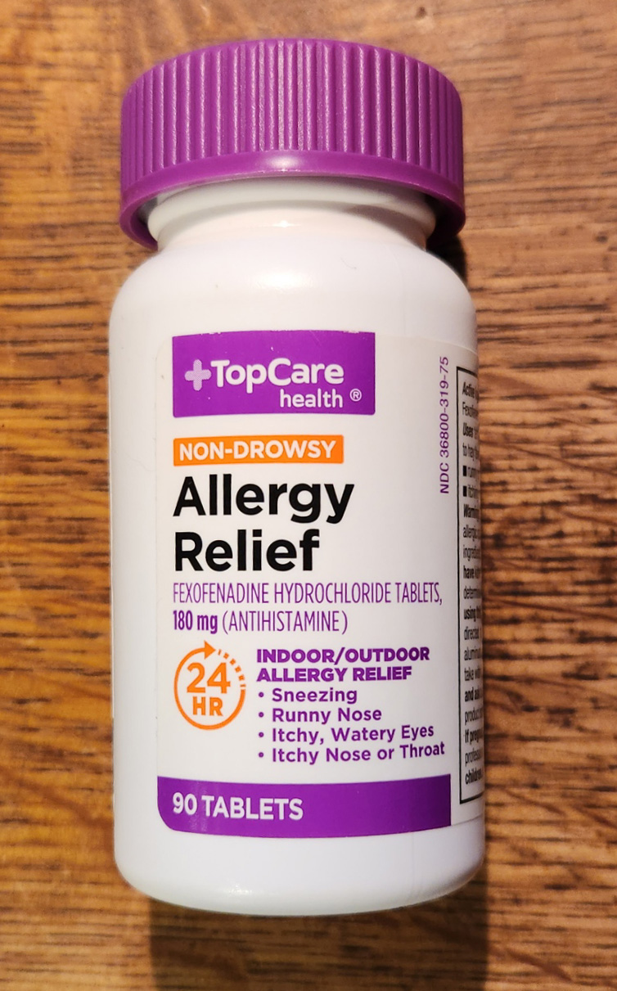
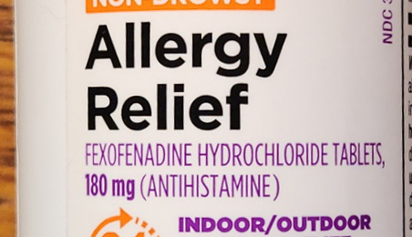
Notes:
This is the H1 antihistamine you want in your personal wilderness first aid/medical kit.
Photo by Keith Conover

Slide 23
-D Versions and Decongestants Don’t Work
“-D” versions of antihistamines also have a decongestant
Oral decongestants don’t work and have bad side effects
Oral decongestants also available separately, names on next slide
Notes:
Like “Allegra-D”

Slide 24
Oral Decongestants
pseudoephedrine
Silfedrine
Sudafed
Suphedrin
phenylephrine
Sudafed PE
Suphedrin PE
Notes:
Like “Allegra-D”

Slide 25
H2 Antihistamines (H2 Blockers)
Marketed for acid indigestion but work for hives and anaphylaxis (but not much for nasal or eye allergies)
Brand names:
famotidine (e.g., Pepcid AC)
cimetidine (e.g., Tagamet HB)
nizatidine (e.g., Axid AR)
famotidine has least drug interactions > best

Slide 26
Best H2 Blocker: famotidine
Pepcid Complete chewable (
famotidine plus antacid
Brand name tastes better, dissolves in mouth quicker than generics
Can take without water
Kids can take
Can chew and hold in mouth > maybe some absorption from veins under tongue > faster than swallowing pills
For hives or anaphylaxis: FOUR 10 mg tablets at once
Notes:
No dose-related toxicity, 40 mg may be overkill but I have treated many cases of hives and anaphylaxis with this dose without any problems, though in the ER I usually give it IV to work faster.

Slide 27
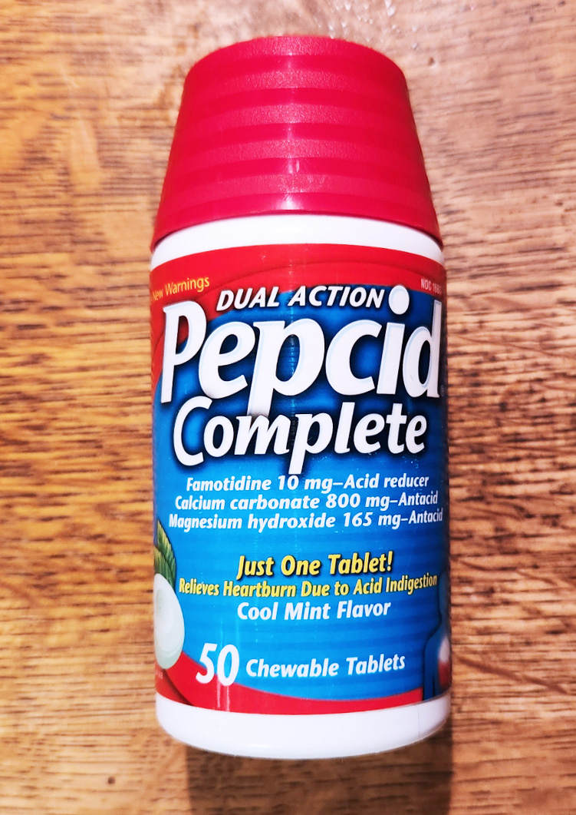
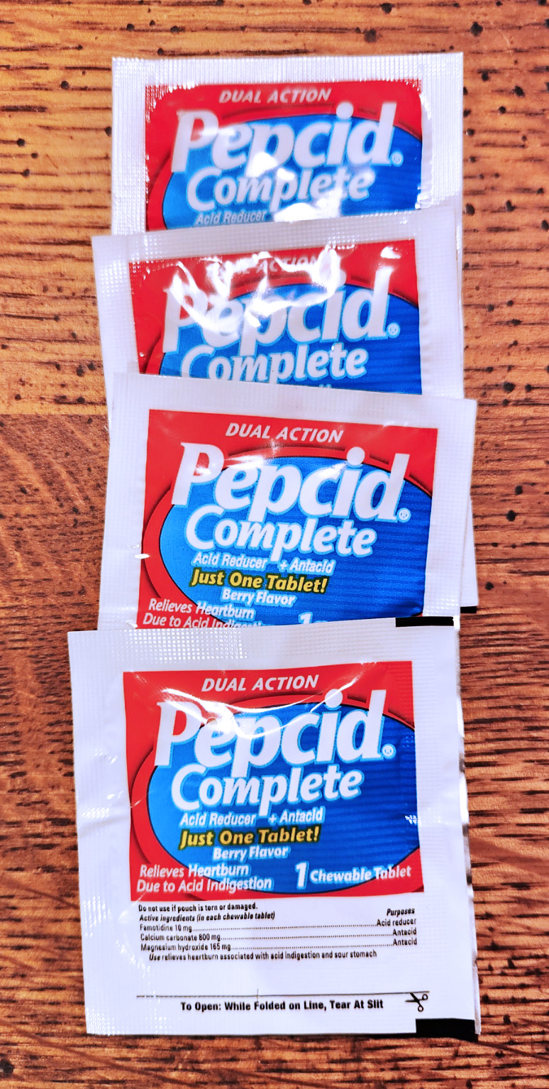
Notes:
Photo by Keith Conover

Slide 28
Proton-Pump Inhibitors (PPIs)
Like H2 blocker antihistamines, marketed for acid indigestion
Unlike H2 blockers, do nothing for hives/anaphylaxis
omeprazole (e.g., Prilosec OTC)
lansoprazole (e.g., Prevacid 24HR)
esomeprazole (e.g., Nexium 24HR)
omeprazole and sodium bicarbonate (e.g., Zegerid OTC)

Slide 29
Steroids
Corticosteroids = “steroids” in medicalese
For delayed hypersensitivity reactions, do nothing for immediate hypersensitivity reactions.
Work slowly (hours to days) unlike antihistamines (minutes to hours).
Available in over-the-counter nasal sprays for allergic rhinitis
Available in over-the-counter 1% hydrocortisone cream for mild poison ivy
Available in prescription pills and high-potency creams for more severe poison ivy
Notes:
Anabolic Steroids are used for boosting athletic performance and landing you in jail as they are quite illegal.

Slide 30
Allergy Syndromes
Delayed:
Allergic conjunctivitis (eye allergies)
Allergic rhinitis (hay fever, nasal allergies)
Allergic rashes (poison ivy, contact dermatitis)
Asthma (not talking about that now, no time)
Immediate:
Hives
Angioedema
Anaphylaxis
Notes:
From least serious to most serious.
Asthma needs a whole separate lecture.

Slide 31
Allergic Conjunctivitis
Try over-the-counter allergy eyedrops
They all work about the same.
If you also have nasal allergies:
fexofenadine will help
a steroid nasal spray will help

Slide 32
Nasal Allergies
First: try an over-the-counter cheap generic steroid nasal spray (e.g., fluticasone)
If that doesn’t work, add the over-the-counter (although maybe cheaper by prescription) antihistamine nasal spray azelastine (e.g., Astepro)
Or, if itching and sneezing are a big problem, try fexofenadine first
Notes:
My wife says the Costco generic fluticasone is best as it smells like honeysuckle.

Slide 33
Nasal Decongestants
oxymetazoline (lasts 12 hours)
Afrin
many generics
phenylephrine (lasts 6 hours)
Neosynephrine
many generics
Effective for nasal congestion
Help stop nosebleeds
Addicting if use more than 7 days
Suitable for your vehicle/duffel bag
Notes:
Since we’re talking about nasal sprays…
“Addicting” in this case means something called “rhinitis medicamentosa”: you have to use more and more Afrin to be able to breathe through your nose. The bottle says no more than 3 days, the more recent research says 10 days which is why I recommend 7 days. Helps sinus infections and ear infections, in the case of ear infections behind the eardrum (“otitis media”) as much if not more than an antibiotic.

Slide 34
Poison Ivy
Recognition, decontamination beyond the scope of this lecture
Itch control:
fexofenadine 180 mg twice a day (recommended by dermatologists)
Over-the-counter anti-itch cream with pramoxine and menthol (e.g., CVS version)
No creams with benzocaine or lidocaine: tend to cause allergic reactions
Mild : over-the-counter 1% hydrocortisone steroid cream makes it better faster
Worse cases: need prescription steroid

Slide 35
Notes:
Hives again.
Licensed under the Creative Commons Attribution-Share Alike 3.0 Unported license via Wikimedia Commons, courtesy Enochlau.

Slide 36
Notes:
Angioedema of the tongue again.
Licensed under the Creative Commons Attribution-Share Alike 3.0 Unported license via Wikimedia Commons, courtesy James Heilman, MD

Slide 37
Beestings
If stung, and stinger still in you, try to flip it off with a fingernail.
You only have two second to flip it off, so forget about using a credit card or knife.
Sting-eeze (potent combination of local anesthetics) very helpful for pain relief
Can result in either a local delayed hypersensitivity rash (treat like poison ivy) or hives, angioedema or anaphylaxis. Even if you’re never been stung before.

Slide 38
Hives and Angioedema
Wilderness first aid/medical care for mild hives or angioedema:
Pepcid Compete or equivalent, 4 tablets chewed, held in mouth, and then swallowed.
fexofenadine 180 mg, one tablet swallowed.
For more severe angioedema, or angioedema not responding to above (“is your voice hoarse?”)
Epinephrine 1:100 0.3-0.5 mg IM
Epi-Pen works
Vials of epi and syringe and needle works
May need to repeat in 15 minutes, several times
Notes:
Both NOLS and Outward Bound train their trip leaders to use vials of epi rather than Epi-Pens and their programs have been successful as published in the medical literature. In AMRG we are in the process of setting this up right now, with training and credentialing for anyone, even at the wilderness first aid level, who wants to carry vials of epinephrine in their personal wilderness first aid/medical kits. Hoarseness is the first sign of swelling deep in the airways and always an indication for an epinephrine injection.

Slide 39
ACEis and ARBs
ACE (angiotensin converting enzyme) inhibitors, known as ACEi, commonly used effectively and safely for high blood pressure and some other problems.
ARBs, (angiontensin receptor blockers) are used similarly.
All of the above, even if used safely for years, predispose to sudden onset of angioedema.
Treat like any other angioedema.
Never take an ACEi or ARB again, and call your doctor tomorrow to discuss alternative medications.

Slide 40
Anaphylaxis
A sudden bad allergic reaction
Not just a vagal reaction to pain that makes you lightheaded and have to lie down
Definition depends on which journal you read:
Hives
Angioedema, with or without airway swelling
Shock, either from loss of fluid from angioedema or other causes; treat for shock if needed
Slow or fast heart rate
Asthma-like wheezing: treat for asthma if needed
Notes:
Treating for shock and asthma beyond the scope of this talk.

Slide 41
Biphasic Anaphylaxis
Sometimes people get over anaphylaxis and then it comes back.
Average time to recur: 10 hours. Longest time: 78 hours.
Always milder than initial attack.
Anyone who recovered from anaphylaxis should stay close to epinephrine for the next day (near street EMS or near someone in the field/backcountry with epi)

Slide 42
Allergy and Anaphylaxis
Keith Conover, M.D., FACEP, Allegheny Mountain Rescue Group
References in Survival and Wilderness Travel Chapter in http://www.conovers.org/ftp/AppSAR-Drafts
Notes:
Reminder that references and more information and links to even MORE information available in the current draft of the Appalachian Search and Rescue textbook’s Chapter 1, Survival and Wilderness Travel, at the link on the screen.

