Slide 1
Basket Hitch Anchors
Joe Ray/Keith Conover,
Allegheny Mountain Rescue Group

Slide 2
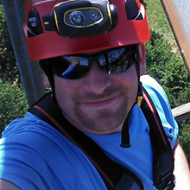
What’s the best anchor?
In 2017, helped by a Mountain Rescue Association grant he obtained, Joe Ray, with help from others in AMRG, did some tests on basket hitches

Slide 3
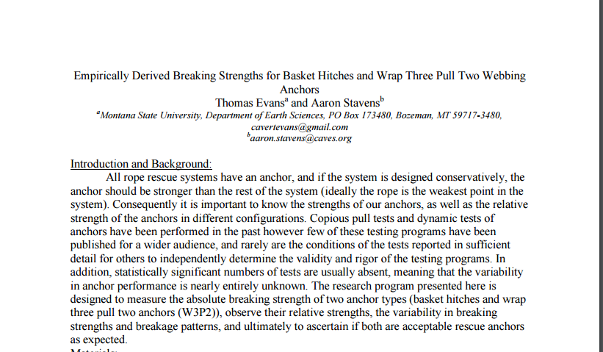
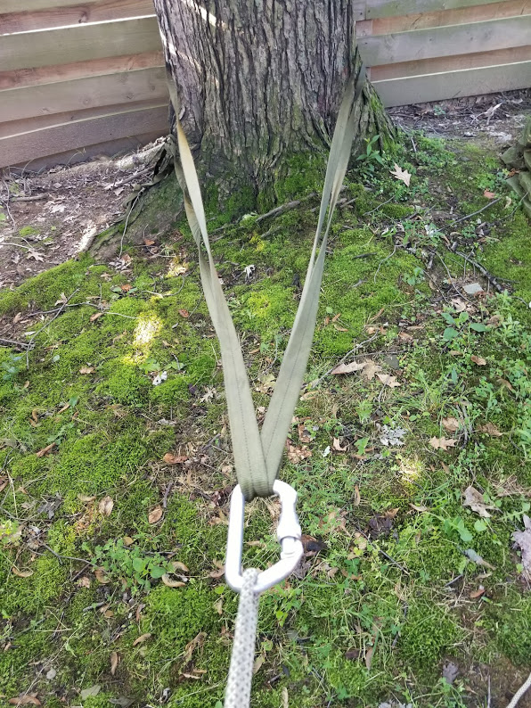
Basket Hitch
4. Basket hitches break, on average, at a higher strength and with less variability (smaller standard deviation) than W3P2 anchors.
5. Basket hitches appear to be between 705 to 775 lbs stronger than W3P2 anchors in the configuration tested.
Notes:
How many of you have ever tied a wrap-3, pull-2 anchor? Is it a pain? Wouldn’t you rather just loop a sling around the tree? Well, maybe it’s actually better to do just that.
Inspired by Thomas Evans’ and Aaron Stavens’ testing from 2011, AMRG became interested in potentially replacing the wrap 3, pull 2 anchor with the basket hitch in certain situations.
While Evans and Stavens work was compelling, it was in the laboratory and we wanted to test the basket hitch in real world applications.
We had concerns with some of the ways we saw the basket hitch being used in real world applications.

Slide 4
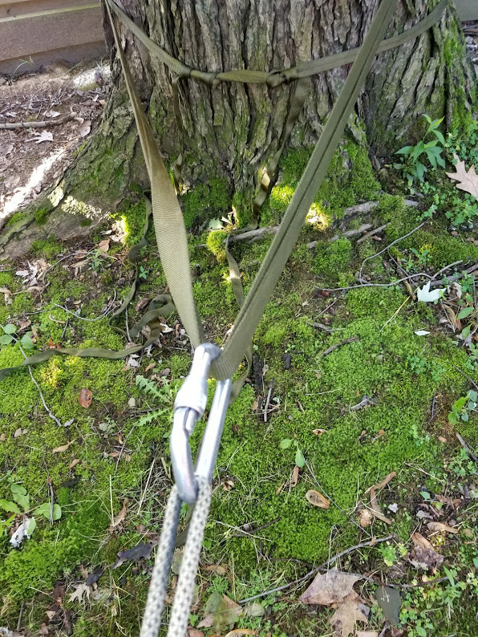
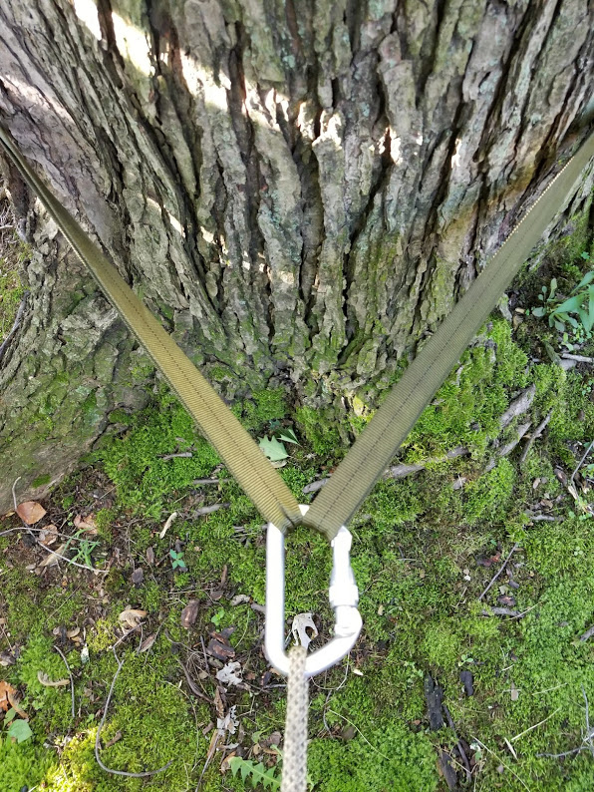
Notes:
Wrap-3 pull-2 on the left, basket hitch on the right. Anything wrong with either of these two riggings? 1. angle 2. Three webbings stressing the biner: Triaxial (3 axes) loading.

Slide 5
The Hypothesis
A basket hitch anchor tied with a high internal angle and using a single carabiner will cause off-axial loading to such an extent that the carabiner could be damaged or fail:
  Before the webbing fails
  At loads within our standard 10:1 static safety factor

Slide 6
Methods
Testing was done using standard rope rescue equipment
All equipment was purchased new for the purposes of this testing
MRA provided a grant for the test equipment and Rock Exotica Enforcer load cells for the testing
Anchors used were those typically used in rope rescue systems (trees, telephone poles)
Cribbing was used in some tests to maximize the angle of the webbing

Slide 7
Methods
Force was slow-pull using several different methods in various tests:
mechanical advantage rope systems
A 3 ton come-a-long
6 ton winch on Harmony Fire Districts Rescue 22 truck
Measurements of the internal angle of the anchor were taken at the following intervals:
50 lbs, 1000 lbs, 2000 lbs, 3000 lbs, 4000 lbs, 5000 lbs

Slide 8
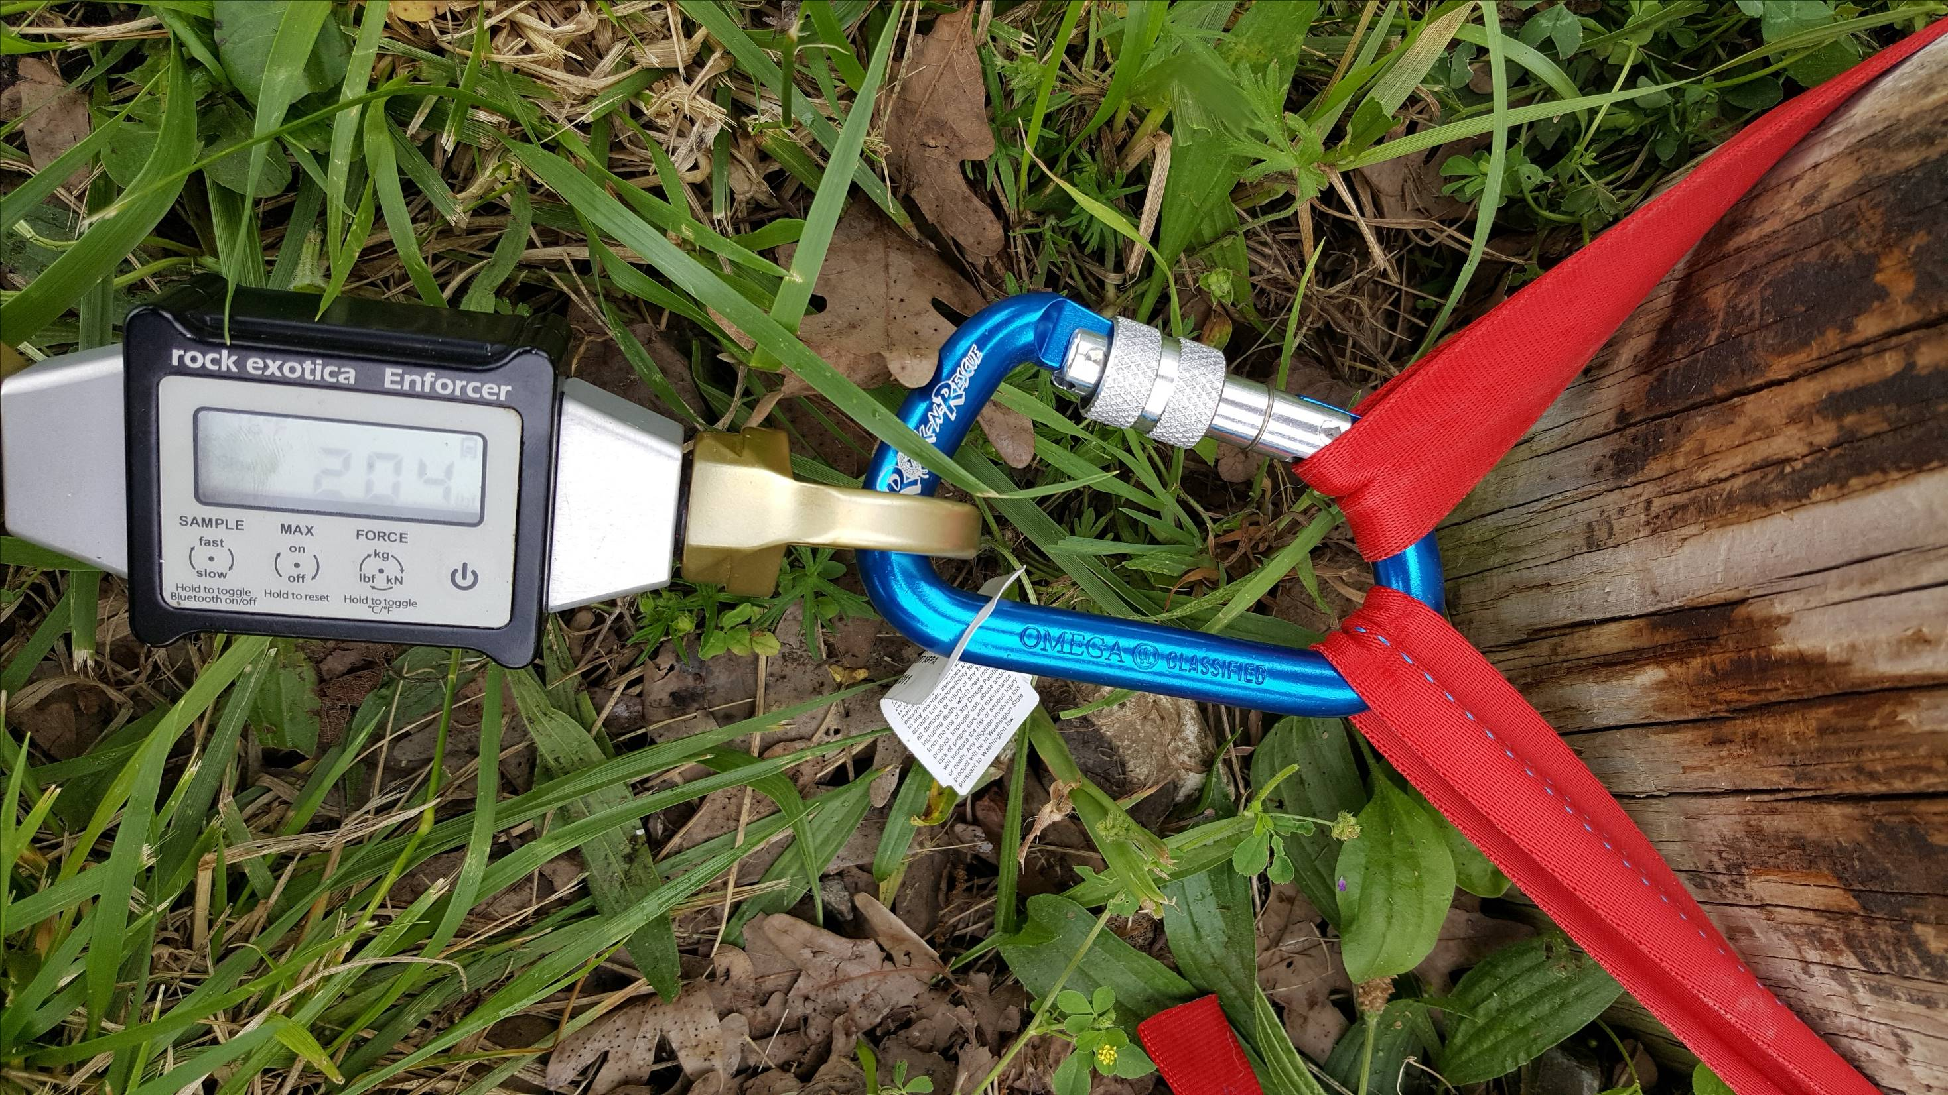
Notes:
Trying to make a really shallow angle to stress the biner

Slide 9
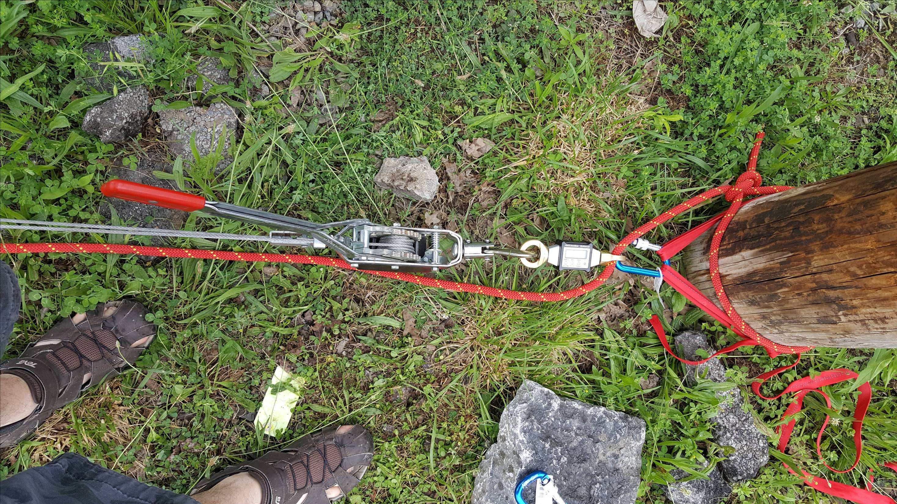

Slide 10
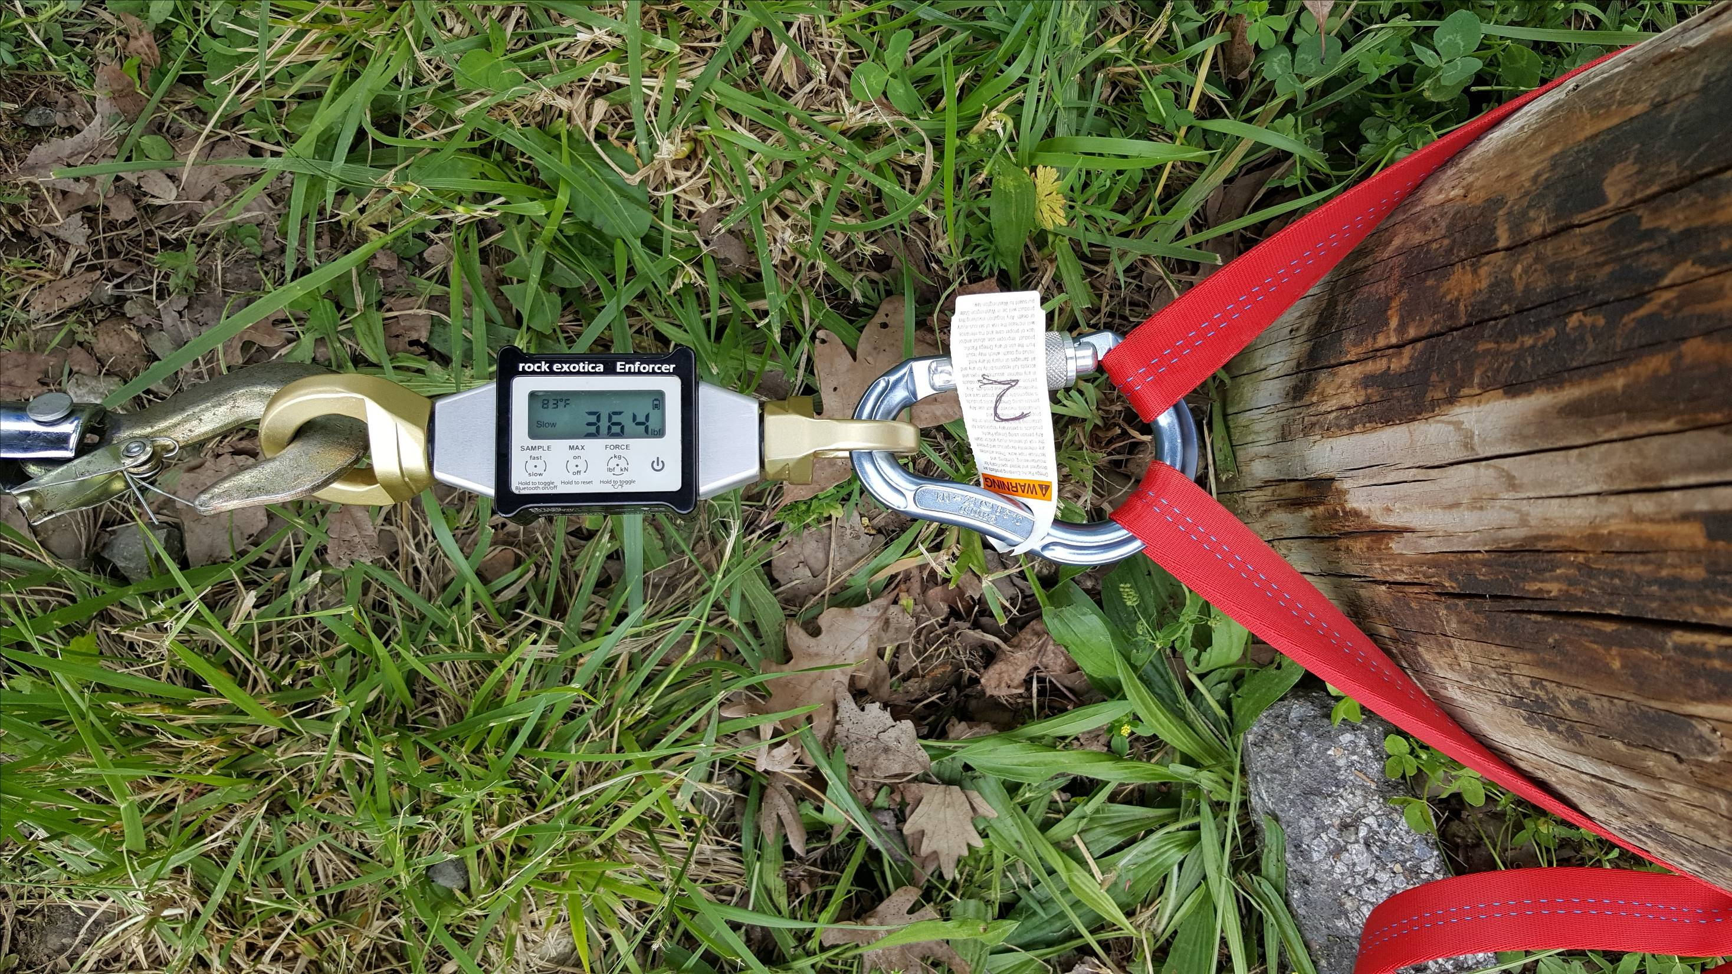
Notes:
Also with a pearabiner

Slide 11
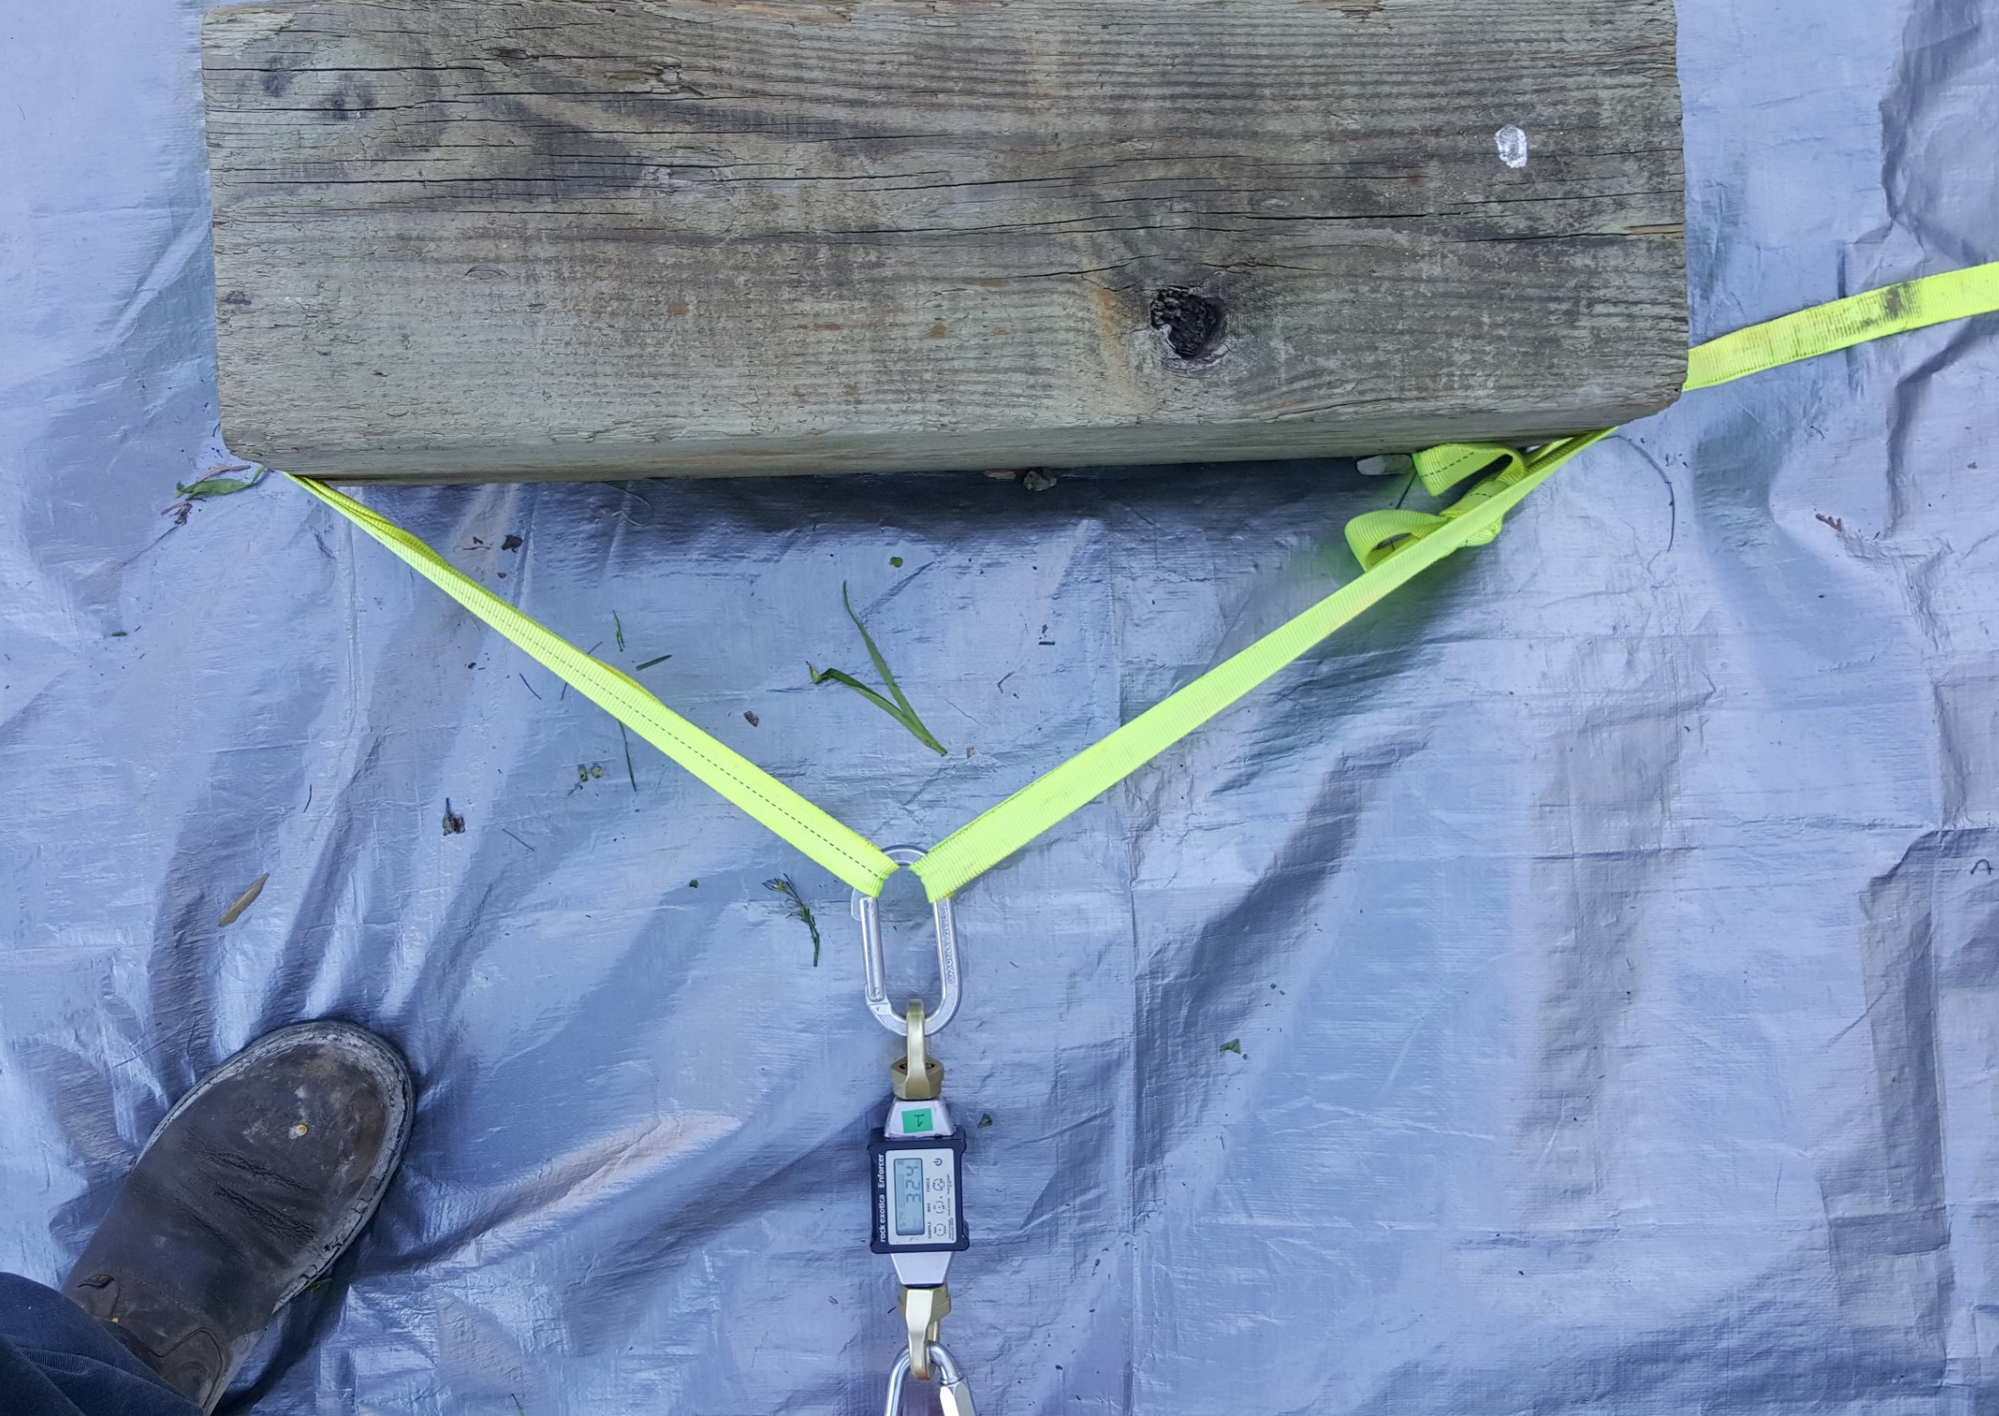
Notes:
Cheating to get really broad angles. Making gear explode is fun.

Slide 12
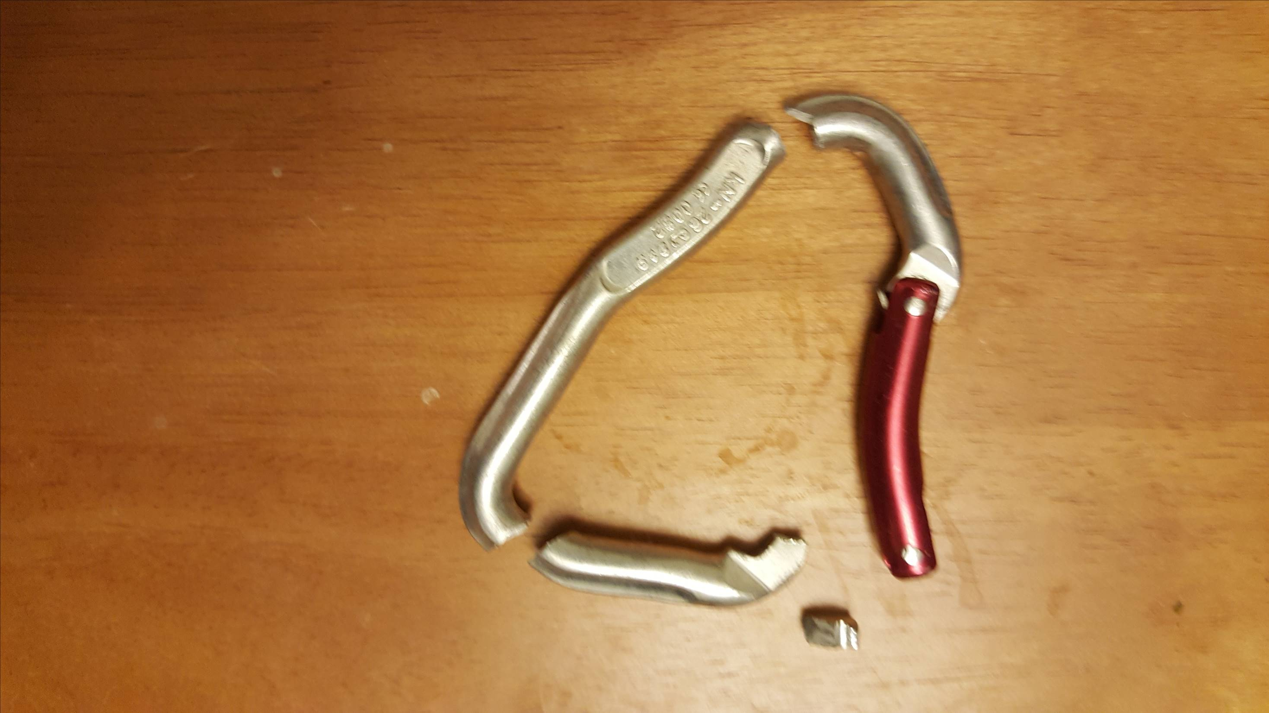
2,200 lbs

Slide 13
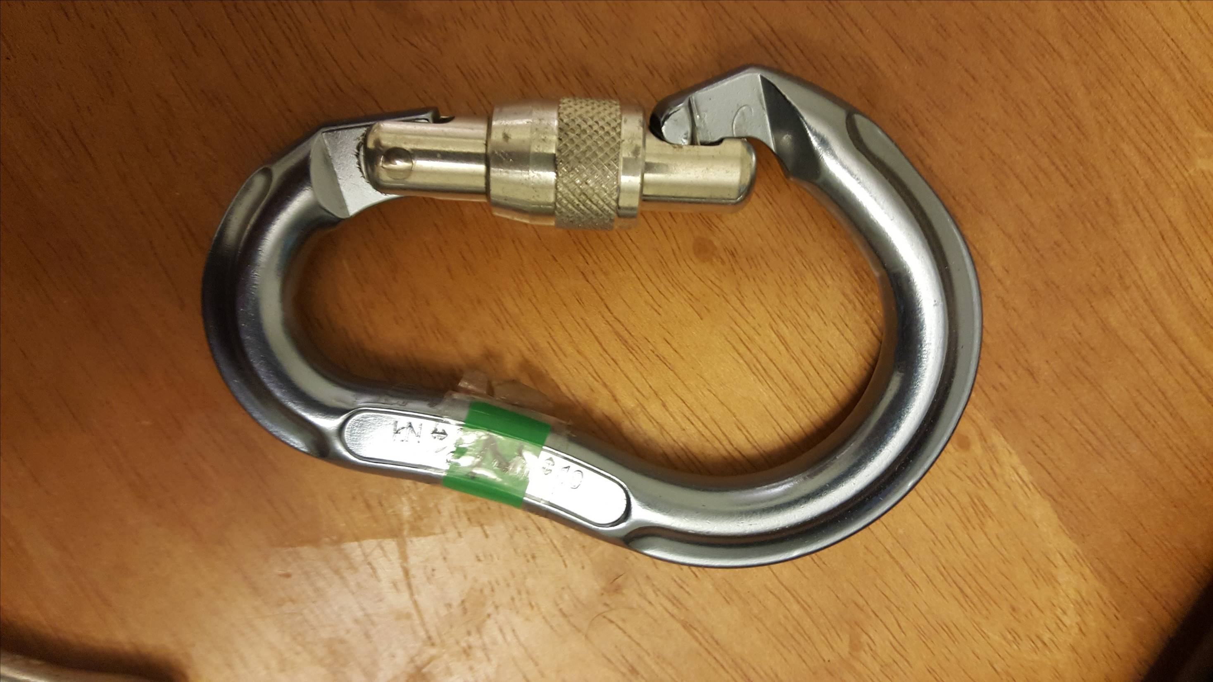
5,808 lbs

Slide 14
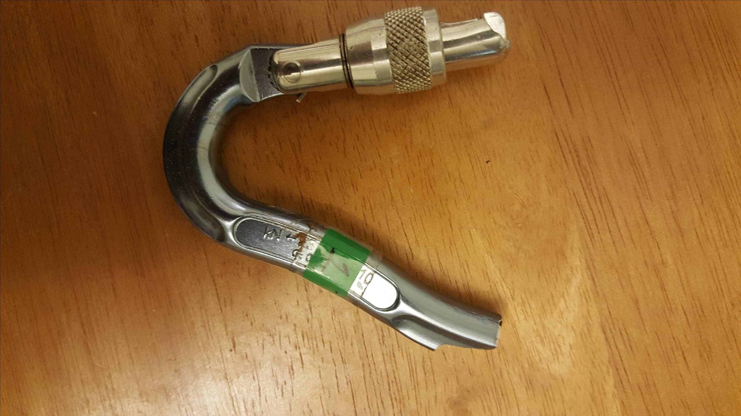
4,144 lbs

Slide 15
Results
Initial internal anchor angle: 86-124°
Under load, webbing stretched, and angles decreased 10%-29%
3,000 lbs,: 74-94°
Larger initial angle = larger stretch (3-4”)

Slide 16
Results
Steel carabiners: no damage or failures
Aluminum locking carabiners: failures within our 10:1 safety margin, as low as 4,144lbs/18.42 kN
Aluminum non-locking climbing carabiners, as low as 2,200 lbs/9.78 kN
The more exotic the shape of the carabiner, the more likely to sustain damage or fail
On asymmetrical carabiners, the wide side experienced more issues than the narrow side

Slide 17
Other issues and failures
9 Prusiks melted/destroyed
One tree pulled out of ground at <4000lbs
1 load releasing hitch melted at ~3000lbs
Anchor strap damaged by abrasion on the anchor
1 screw link was damaged under normal usage

Slide 18
Conclusion and Recommendations
The basket hitch is as strong or stronger than the W3P2 when tied with an internal angle less than 45 degrees: avoid extreme angles!
Use a rigging plate and/or multiple carabiners to avoid triaxial loading on a single carabiner
If using an asymmetrical carabiner, position the smaller end of the carabiner on the anchor side and the wider end on the load side

Slide 19
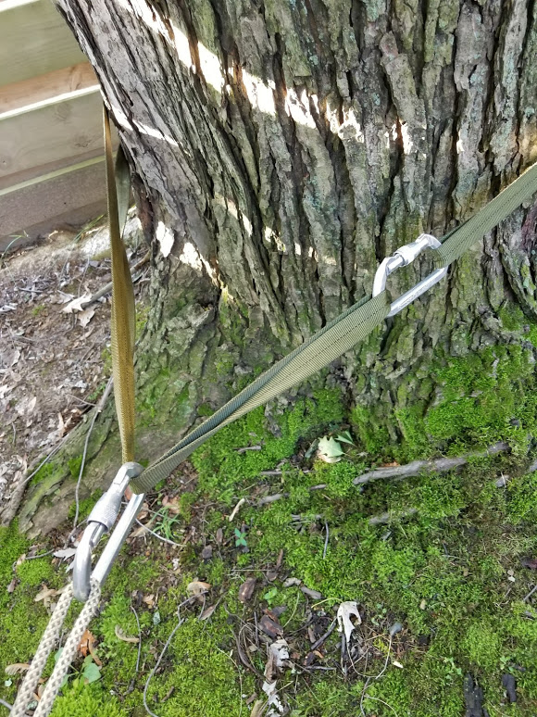
Notes:
This “Modified Basket Hitch” (or AMRG hitch if you wish) has two advantages over a “plain” basket hitch. First, no triaxial loading of the carabiner. Second, if the load direction shifts, unlike a “regular” basket hitch where all the stress can end up on one side, the Modified Basket Hitch/AMRG hitch is self-equalizing as the carabiner connecting the load to the hitch will slide a bit. Third – and this is an advantage if you like efficiency and a disadvantage if you look at it from a safety standpoint: with a biner weighting the end of the loop sling it’s easier to fling it around the tree and back to yourself. Or to fling it around the tree and hit yourself in the face.

Slide 20
Questions?
Joe Ray/Keith Conover,
Allegheny Mountain Rescue Group

