Slide 1
Cave Rescue
Keith Conover, M.D., FACEP, FASRC
Clinical Associate Professor, Department of Emergency Medicine, University of Pittsburgh
Appalachian Search and Rescue Conference
Medical Advisory Committee Chair
ASRC Field I/MRA Rescue Member,
Allegheny Mountain Rescue Group
Medical Advisor and Teaching Specialist,
Eastern Region, National Cave Rescue Commission

Slide 2
Cave and Above-Ground SAR:
  80% the same.
  What do they have in common?
Notes:
People say this all the time. It may not be exactly 80%, but that’s close. We’ll briefly consider what they have in common, and then go on to consider those things that are unique to cave rescue. Think about it to yourself before we go on to the next slide…

Slide 3
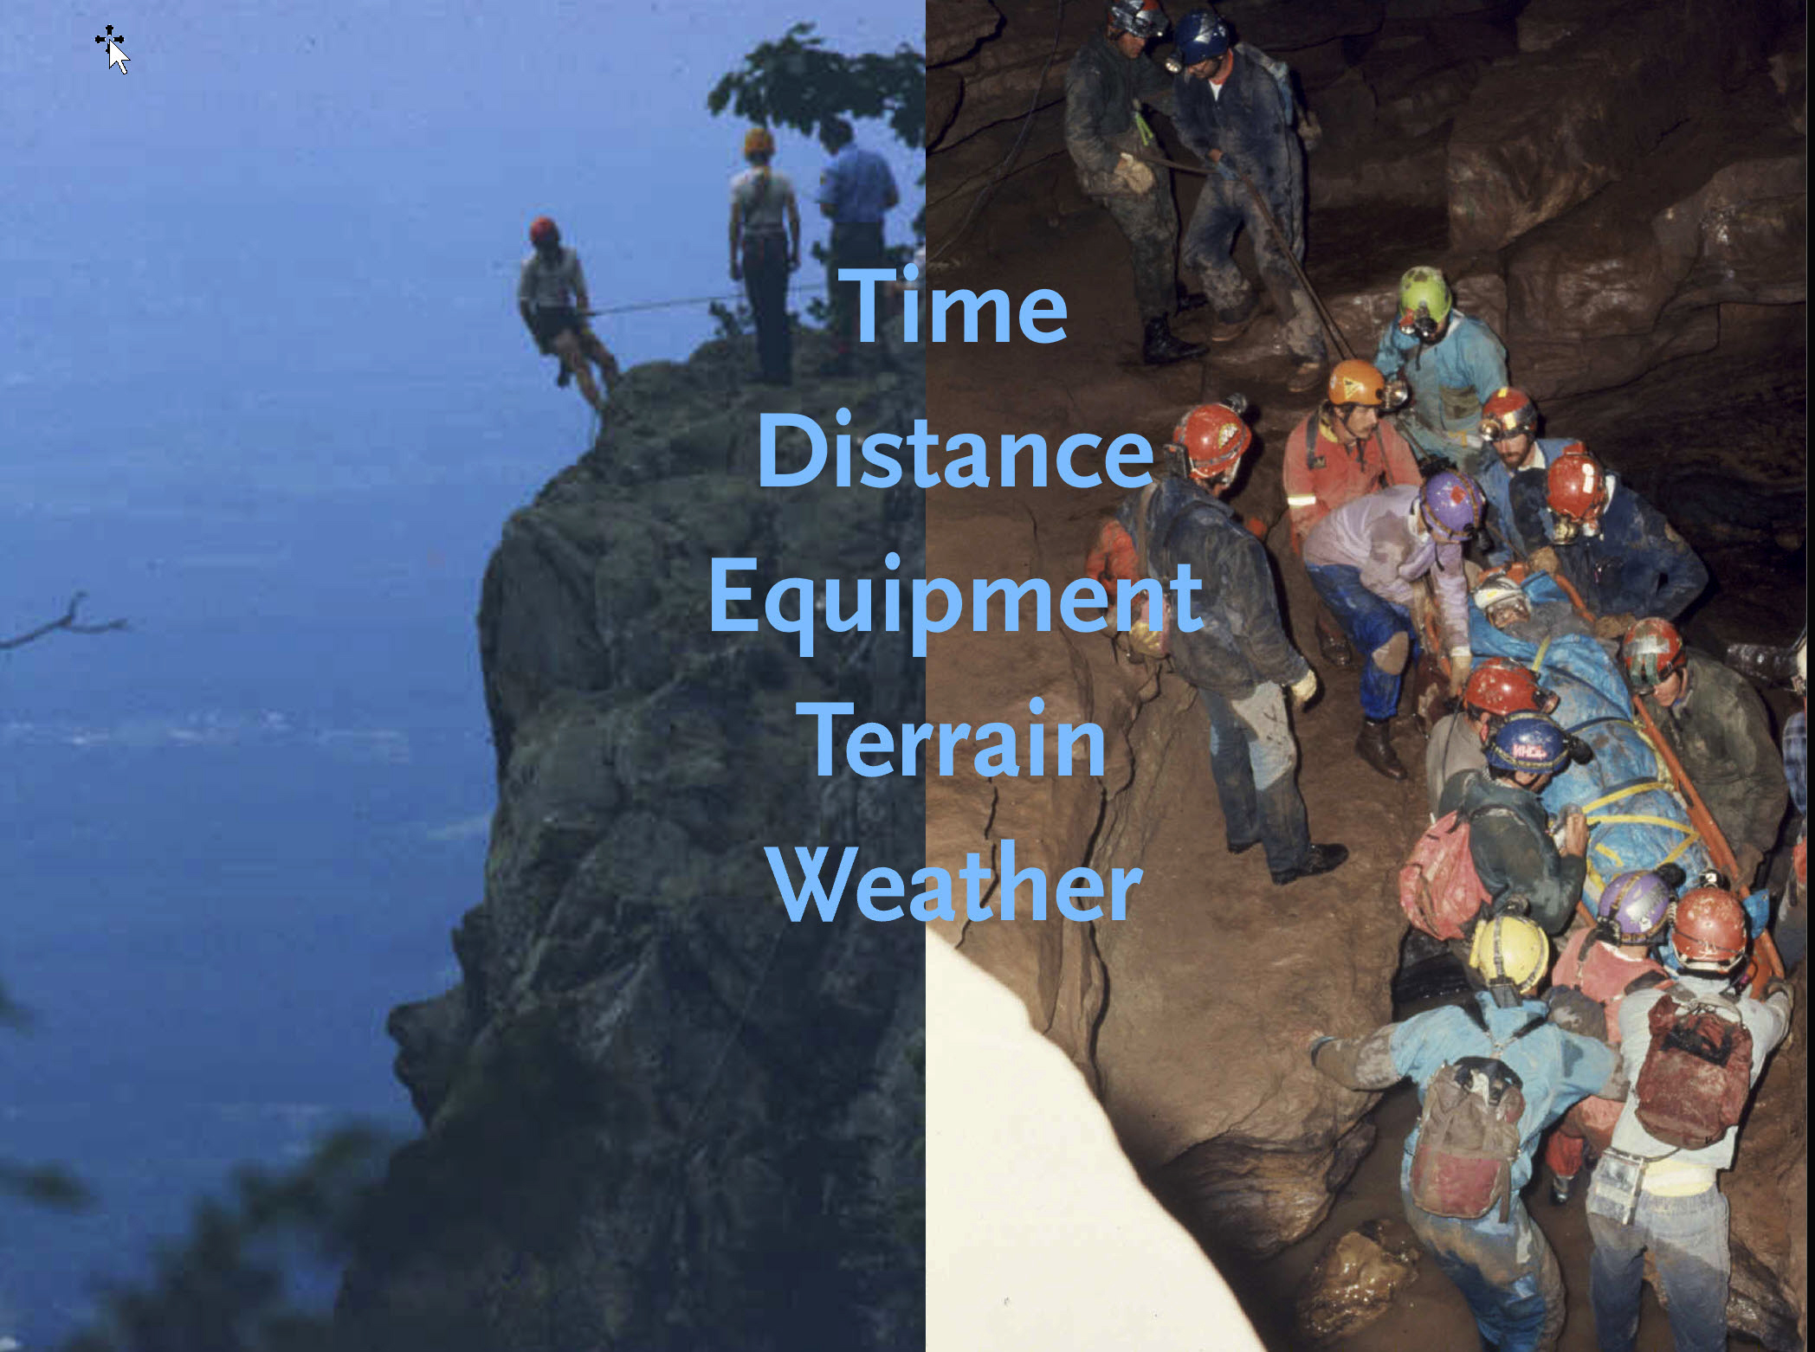
Time
Distance
Equipment
Terrain
Weather
Notes:
These are common features of what we call Austere EMS and Austere Medicine: wilderness, tactical and disaster.
Although, mostly – except for flooding – caves have climate instead of weather.
[Pictures by Keith Conover, covered under the Creative Commons by-sa of this presentation]

Slide 4
Cave and Confined Space:
  Cave ≠ Mine
  Cave ≠ Trench
  Cave ≠ Other Confined-Space
Notes:
Cave rescue is not like mine rescue, trench rescue, or for the most part like other confined-space rescue. It is a natural environment, not a built environment, and the hazards are quite different, though a few of the patient movement techniques may be similar. I can’t teach you about mine, trench, or urban/rural confined-space rescue as I know enough to know I don’t know squat about it.

Slide 5
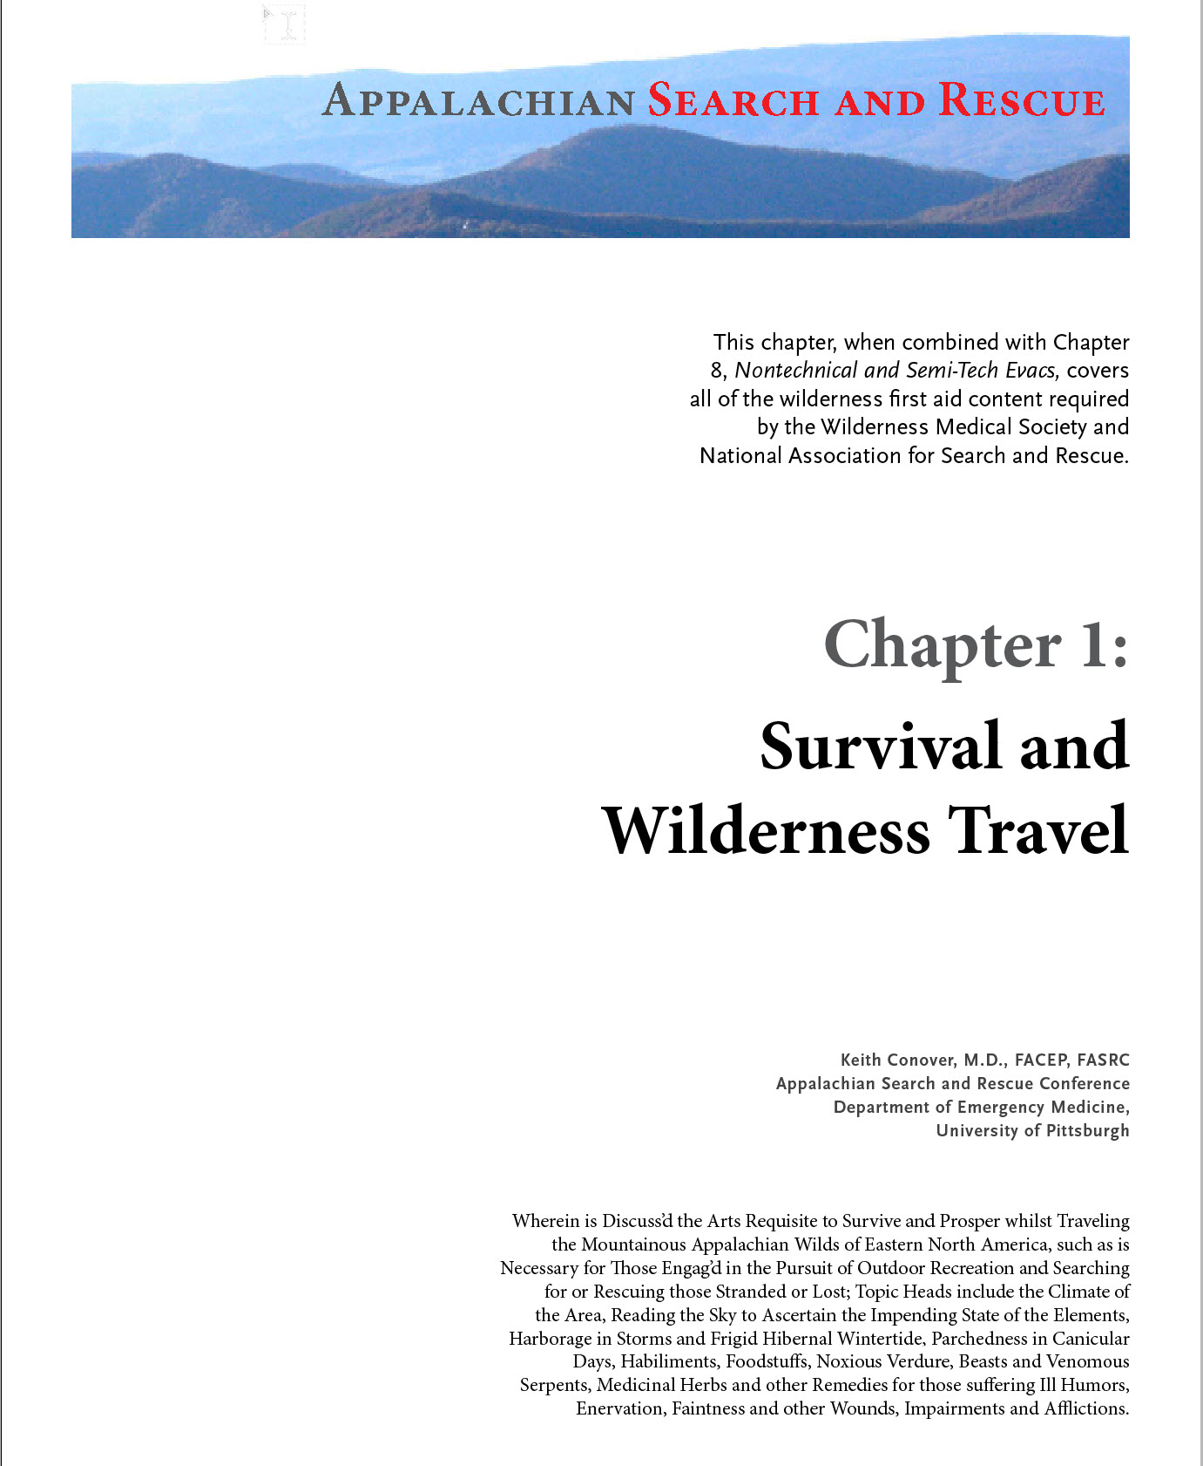
Notes:
Are you interested in some book-learning about backcountry search and rescue in the mid-Appalachians and nearby? With my colleagues, I’m in the process of writing a free, peer-reviewed online wilderness search and rescue textbook, and we post chapters as they become available.
It also includes all of the wilderness first aid topics required by the Wilderness Medical Society and National Association for Search and Rescue and is written at that level. However, it has enrichment – non-required footnotes and sidebars – of interest to any student of medicine, from the wilderness first aid level through paramedic level to board-certified attending level.
I will show you the URL where the chapters are posted on the next slide, in case you want to use your phone to take a picture. However, as this particular chapter, which has information on the cave environment for wilderness medicine and cave search and rescue, is still in draft form. But I’m also going to show you where you can access this and other draft chapters if you wish to get the latest and most complete information. Sssh, it’s a secret.
[covered by the Creative Commons by-sa of this presentation and the by-sar of the Appalachian Search and Rescue textbook.]

Slide 6


Appalachian
Search and Rescue textbook
conovers.org/ftp/AppSAR
conovers.org/ftp/AppSAR-Drafts
Notes:
The top URL and left QR code are the official releases, the bottom URL and right QR code are where the drafts are. I will also show this at the end.

Slide 7
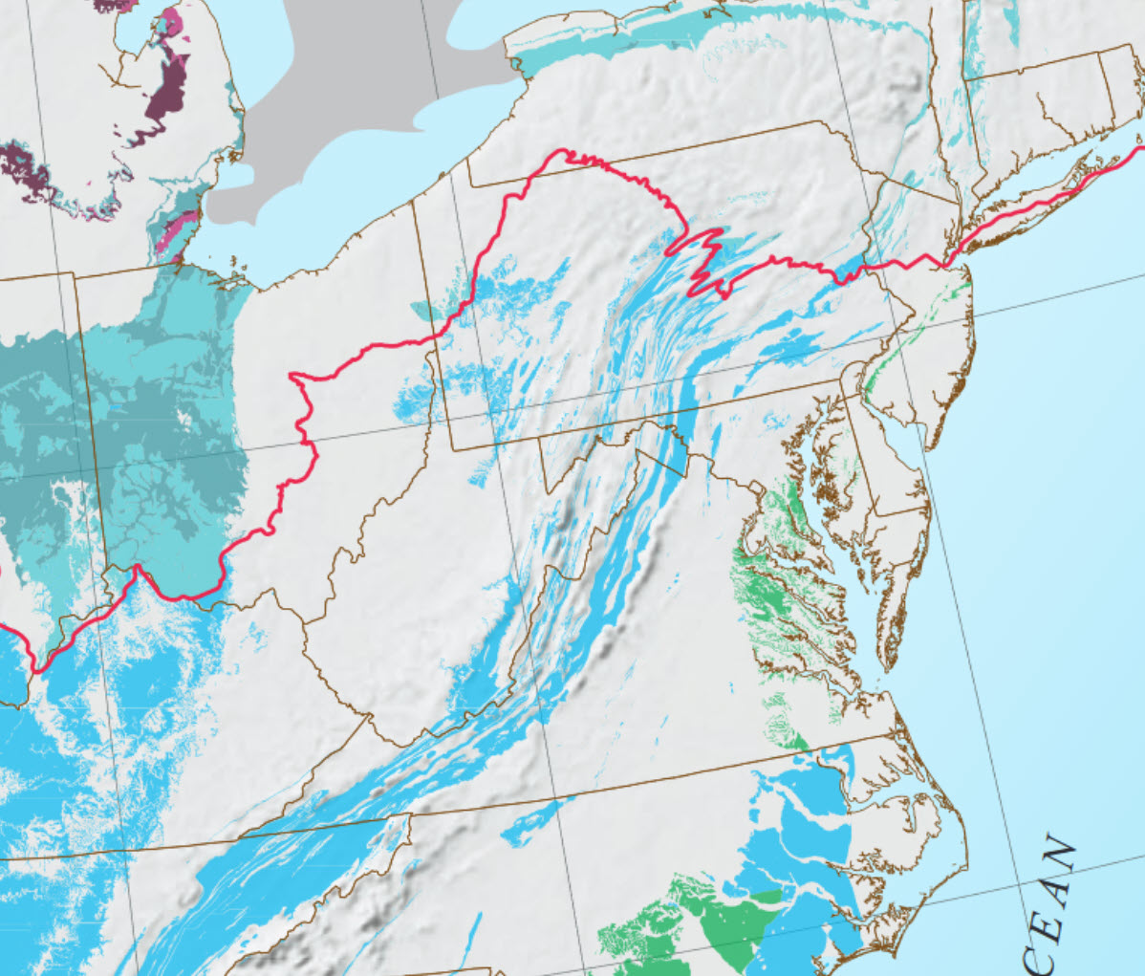
Notes:
Most of the caves around here are limestone solution caves, formed by rain percolating through the ground dissolving limestone. The blue shows where limestone caves can form. The red line is the southern limit of glaciers during the last ice age.[Public domain, US Geological Survey. https://pubs.usgs.gov/of/2014/1156/pdf/of2014-1156_hi-res-pdfs/of2014-1156_figure_1.pdf/]

Slide 8
Cave
Hazards

Slide 9

Notes:
Caves are scary. Some people, like me, find caves interesting and familiar and are comfortable there. Some people have irrational fears of caves; they know these fears are irrational, but just don’t like being in caves. While there are cave rescue teams where all members are trained to work in a cave, there are wilderness search and rescue teams that do cave rescue as part of what they do, like my Allegheny Mountain Rescue Group. Many of these teams require mountain rescue training and participation from all of their members, but due to these psychological factors, allow members to choose whether they will serve underground or not. During a cave rescue there is always plenty of above-ground work so this is not a problem for the team. [Public domain, copyright expired]

Slide 10
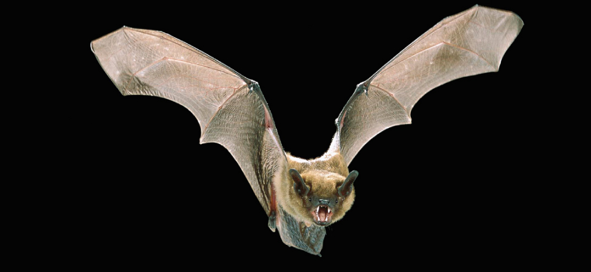
Notes:
Caves have vampire bats that will suck your blood! Well, not around here, only in Central and South America. They won’t get in your hair, either, their sonar is too good. And besides, you should be wearing a helmet anyway. There is some slight concern for aerosol rabies from the bat poop, so if you are sport caving on a regular basis you should consider getting your rabies shots. ﻿[Licensed under the Creative Commons Attribution 4.0 International license via Wikimedia Commons, courtesy OpenStax University Physics.]

Slide 11
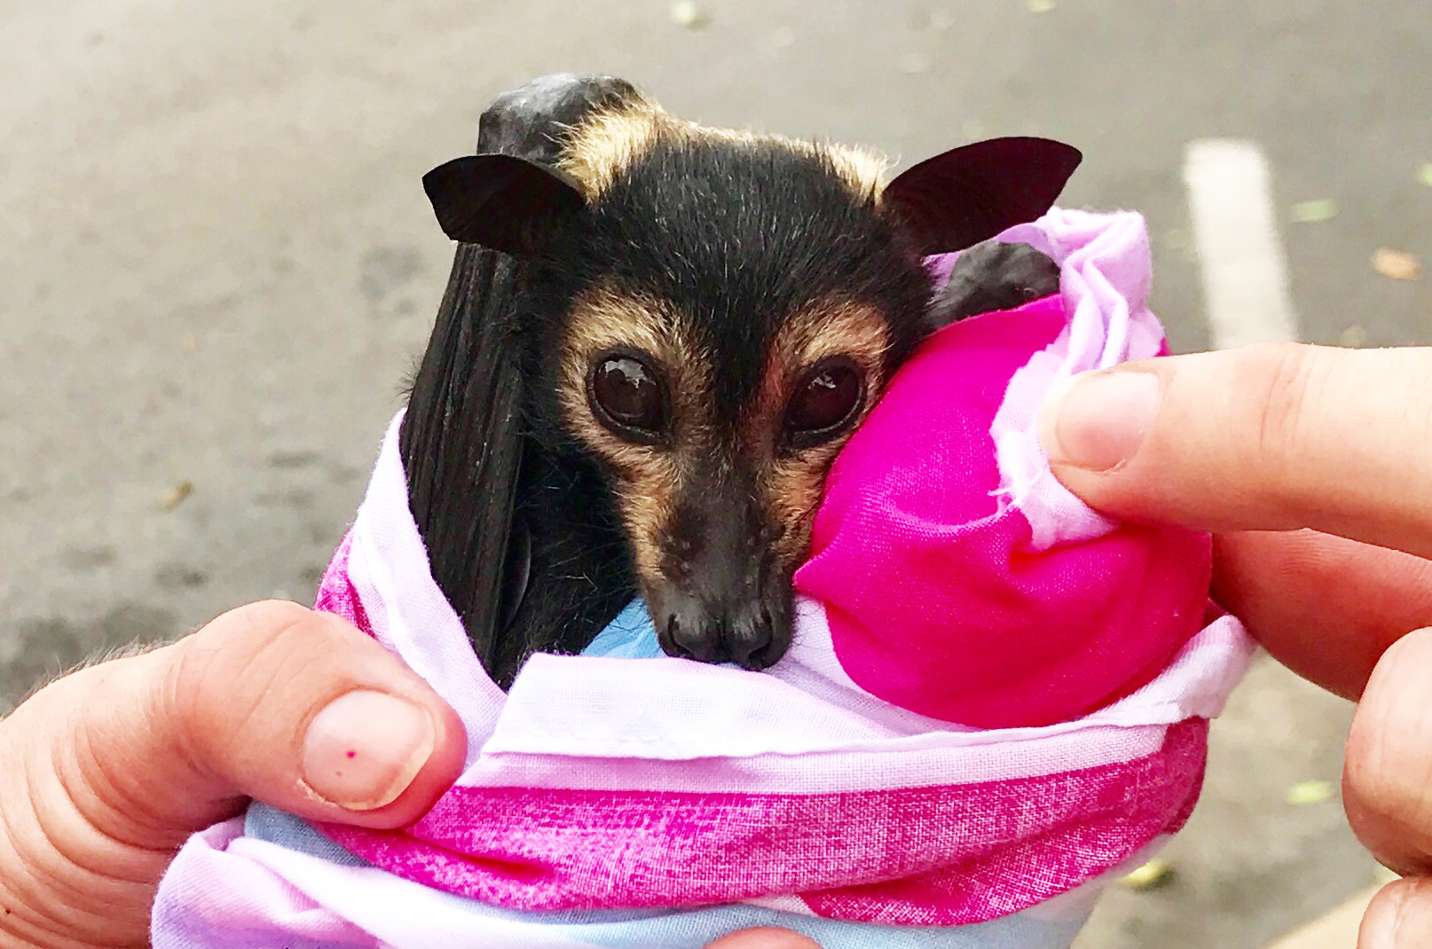
Notes:
Even if baby fruit bats like this flying fox from central Australia are incredibly cute, there is some slight concern about getting aerosol rabies from bats in caves. So, if you plan to do a lot of caving, talk to your doctor about getting the series of three injections in the arm to prevent rabies. [﻿Licensed under the Creative Commons Attribution-Share Alike 2.0 Generic license via Wikimedia Commons and Flickr, courtesy Mike's Birds.]

Slide 12
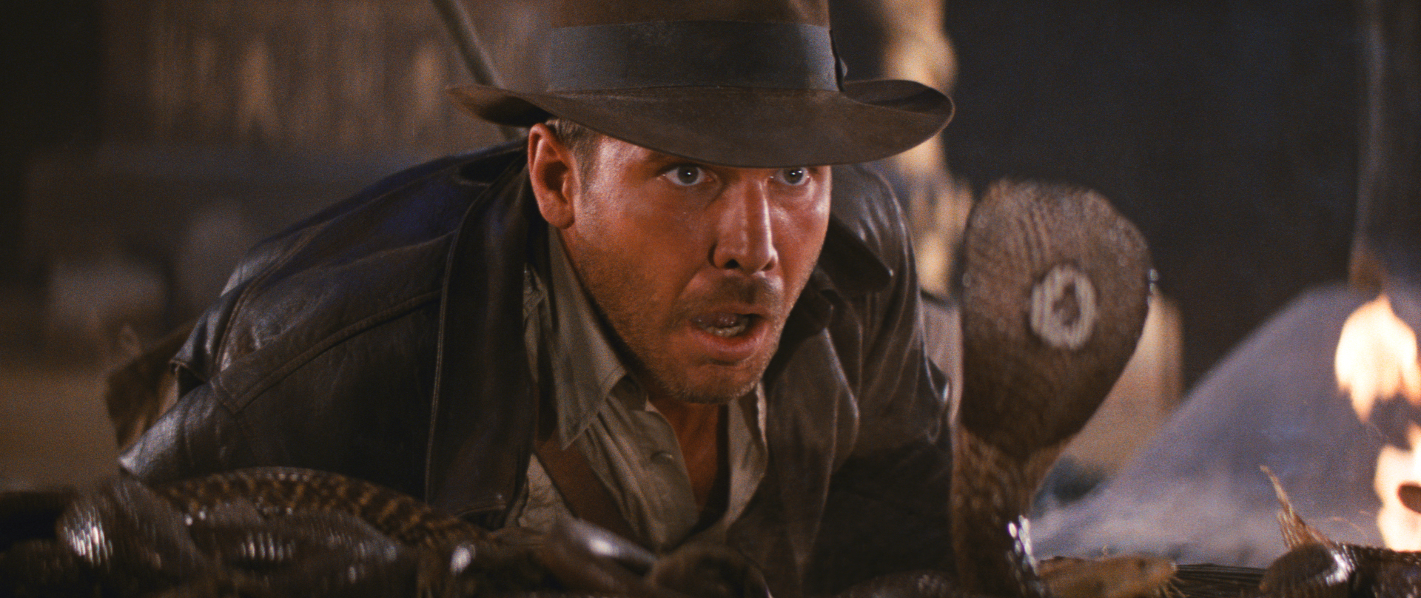
“Snakes…why’d it have to be snakes?”
—Indiana Jones, in the movie Raiders of the Lost Ark
Notes:
“Snakes…why’d it have to be snakes?” I have never seen a snake in a cave, but I’ve seen a lot in my back yard and when out hiking. You’re more likely to see snakes hiking to the cave entrance. [Image probably copyrighted but doubt they would object to it appearing here to generate more publicity, and probably fair use anyway.]

Slide 13
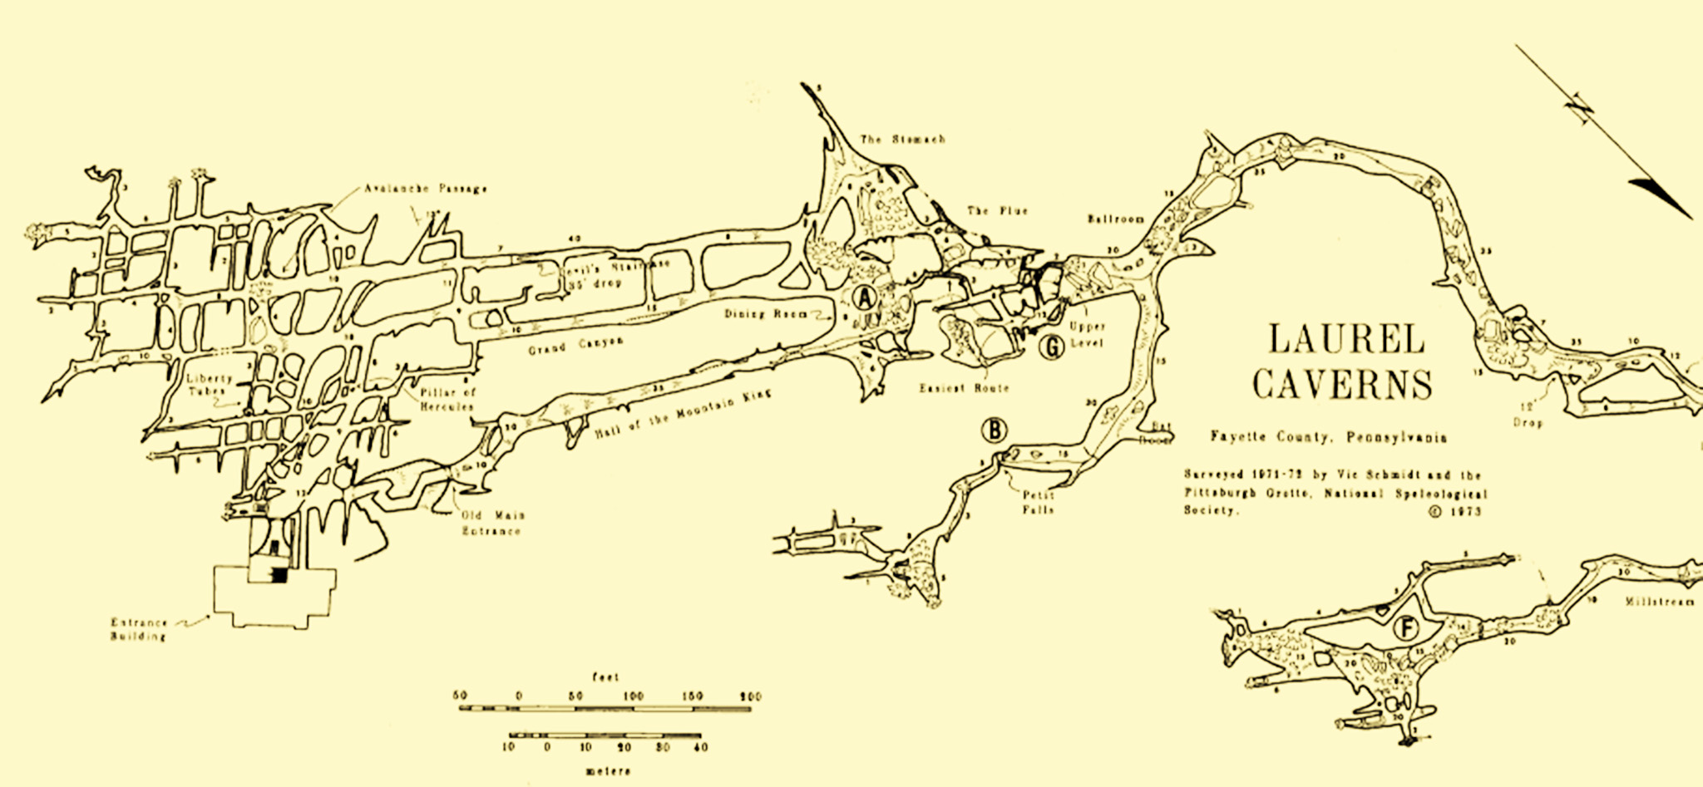
Notes:
I may get lost! Since cellphones and GPS and radios don’t work underground, this is a more real concern. Learning to read cave maps is a good idea, they’re nothing like aboveground maps. Marking the walls with arrows is considered vandalism and a criminal offense in many states. You can take popsickle sticks and put a but of Scotchlite or eqivalent on the end. You can use these as markers that you can pick up and resuse on the way out. When you come to a junction, you can look over your shoulder, so you know what it looks like on the way out. [Map courtesy Laurel Caverns.]

Slide 14
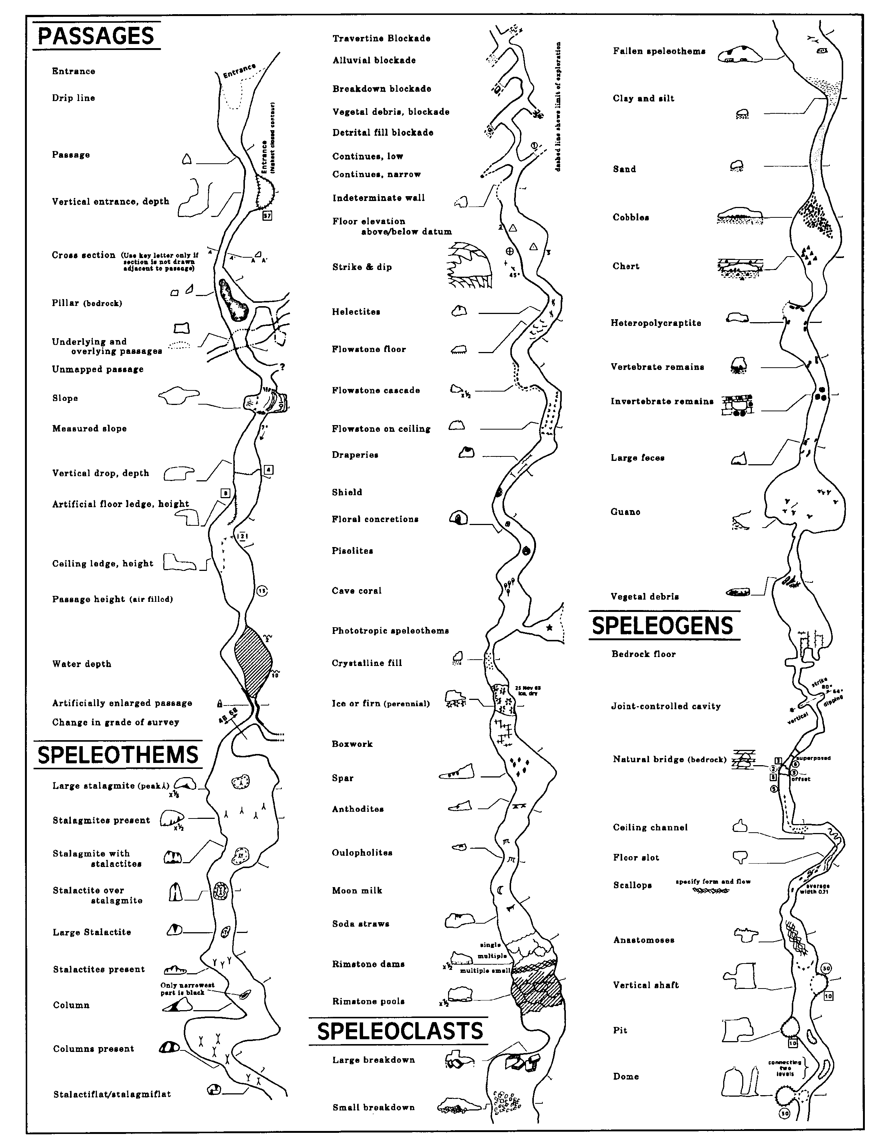
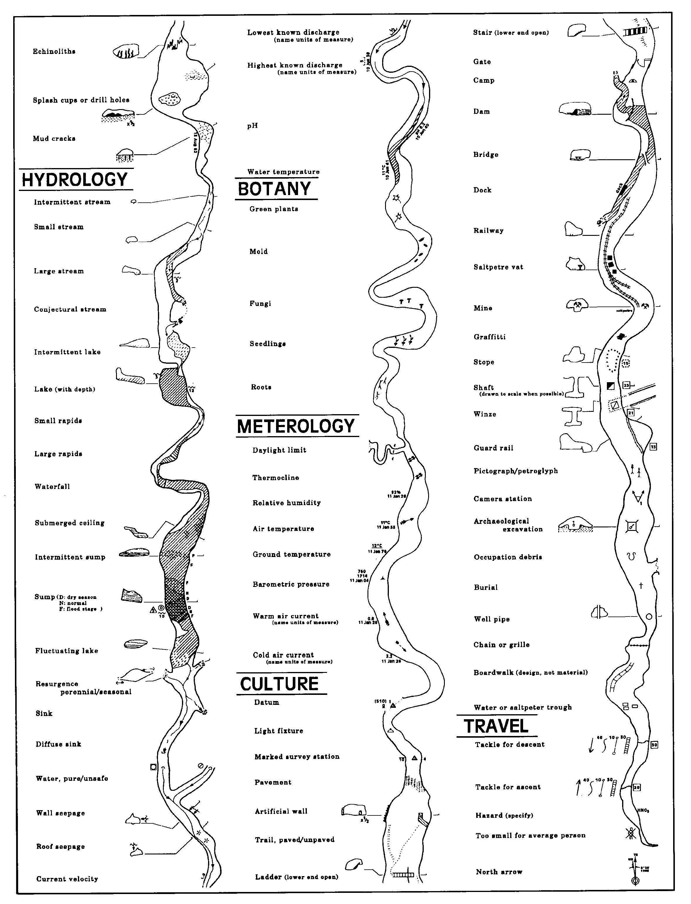
Notes:
If you want to spend time in caves either for recreation or rescue, you should learn what the standard map symbols mean.

Slide 15
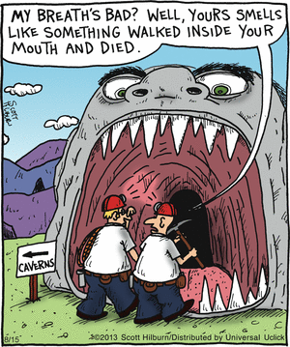
Notes:
Caves have bad air! True, a few do, but much less frequently than mines, and very rarely; only about 1:250 cave rescues have air problems, and not usually as bad as in mines. (Unlike mines, caves are not known for exploding from combustible gas or coal dust.) [Fair use as per https://ogc.harvard.edu/sites/hwpi.harvard.edu/files/ogc/files/ogc_copyright_and_fair_use_guide_5-31-16.pdf]

Slide 16
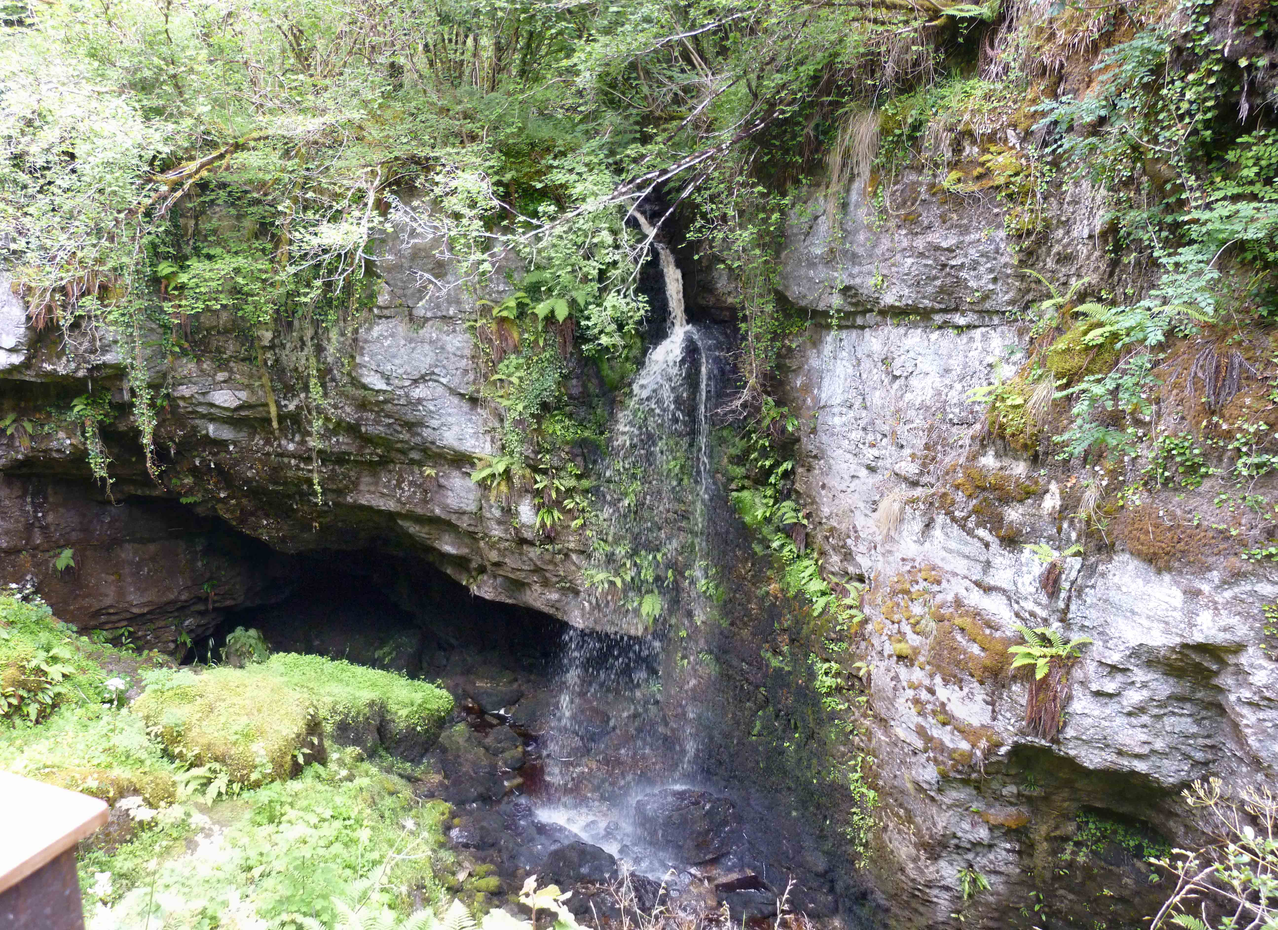
Notes:
Once upon a time, I flew to Ireland with a couple of other NCRC folks to give a talk at a cave rescue conference. I had some time off before the conference, and some Irish cavers were kind enough to take me to Pol na Gollum (“cave of the doves” in Irish Gaelic; and yes, we think that’s where Tolkien got the name “Gollum” from). It’s a river cave with lots of small sinkhole entrances. The plan was to go into one of these potholes, get up into an upper-level dusty crawlway to another part of the stream passage, then wade the stream passage back to the entrance. As I was crawling through that dusty passage, at the end of the group, I started breathing heavily. Was it my asthma acting up? No, I only get an asthma attack when I’m sick, and I’m not wheezing. Maybe I was just jet-lagged? Dunno. Breathing harder now. Oh, no, maybe I’m claustrophobic and I’ll never be able to go caving again! We got out into the main stream passage and I started breathing easier. I mentioned this to the Irish caves. “Oh, didn’t we tell you? There’s no air circulation in that passage and the last person through doesn’t get much oxygen.” Hmph. [﻿Licensed under the Creative Commons Attribution-Share Alike 3.0 Unported license via Wikimedia Commons, courtesy Youngbohemian. ]
We had a rescue at Keyhole Cave near Albany, NY some years ago. A caver was trapped by his leg in a narrow part of the keyhole passage. There were so many people in the cave for so long, that the CO2 started building up. They had to start pumping fresh air into the cave.

Slide 17
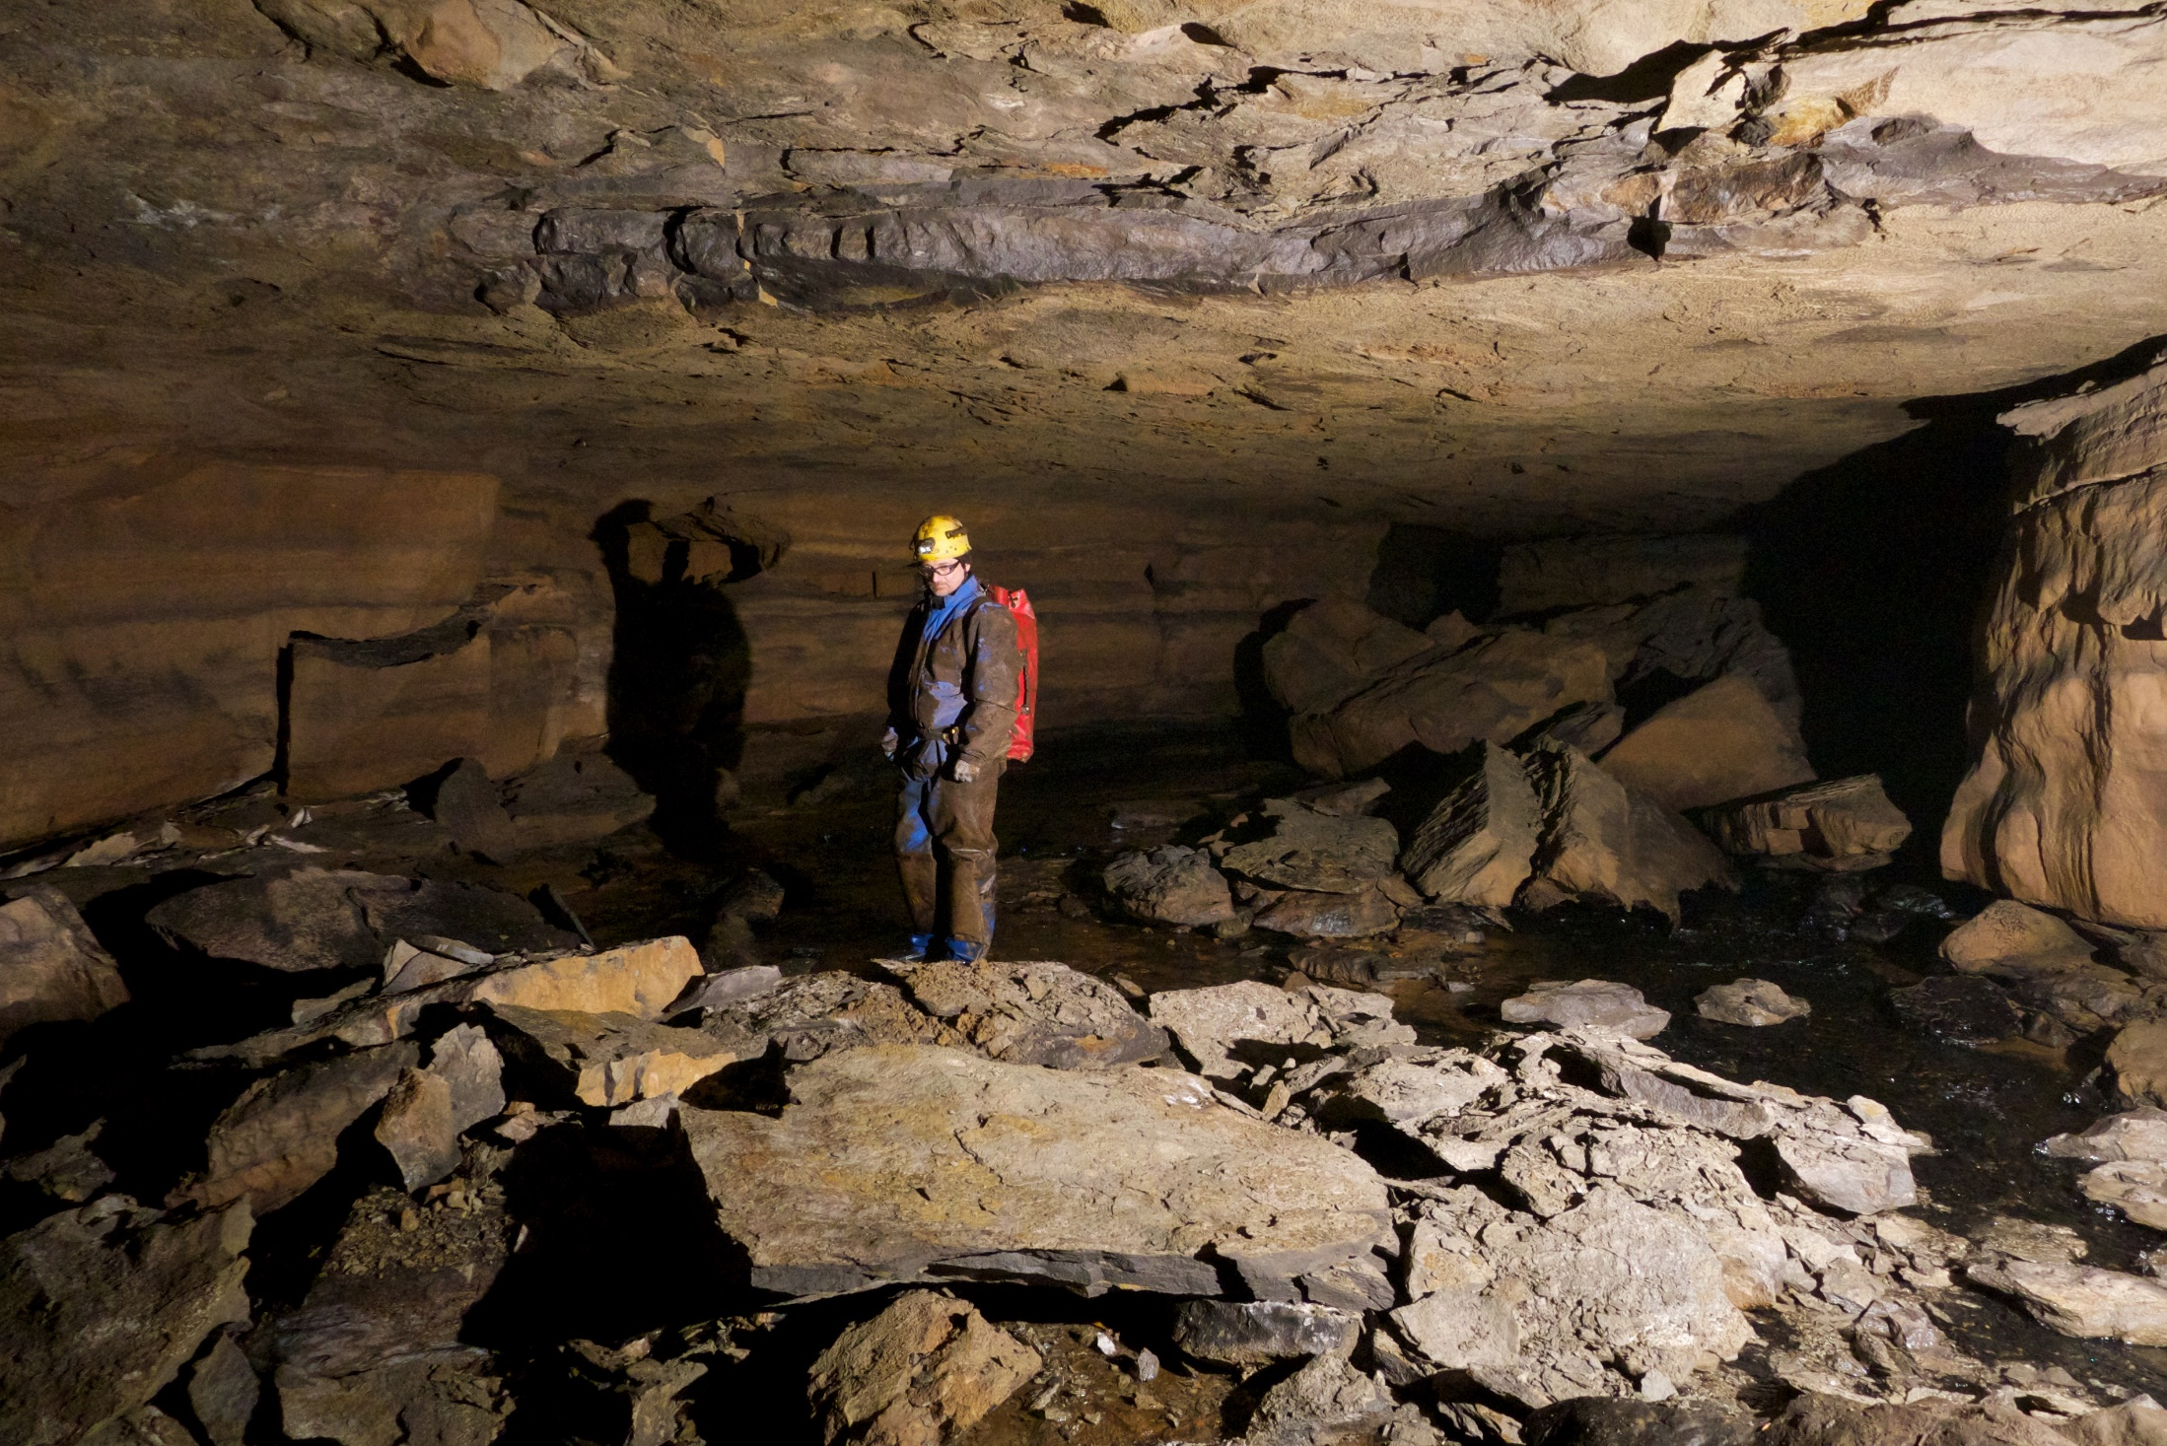
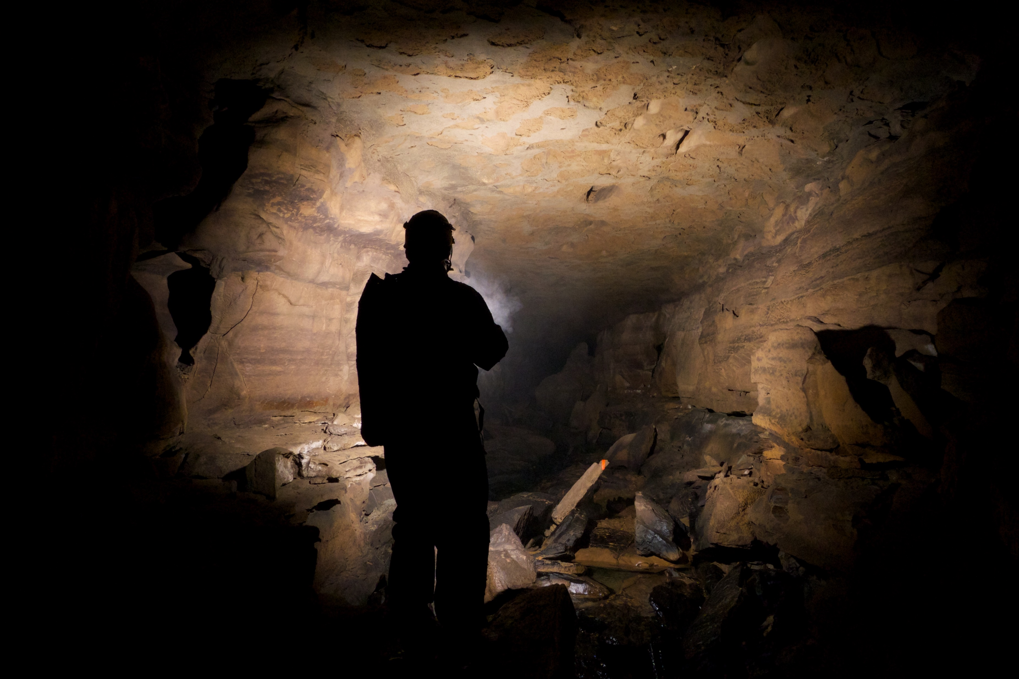
Notes:
The cave may cave in on me! Parts of caves do collapse, but only every 10,000 years or so. You are much more likely to get crushed by a tree falling over on you walking to the cave entrance. Or being crushed by a piece of a deorbiting Chinese rocket booster. [﻿Licensed under the Creative Commons Attribution-Share Alike 2.0 Generic license via Wikimedia Commons, courtesy David A. Riggs. ]

Slide 18

Notes:
Despite what you might see on the Na’vi River Journey ride at Disney World… [﻿Licensed under the Creative Commons Attribution-Share Alike 2.0 Generic license via Wikimedia Commons and Flickr, courtesy en Henderson.]

Slide 19
Notes:
It’s dark in there! Take three sources of light. That’s three sources of light with which you can cave. [A totally black rectangle is definitely public domain.]

Slide 20
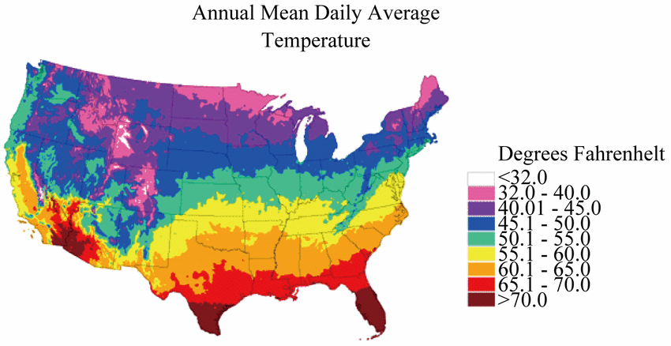
Notes:
It’s wet and cold in there! Well, it can be wet and cold aboveground, but caves are often cold and wet even in the summer.
Caves are at the annual average temperature. In the mid-Appalachians, that ranges from ~50 degrees F (10° C) in northern Pennsylvania to ~55° F (13° C) in southern Virginia. It doesn’t sound that cold, especially as there’s no windchill. But it’s often wet. And much of the time you’re in contact, sometimes full-body contact, with cold rock. And you’re often tired. Hypothermia is a real problem in caves. So, you need to dress properly, warm-when-wet long underwear and preferably a set of overalls over that that help keep out the mud. You don’t need wind or rain protection, however.
[Public domain, US NOAA.]

Slide 21
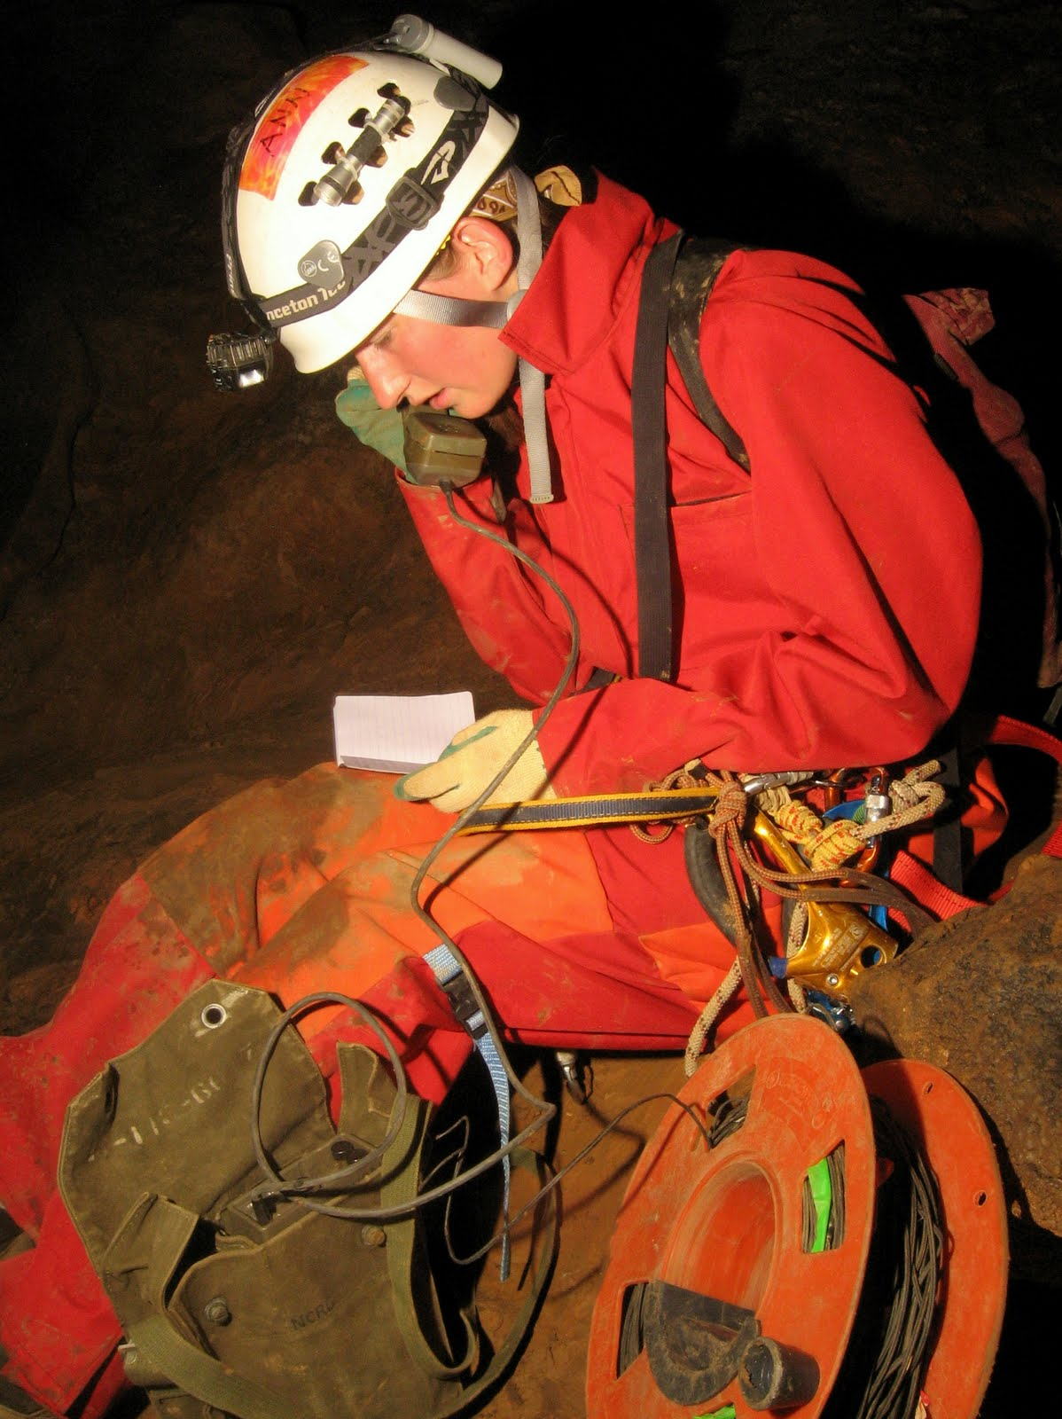
Notes:
I won’t be able to use my cellphone! Caves are underground. Cellphones don’t work underground. You can’t call for help. Many think that the minimum cave party is four: one to stay with the casualty, and two to physically go out for help. And once you get out and call, it may take a long time for help to arrive. When we have a long cave rescue, we tend to run military surplus field phone wire and use portable surplus field phones. ﻿["Text and images ©tp6n.blogspot.com and acknowledged contributors. Feel free to share for educational or other non-commercial use.“]

Slide 22
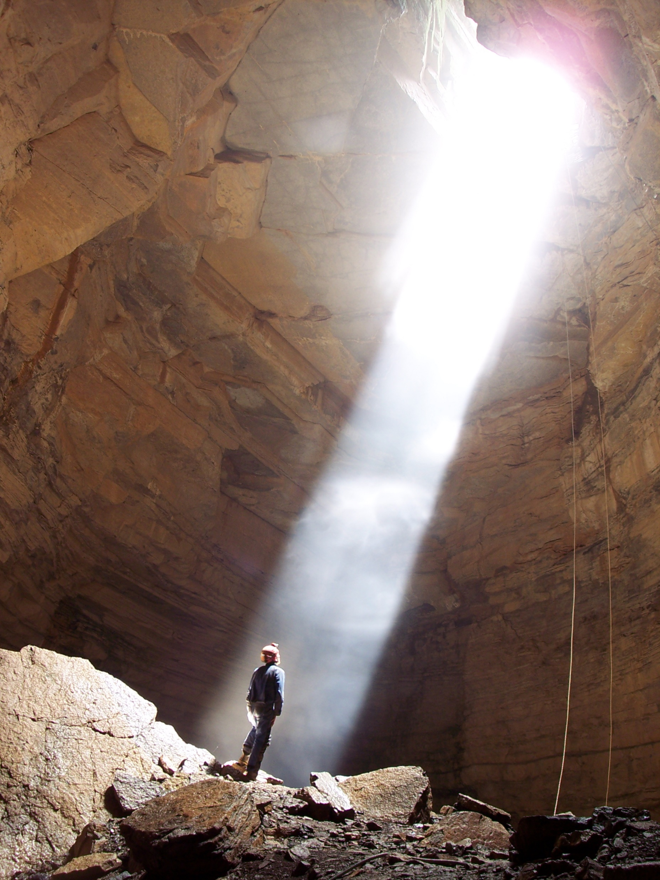
Notes:
I may fall in a hole! Most of the caves in the mid-Appalachians are what we call horizontal caves. That means you don’t need cable ladders or ropes to navigate through the cave.
Even horizontal caves are three-dimensional, though. Even without big drops, there is often lots of scrambling and some minor injury risk.

Slide 23
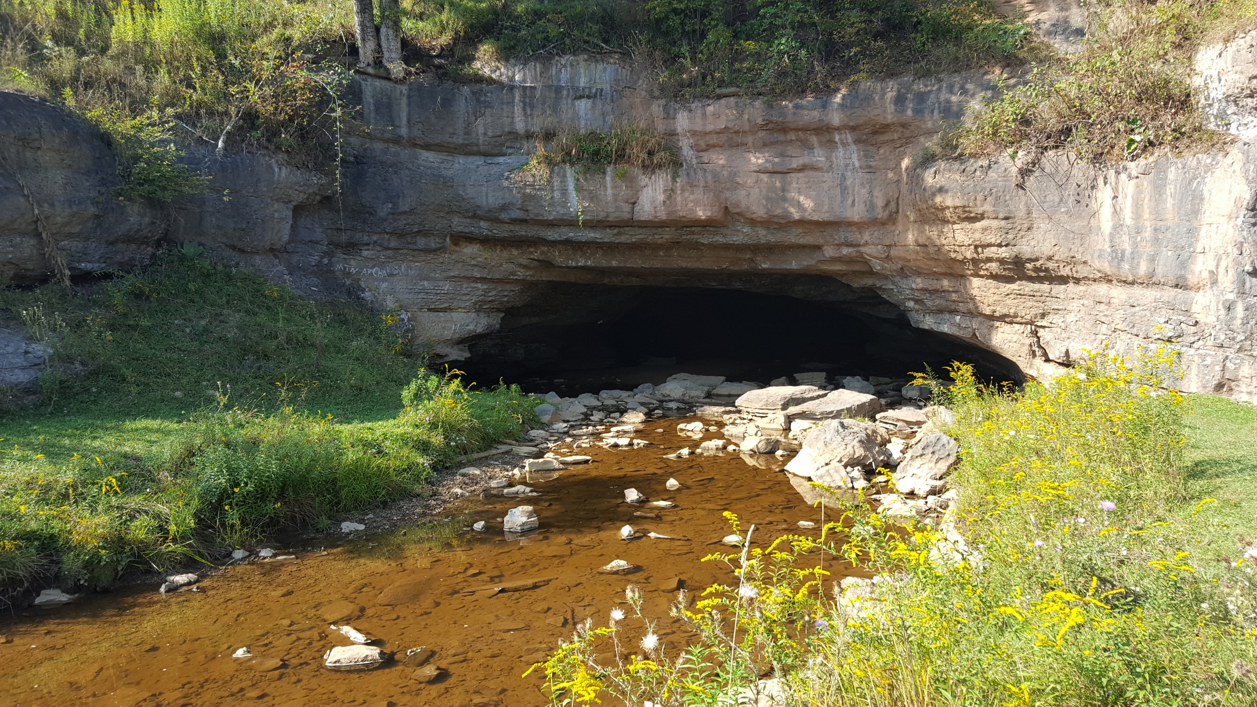
Notes:
I might drown! Caves can be dry. Caves can be muddy. Caves can be wet. Caves can have rivers running through them. This is the entrance to the Sinks of Gandy cave. The stream goes into the cave here and comes out after passing under Yokum Knob. Imagine what happens inside when the stream floods. Learn to look for evidence that a cave passage floods from time to time: leaves and sticks from aboveground, highwater lines on the sides of the passage. [﻿Licensed under the Creative Commons Attribution-Share Alike 4.0 International license via Wikimedia Commons, courtesy Thespooker.]

Slide 24
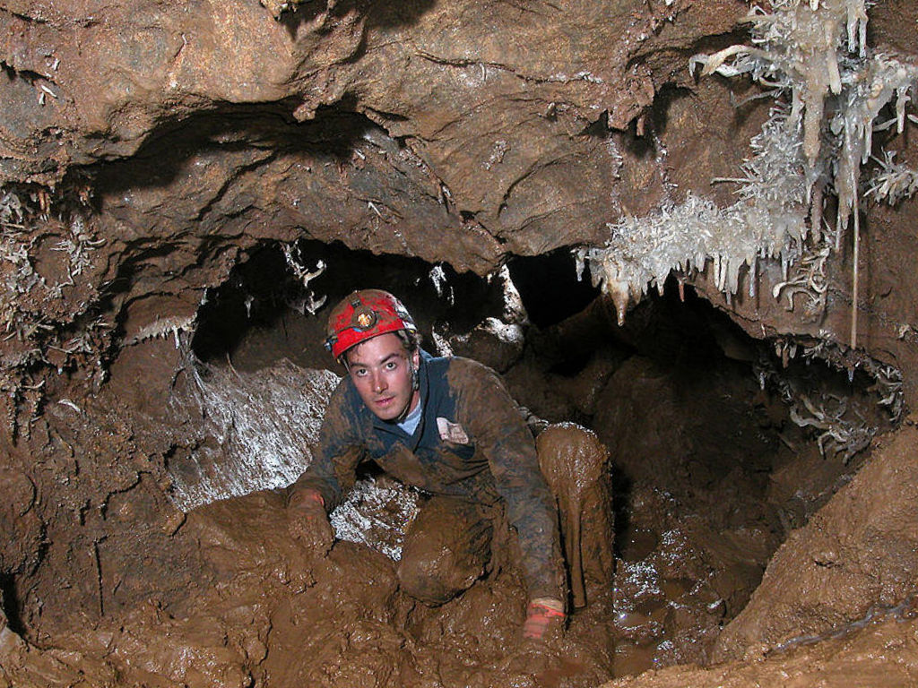
Notes:
Caves are dirty and muddy! If that really bothers you, maybe you should consider some volunteer public service opportunities other than cave rescue. [﻿Licensed under the Creative Commons Attribution-Share Alike 2.5 Generic license via Wikimedia Commons, courtesy Dave Bunnell.]

Slide 25
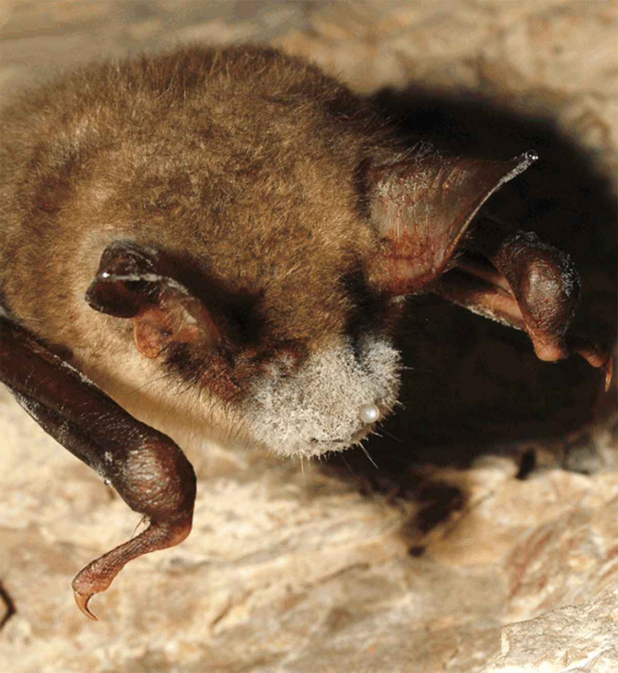
Notes:
I might catch some contagious disease in there! Well, that is possible, but what is much more likely is that you give a contagious disease to bats and kill them. White nose disease – a fungus that grows on hibernating bats and kills them – may be transmitted from one cave to another by cavers. That’s why some caves are closed when bats are hibernating. And why cavers and cave rescuers need to disinfect their gear between cave trips. See the Survival and Wilderness Travel chapter of Appalachian Search and Rescue for more about this. [﻿Public domain via Wikimedia Commons courtesy Tamás Görföl and USGov-HHS-CDC.]

Slide 26
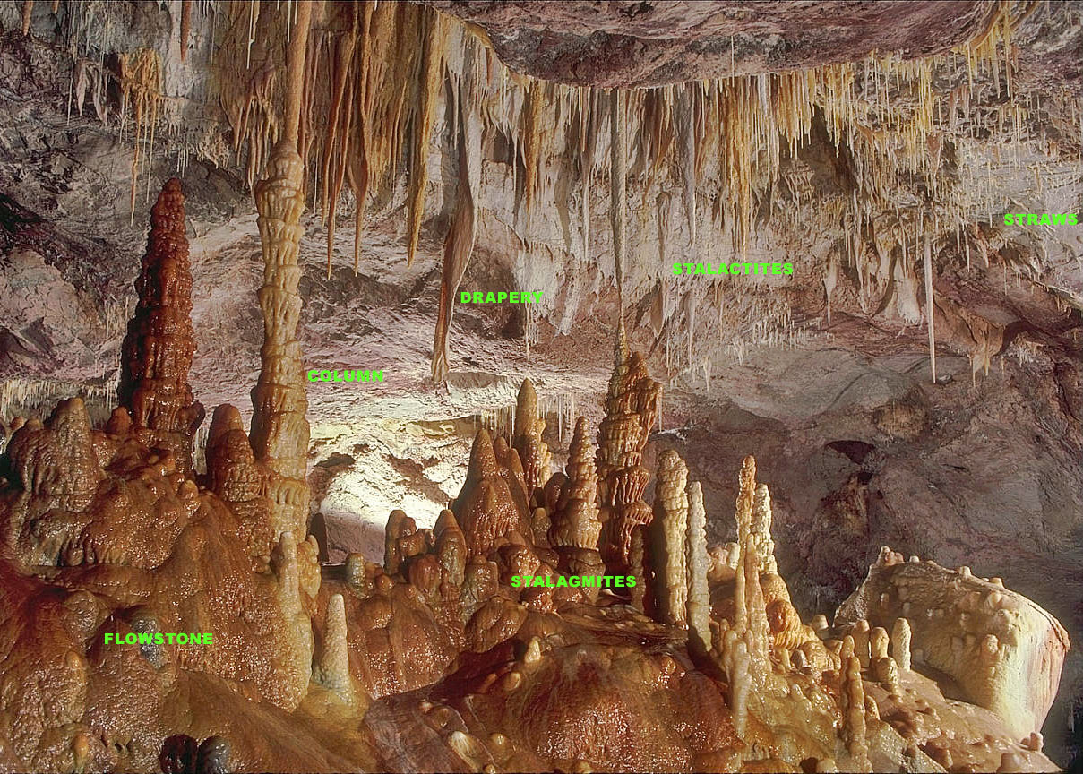
Notes:
I might destroy an ancient cave formation! This is a real concern, so you need to be careful when caving. Cave formations (speleothems) take thousands of years to develop. Rainwater percolates through soil and limestone rock down into the cave. As it does so, it dissolves a bit of the limestone. When the water enters the cave and evaporates, it leaves behind a white mineral called calcite. Calcite speleothems take many forms: stalactites, stalagmites, columns when the two join, flowstone, draperies, soda straws, rimstone dams, anthodites and helectites, to name a few. [Licensed under the Creative Commons Attribution-Share Alike 2.5 Generic license via Wikimedia Commons, courtesy Dave Bunnell.]

Slide 27
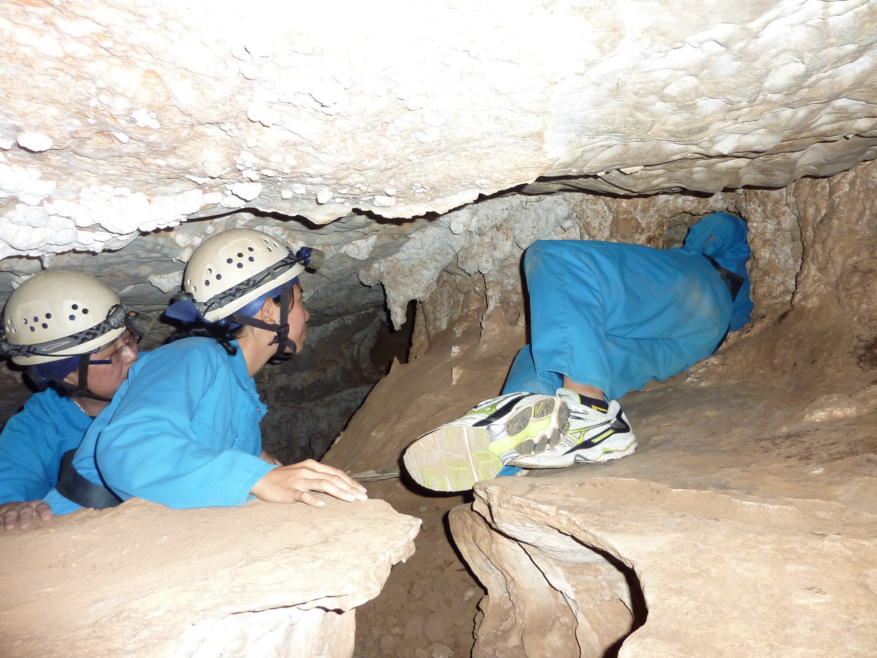
Notes:
I may get stuck! Just like Floyd Collins famously did, and then died. This is a reasonable concern. You can get stuck in a small passage. It’s pretty rare, though. If you get stuck, we have ways to get you out, usually involving your getting naked and using motor oil and axle grease. You have been warned. Maybe pass on the French fries with cheese and gravy right before your next cave trip. Of course, if you’re from Quebec you can call it poutine and thus get away with eating it as part of your cultural heritage. [﻿Licensed under the Creative Commons Attribution 2.0 International license via Flickr, courtesy Karl Baron.]

Slide 28
Notes:
I may hit my head! Unlike the rest of the great outdoors, caves have ceilings, so let’s talk about…
[﻿Licensed under the Creative Commons Attribution-Share Alike 2.5 Generic license via Wikimedia Commons, courtesy Dave Bunnell.]

Slide 29
Caving Gear

Slide 30
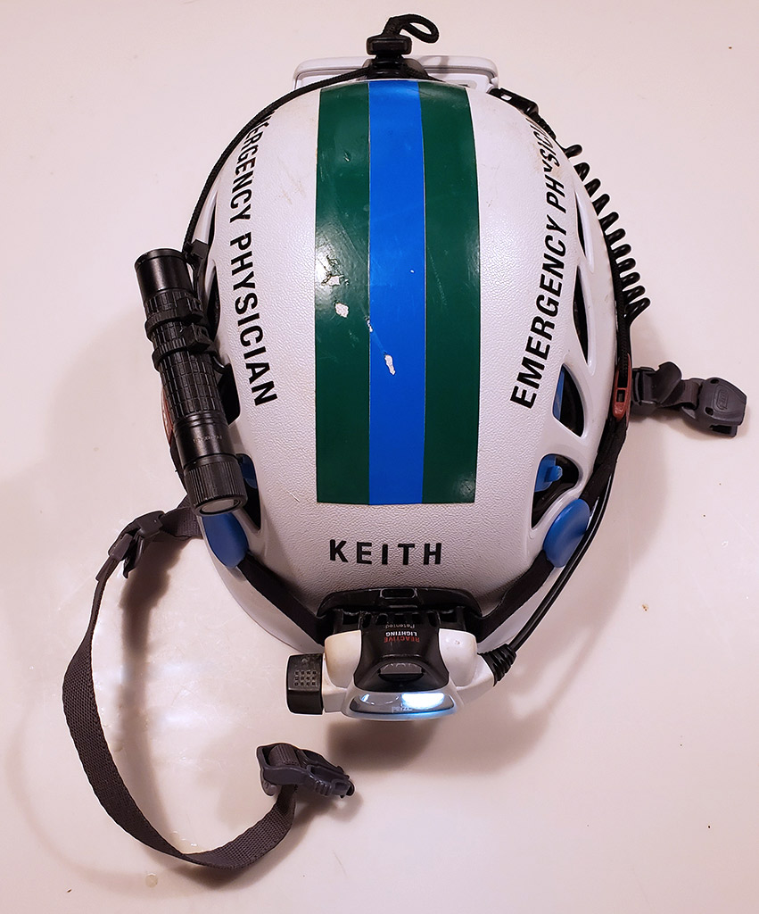
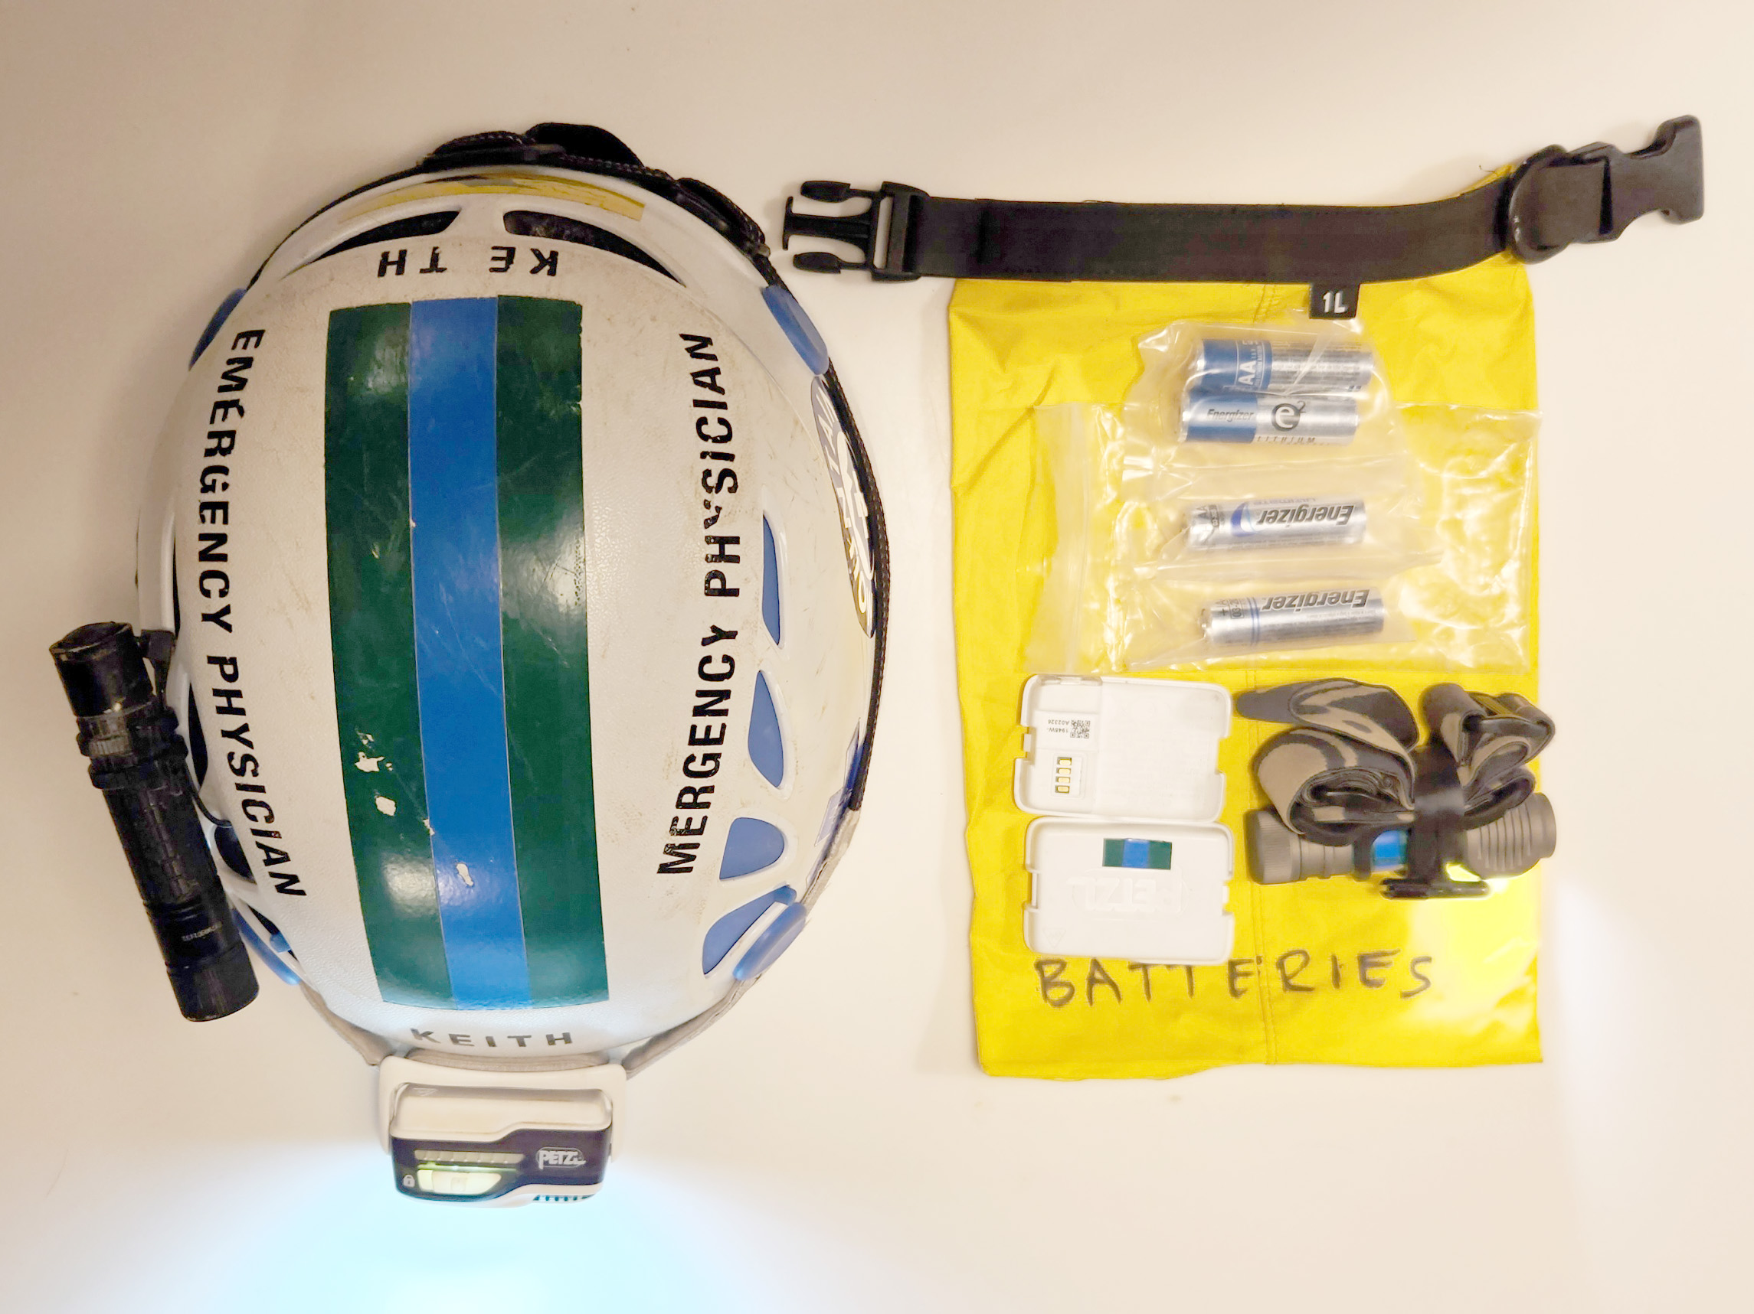
Notes:
This is a ceiling-finder, which non-cavers call a helmet. This is a Petzl Elios helmet. Note the scrapes on the color code tape from finding the ceiling. The headlamp (a Petzl Swift RL which is an excellent headlamp for both cave and above-ground, and put spare batteries in my cavepack) and the backup light (Fenix E11 single AA again with backup batteries in my cavepack; the Fenix E12 V2 is the current equivalent) attached to the helmet with cable ties. In my cavepack (bottom right in the picture) is third light (Zebralight H51FW 164-Lumen AA Floody Headlamp with head strap with battery reversed to prevent going on in my cavepack; current equivalent is the Zebralight H503c, which many cavers use as a primary light, but I like the Swift RL a bit better.) These details are in the PDF of this presentation posted online.

Slide 31
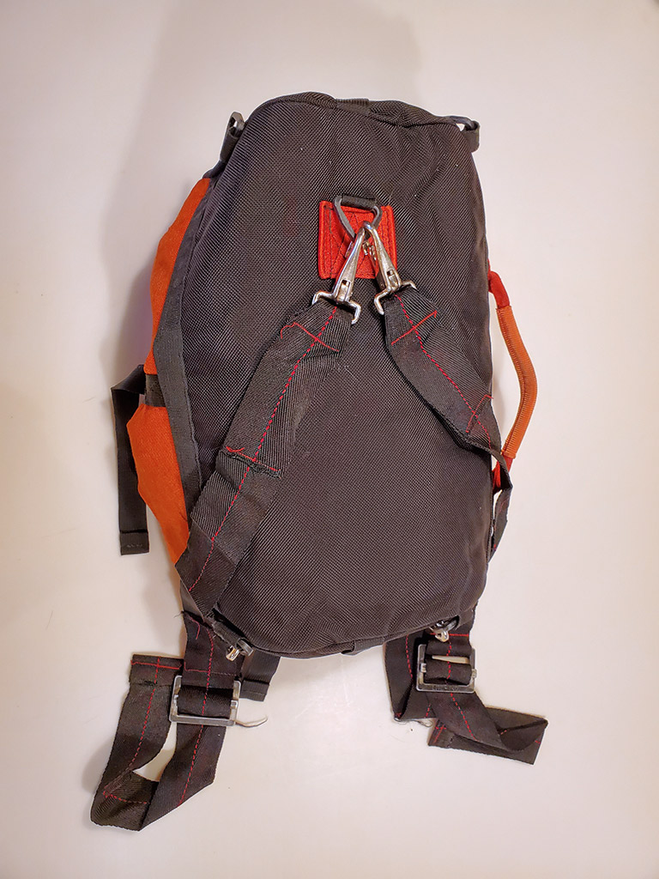
Notes:
Cave pack with handle, easily adjustable backpack/shoulder straps so can be tossed over a shoulder, worn as a backpack, or just picked up by the handle and pushed ahead of you in a crawlway. Cavepacks don’t need sternum straps, hipbelts or fancy suspensions.

Slide 32
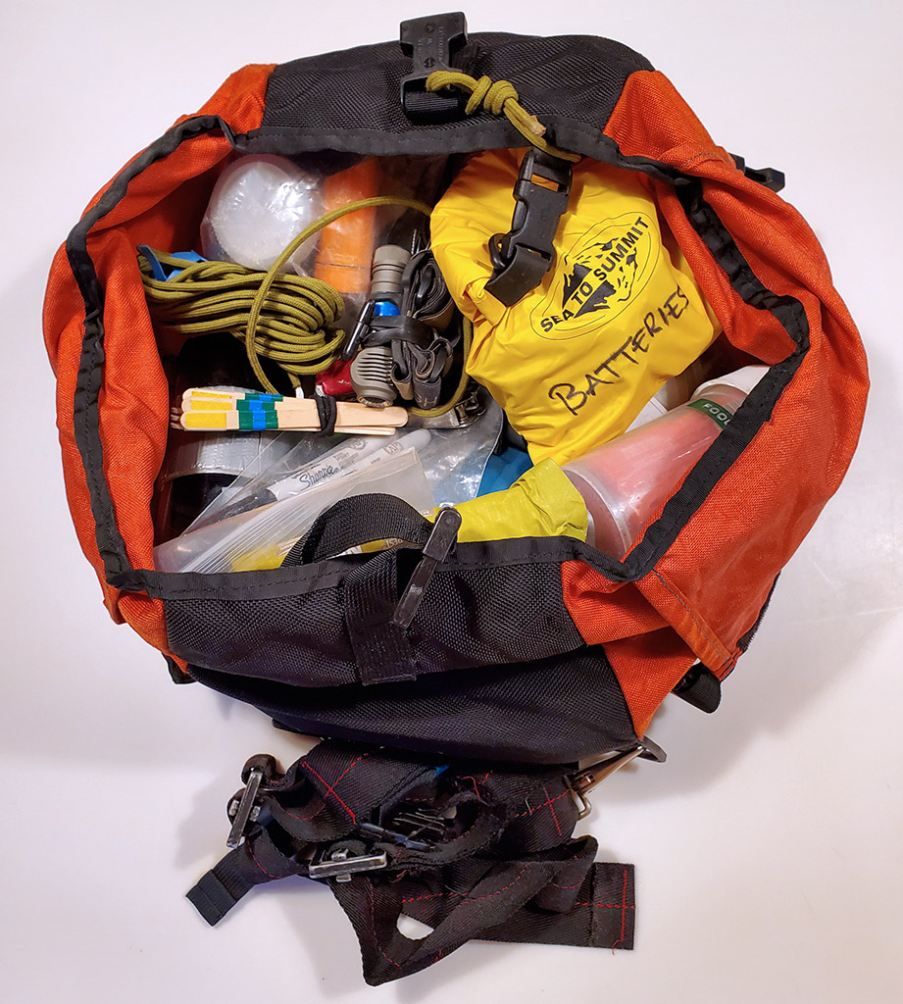
Notes:
Contents of my cave pack. To see a list of what’s in it, check out: conovers.org/ftp (“file transfer protocol”) and scroll down to SAR-Gear.pdf.

Slide 33
Essential Cavepack Gear
10 Essentials (1992 version, adjusted for caving):
  Navigation: compass, and if available, cave map; GPS app and map for approach
  Sun Protection: maybe for approach
  Insulation: extra clothing
  Illumination: three sources of light
  First-aid Kit & insect repellent for approach
  Fire: candle and waterproof matches/lighter
  Repair kit and tools
  Nutrition: food (Millenium bars travel well)
  Hydration: water and water purification
  Shelter: plastic leaf bags

Slide 34
Caving Clothing
Boots, wool socks and gloves with good grip when wet
Warm-when-wet long underwear or fleece tops and bottoms
Coveralls (more freedom of movement than shirt and pants)
  Ones like mechanics wear: get from places like Dickies or Duluth Trading Company (preferably not cotton)
  Military surplus flight suits
  Suits made for canyoneering or canyoneering
  Waterproof only for very wet caving, otherwise breatheable (no need for Gore-Tex)

Slide 35
Cave-Specific-Rescue
Techniques
Notes:
Milk-jug splints, paving and turtling an’ ‘at

Slide 36
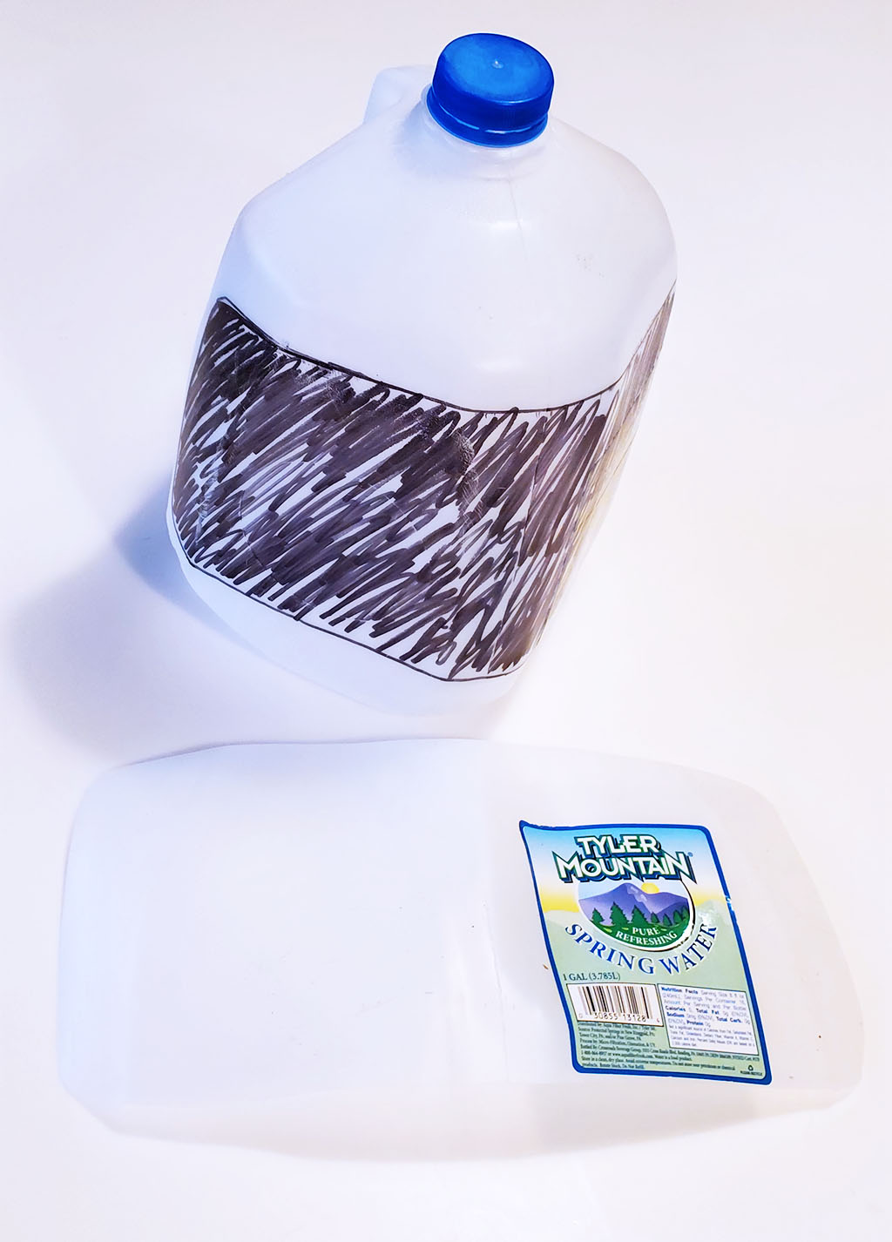
Notes:
Mud and rocks don’t work well as improvised splints, so your personal wilderness first aid/medical kit should include SAM splint, or a much lighter and cheaper variant, which is a couple of pieces of plastic cut from plastic milk jugs or even better, from a windshield washer fluid jug. (From Appalachian Search and Rescue, covered by its cc-by-sa Creative Commons license).

Slide 37
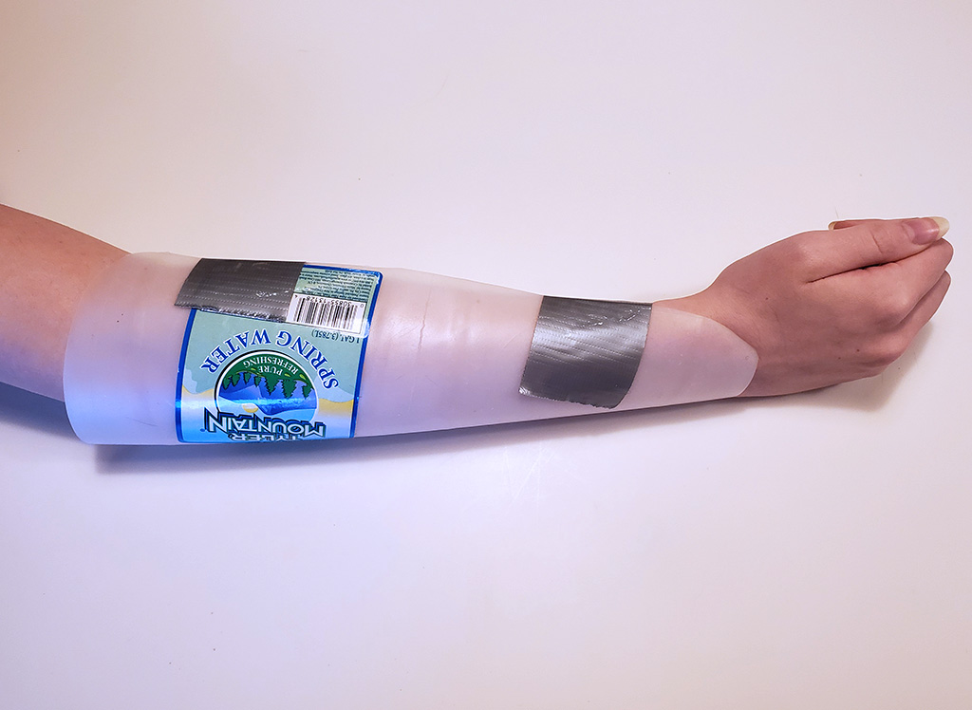
Notes:
Just add a little duct tape. You can use two and more dust tape to make a longer splint. (From Appalachian Search and Rescue, covered by its cc-by-sa Creative Commons license).

Slide 38
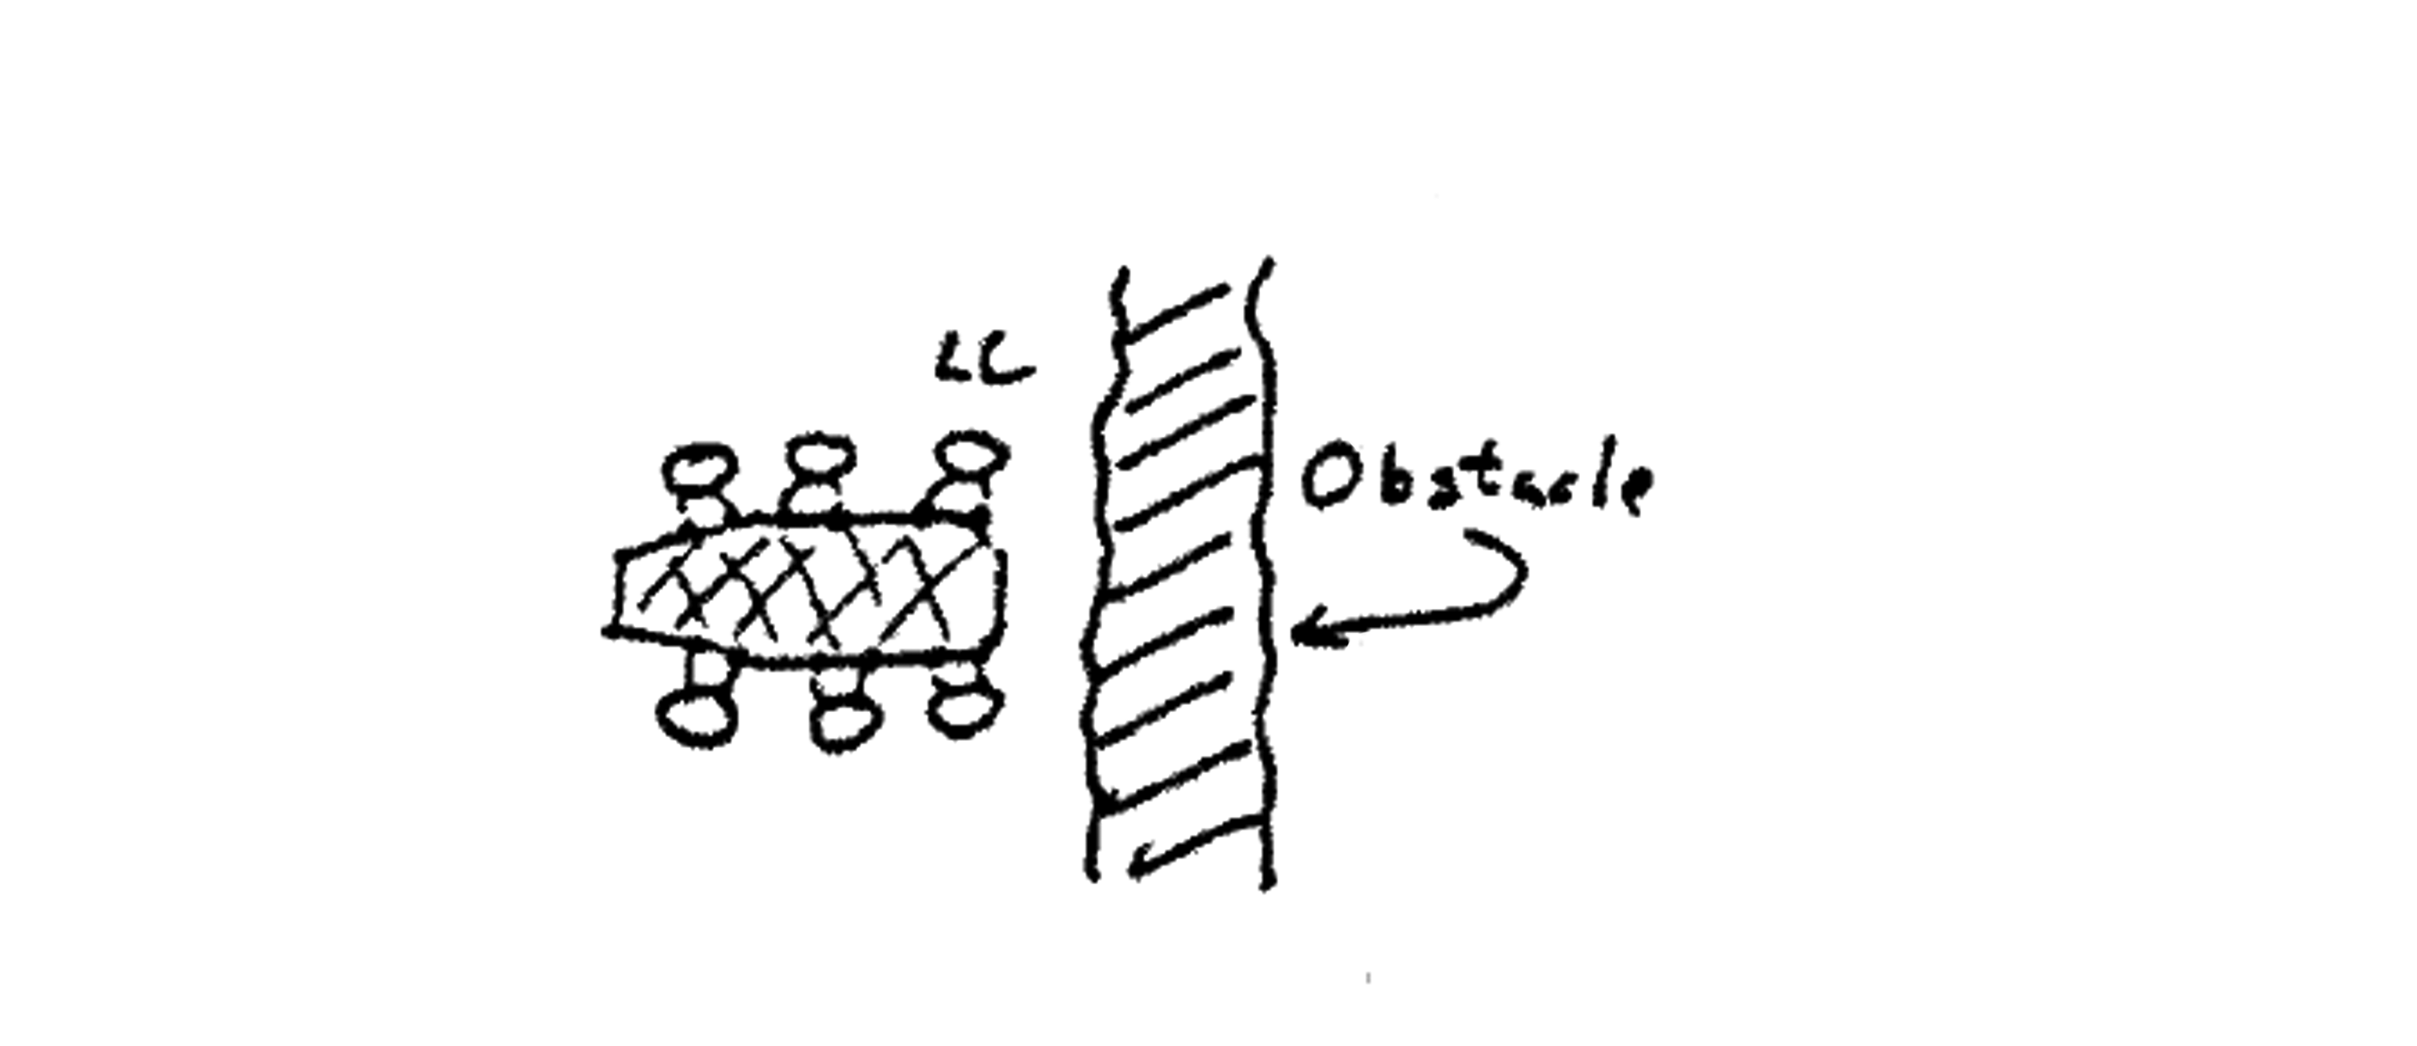
Notes:
This is used aboveground as well, and it’s called laddering. LC is the litter captain: in charge of the litter always whoever’s in the front left. [From the ASRC From ASRC Mountain Rescue Manual, copyright © 1983 ASRC, used with permission.]

Slide 39
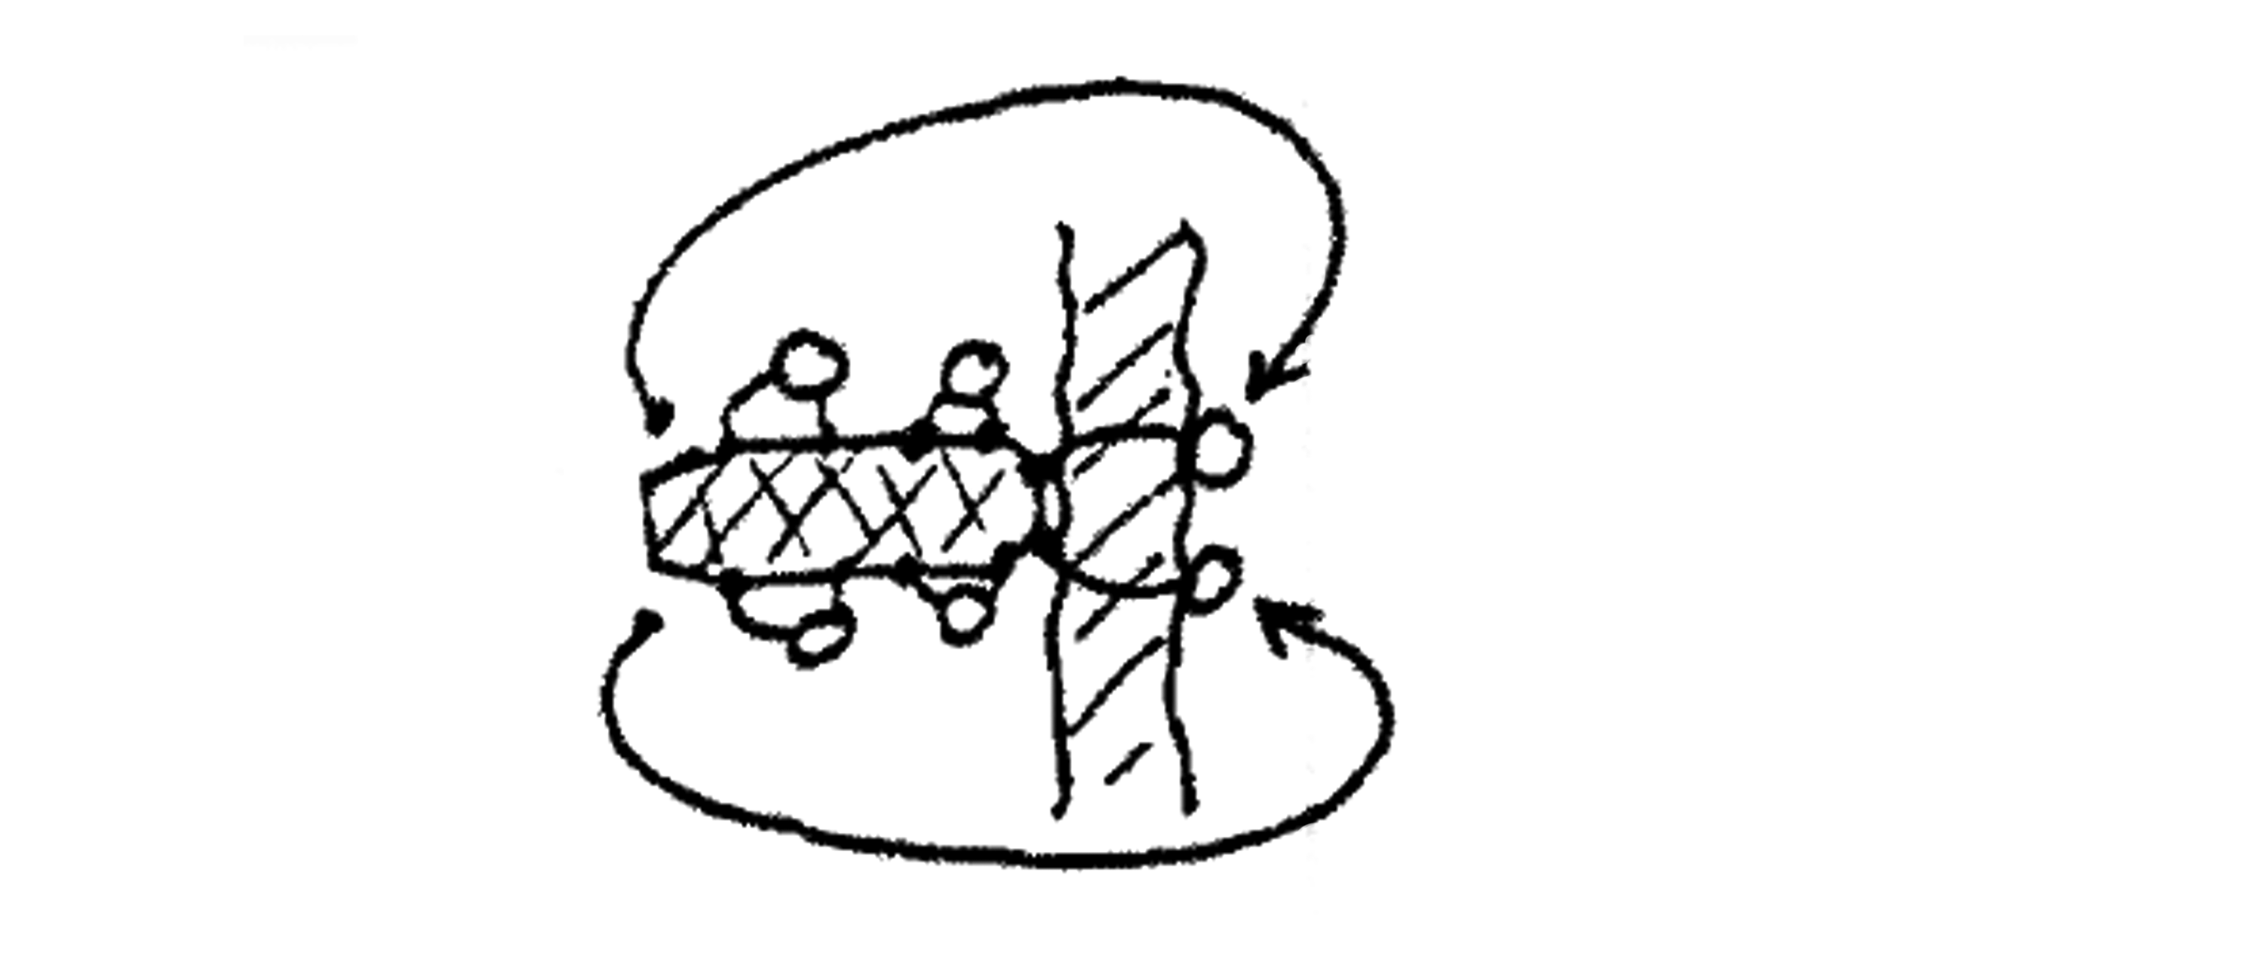
Notes:
If it’s a solid object rather than a crack in the ground, you place the head of the litter on the object, the Litter Captain calls “Ready to Ladder!” The front four litter bearers shift their hands back a bit, and the two at the back peel off, scramble over the object, then the new Litter Captain (the new front-left litter bearer, now in the driver’s seat) calls out “Ladder” and, without moving their feet… [From the ASRC From ASRC Mountain Rescue Manual, copyright © 1983 ASRC, used with permission.]

Slide 40
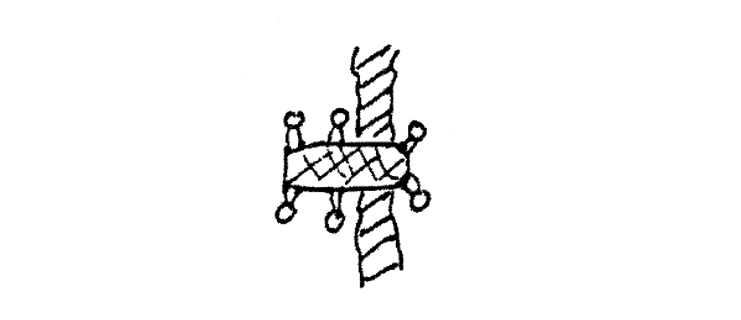
Notes:
everyone slides the litter forwards a foot or two. The new Litter Captain then calls “Ready to Ladder!” [From the ASRC From ASRC Mountain Rescue Manual, copyright © 1983 ASRC, used with permission.]

Slide 41
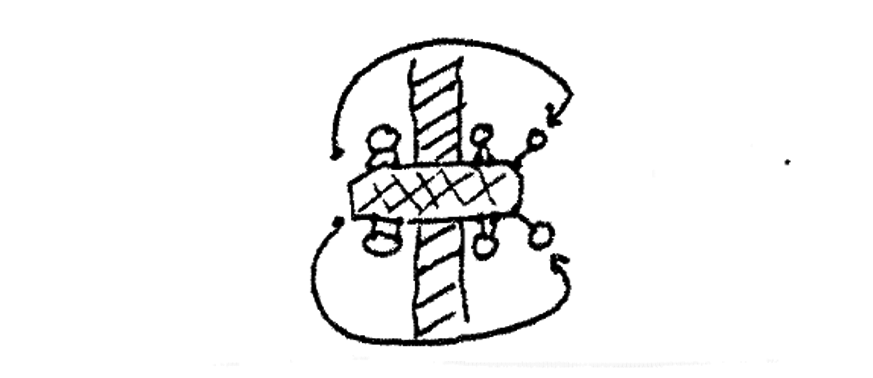
Notes:
And the same thing repeats until…[From the ASRC From ASRC Mountain Rescue Manual, copyright © 1983 ASRC, used with permission.]

Slide 42
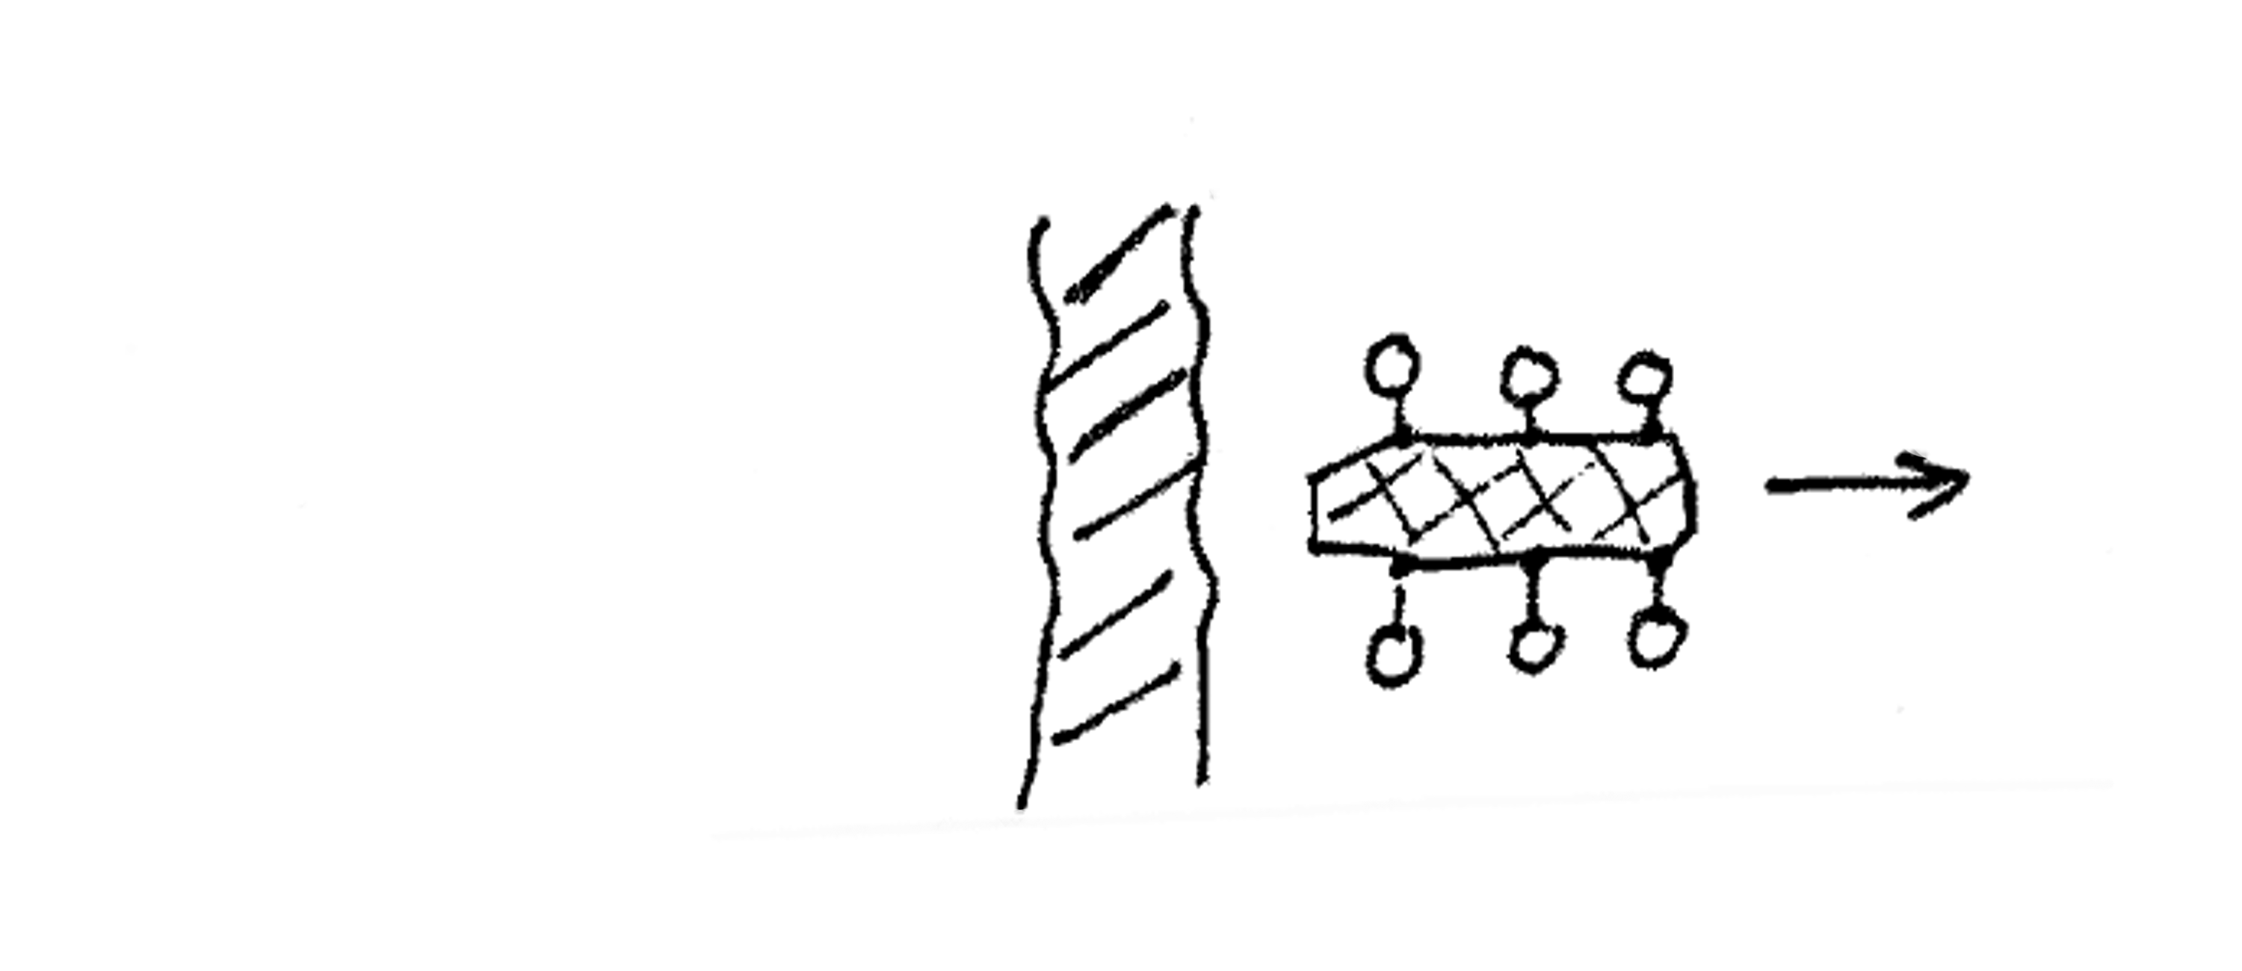
Notes:
The litter is over the obstacle and people continue carrying it. [From the ASRC From ASRC Mountain Rescue Manual, copyright © 1983 ASRC, used with permission.]

Slide 43
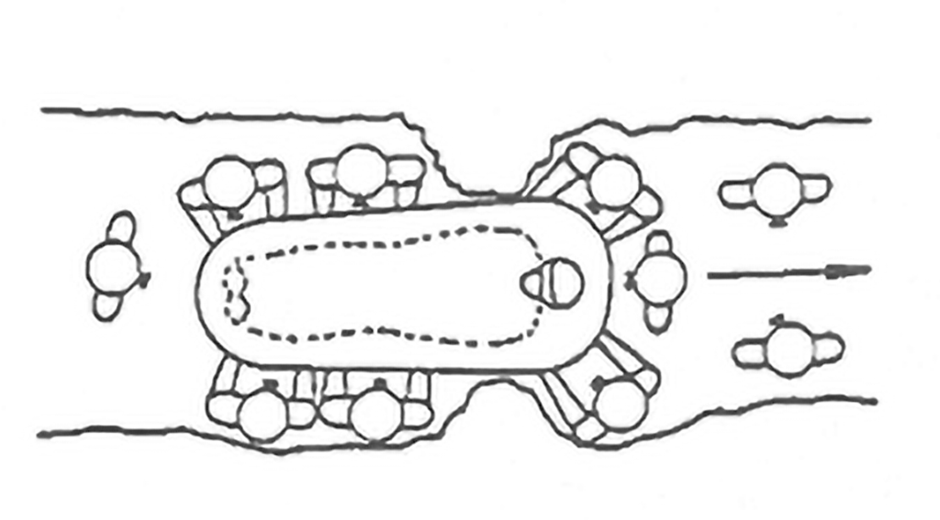
Notes:
Sometimes in a cave, the object you have to ladder past is a crevice, or a tight spot where litter bearers have to crawl under the litter to get ahead, but the principle is the same. [Courtesy Eastern Region, National Cave Rescue Commission, used with permission]

Slide 44
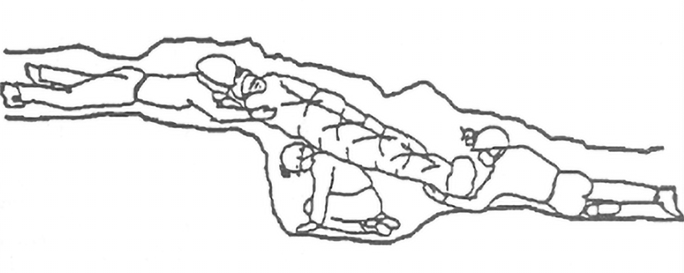
Notes:
Now for some more-caving-specific techniques. This is paving: putting people in holes so the litter, or the patient if the patient is walking, doesn’t fall in. [Courtesy Eastern Region, National Cave Rescue Commission, used with permission]

Slide 45
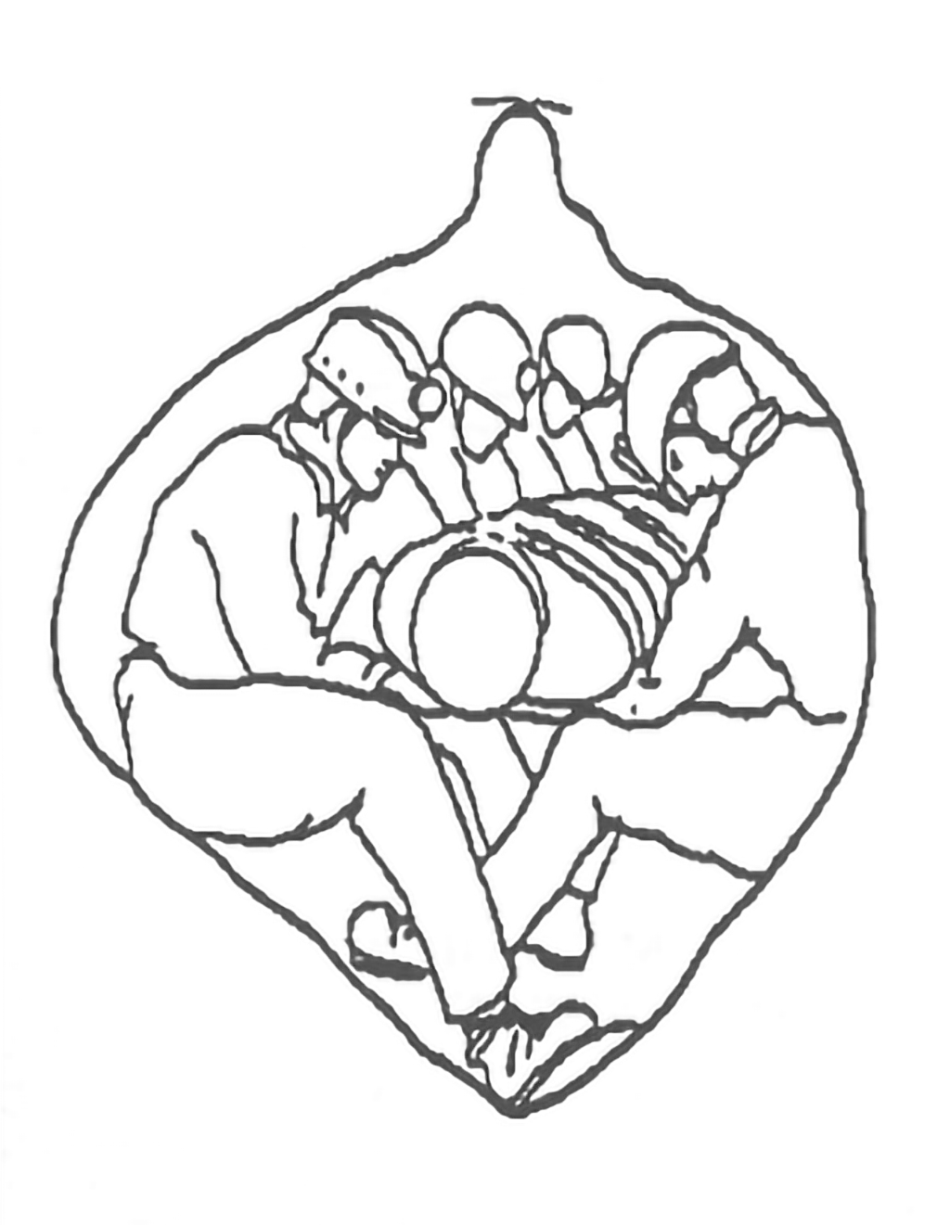
Notes:
For certain passages, everyone can sit on a shelf on the sides and do what we call a lap pass. [Courtesy Eastern Region, National Cave Rescue Commission, used with permission]

Slide 46
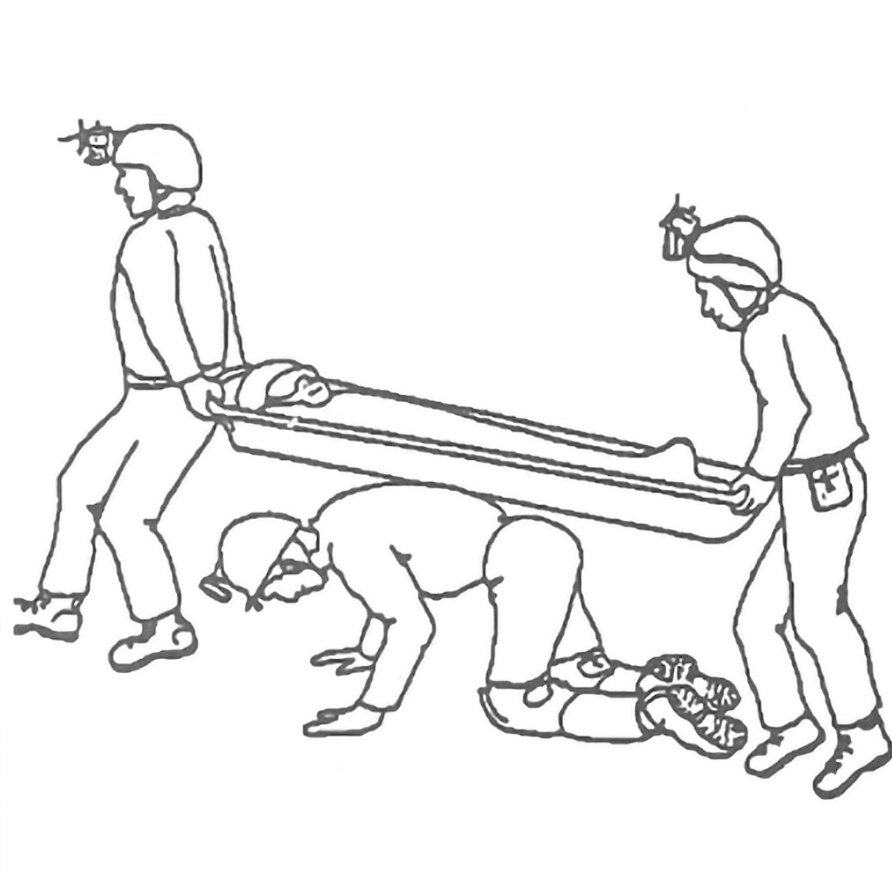
Notes:
In a narrow passage where people can’t get on either side, you can get on your hands and knees under the litter and crawl, supporting it with your back. [Courtesy Eastern Region, National Cave Rescue Commission, used with permission]

Slide 47
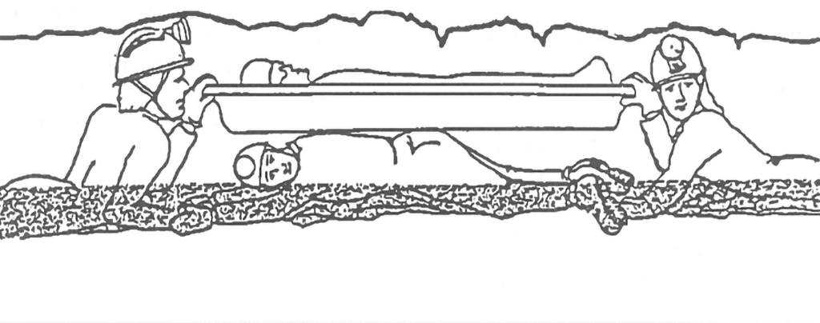
Notes:
Or sometimes you have to be on your belly in a stream to support the patient, which we call snaking. [Courtesy Eastern Region, National Cave Rescue Commission, used with permission]

Slide 48
More Cave Rescue Training
National Cave Rescue Commission Orientation to Cave Rescue class:
  one weekend
  Lecture/Discussion starting Friday evening and Saturday before lunch
  Saturday afternoon above-ground packaging and litter handling practice
  Sunday mock cave rescue in a cave
Also more advanced “weeklong” (9-day) courses
More info: https://ncrc-er.caves.org

Slide 49
Appalachian
Search and Rescue textbook
conovers.org/ftp/AppSAR
conovers.org/ftp/AppSAR-Drafts
Notes:
The top URL and left QR code are the official releases, the bottom URL and right QR code are where the drafts are. I will also show this at the end.

